Slide 1
Realizing Value:
Tuna Sustainability Progress
& Market Priorities
ISSF 2026 Tuna Sustainability Market Forum | 7 October 2026

Slide 2
Agenda
TIME | SPEAKER | TOPIC
9:30–9:45am | Michael Cohen (ISSF) | Welcome and Event Overview
9:45–11:15am | Session 1 Susan Jackson (ISSF) Dr. Victor Restrepo (ISSF) Discussion/Q&A | Driving Sustainability Progress & Supporting Market Strategic Priorities Turning Science into Action: Global Tuna Progress Through ISSF Collaboration
11:15-11:45am | Coffee Break
12:00–1:30pm | Session 2 Paola Guglielmo & Matilde Vallerani (MSC Italy) David Parreno Duque & Cody Pajunen (SFP) Michael Cohen (ISSF) | The Role of MSC in Advancing Tuna Sustainability Leveraging Vessel-Level Data to Advance Sustainability and the Value of ISSF Tools Activating Market Influence & Creating Strategic Value
 | Susan Jackson (ISSF) Discussion/Q&A | Closing Comments
1:30–2:30pm | Light Lunch

Slide 3
Welcome and Event Overview
7 October 2026
Michael Cohen
ISSF Market Outreach Associate

Slide 4
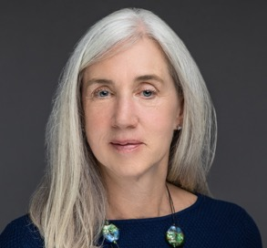
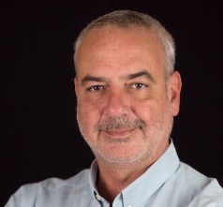
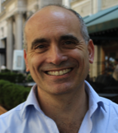
Today’s Presenters
Susan Jackson
ISSF
President, ISSF
Dr. Victor Restrepo
ISSF
Vice President, Science
Michael Cohen
ISSF
Market Outreach Associate

Slide 5
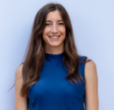

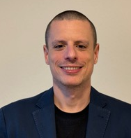

Today’s Presenters
Matilde Vallerani
Marine Stewardship
Council Italy
Fishery Manager
Paola Guglielmo
Marine Stewardship
Council Italy
Commercial Manager
David Parreno Duque
Sustainable Fisheries Partnership
Partnerships & Markets Engagement Specialist
Cody Pajunen
Sustainable Fisheries Partnership
Fisheries Policy and Information Analyst

Slide 6
Driving Sustainability Progress
& Supporting Market Strategic Priorities
7 October 2026
Susan Jackson
President

Slide 7

Driving More than a Decade of Measurable Change
For 15+ years, ISSF partners — scientists, seafood companies, environmental NGOs — have worked side-by-side to transform global tuna fisheries
Science-Led Action: Advancing cutting-edge research, practical tools to guide management
Global Collaboration: Uniting industry, governments, & NGOs across every tuna-fishing region
Verified Impact: Independent audits, transparent reporting that prove measurable progress
Sustained commitment has turned early challenges — data gaps, weak management, and limited accountability — into tangible wins:
Healthier tuna stocks
Stronger RFMO policies
Market-recognized best practices
More than half of global tuna catch from MSC-certified fisheries
Our journey shows that long-term collaboration can deliver improved sustainability
7

Slide 8
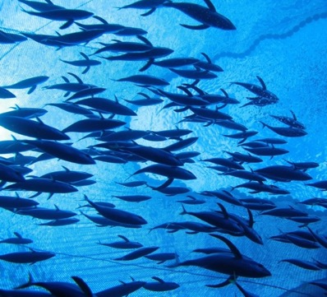
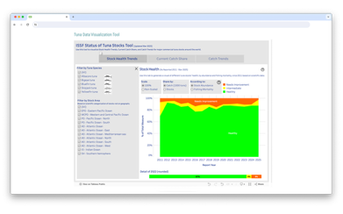

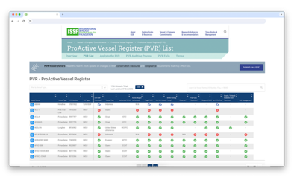
From Challenge to Change
More than a Decade of Sustainable Tuna Progress
DATA & TRANSPARENCY
THEN:
Global tuna stock information fragmented, with no single harmonized source—minimal verifiable vessel reporting
NOW:
Publicly available ISSF Status of the Stocks reports, vessel-level transparency through ProActive Vessel Register (PVR) and Vessels in Other Sustainability Initiatives (VOSI) platform
Our journey shows that long-term collaboration can deliver improved sustainability.
1,800+
vessels
voluntarily
Registered on the PVR
8

Slide 9
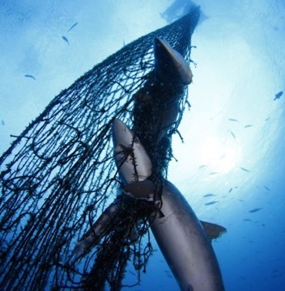
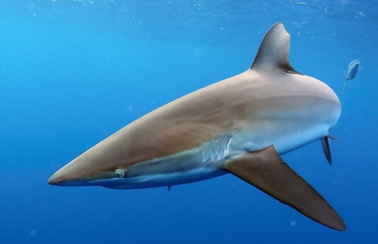
From Challenge to Change
More than a Decade of Sustainable Tuna Progress
BYCATCH & ECOSYSTEM IMPACTS
THEN:
Sparse data on non-target species in tuna fisheries and few safeguards for sharks, sea turtles, and seabirds
NOW:
Widespread adoption of ISSF bycatch mitigation best practices and fishing gear designs that reduce animal entanglement; RFMO-adopted shark-finning bans and seabird mitigation measures
Our journey shows that long-term collaboration can deliver improved sustainability.
9

Slide 10
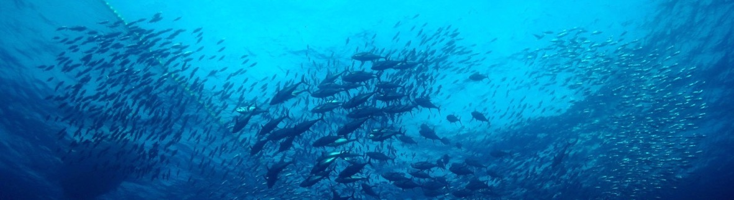
From Challenge to Change
More than a Decade of Sustainable Tuna Progress
HARVEST STRATEGIES
THEN:
Only a handful of tuna stocks had harvest control rules
NOW:
All 4 tropical tuna management organizations have adopted harvest strategies or interim harvest control rules for key species like skipjack and yellowfin, with implementation timelines for others
Our journey shows that long-term collaboration can deliver improved sustainability.
10

Slide 11

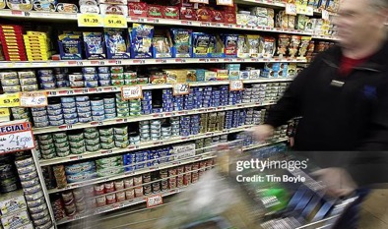
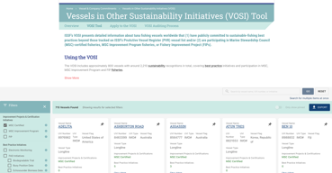
From Challenge to Change
More than a Decade of Sustainable Tuna Progress
INDUSTRY & MARKET ENGAGEMENT
THEN:
Inconsistent industry engagement and transparency
NOW:
ISSF participating companies undergo independent, publicly reported audits and use PVR and VOSI to demonstrate best practice commitments
THEN:
Retail expectations for demonstrable sustainability just beginning to take shape
NOW:
Globally, 73 major retailers reference ISSF participation and PVR/VOSI listings in sourcing policies, helping companies de-risk investments
Our journey shows that long-term collaboration can deliver improved sustainability.
Image to come
11

Slide 12
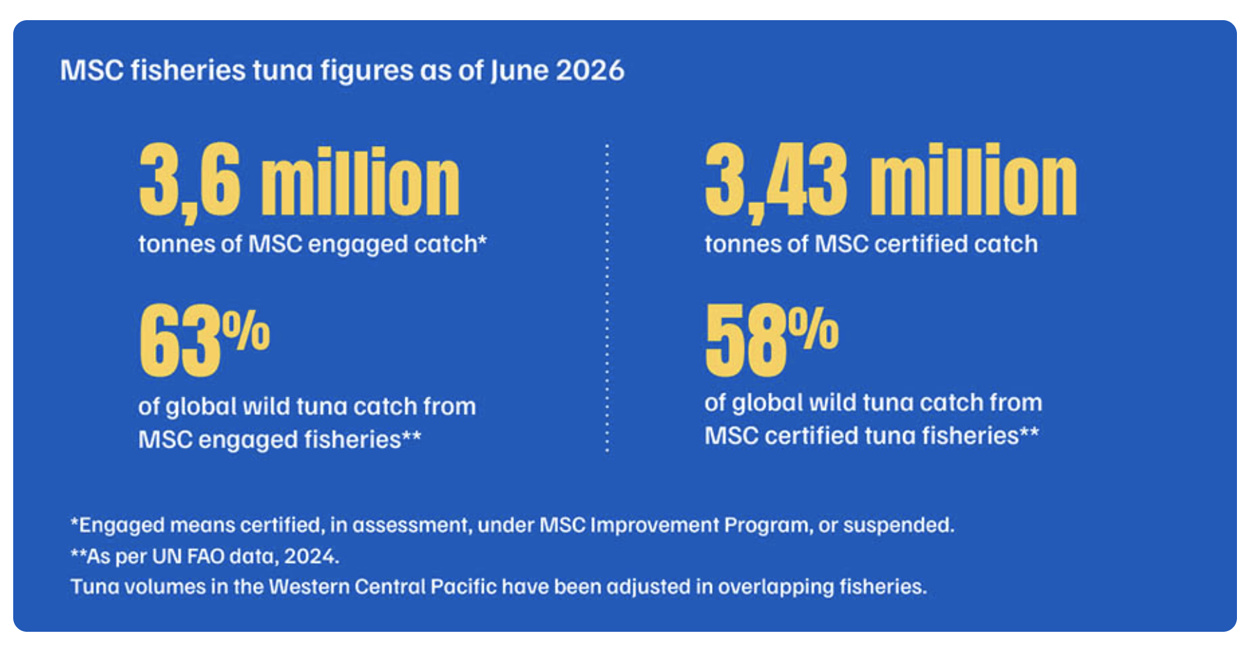
From Challenge to Change
More than a Decade of Sustainable Tuna Progress
MARINE STEWARDSHIP COUNCIL-CERTIFIED TUNA CATCH
THEN:
14% of the world’s annual tuna catch came from Marine Stewardship Council (MSC)-certified catch
NOW:
58% of the world’s annual tuna catch comes from MSC-certified fisheries
Our journey shows that long-term collaboration can deliver improved sustainability.
Source: Marine Stewardship Council, June 2026
12
12

Slide 13
How Did We Get Here?
The ISSF Approach

Slide 14
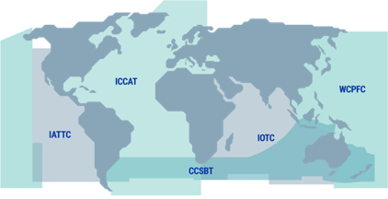
The ISSF Approach
Science-Led Innovation • Global Influence • Implementation Integrity
ABOUT ISSF
ABOUT ISSF
In 2009, acclaimed scientists, leaders in industry, and environmental champions launched the International Seafood Sustainability Foundation (ISSF) based on shared concerns about the future of tuna fisheries and a desire to do something about it — together.
ISSF MISSION
To undertake and facilitate science-based initiatives to continuously improve the sustainability of global tuna fisheries and the health of the ecosystems that support them.
ISSF OBJECTIVE
ISSF OBJECTIVE
To continuously improve the sustainability of global tuna fisheries and the ecosystems that support them to result in those fisheries meeting and maintaining the MSC certification standard.
We achieve this through:
  The development and implementation of verifiable, science-based practices, measurable commitments, and conservation management measures by participating companies
RFMOs: Regional Fisheries Management Organizations
IATTC: Inter-American Tropical Tuna Commission
ICCAT: International Commission for the Conservation of Atlantic Tunas
IOTC: Indian Ocean Tuna Commission
WCPFC: Western and Central Pacific Fisheries Commission
CCSBT: Commission for the Conservation of Southern Bluefin Tuna
  Advocacy to tuna RFMOs
14

Slide 15
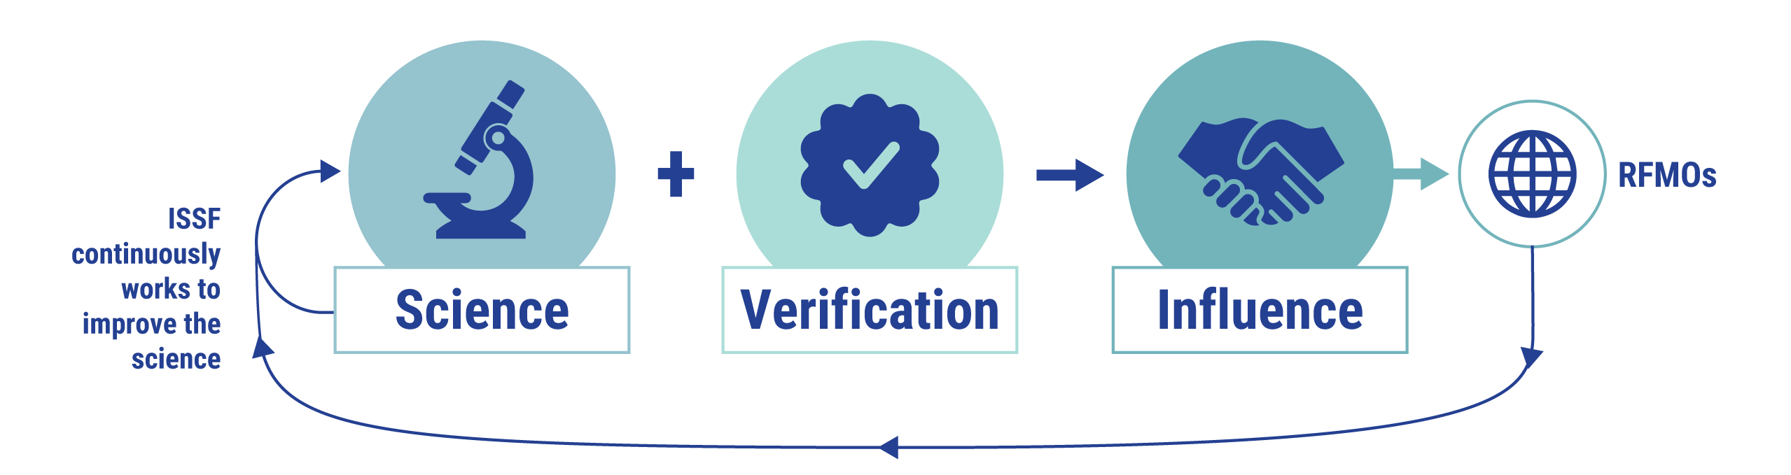
ISSF Theory of Change
Sustainable Management Requires Continuous Improvement
ISSF advocacy to RFMOs is grounded in what the best current science requires.
Simultaneously, ISSF continuously works to improve the science.
The intended result of our efforts is the adoption & implementation of science-based management measures by industry and RFMOs.
We recognize that comprehensive and sustainable management requires continuous improvement.
15

Slide 16
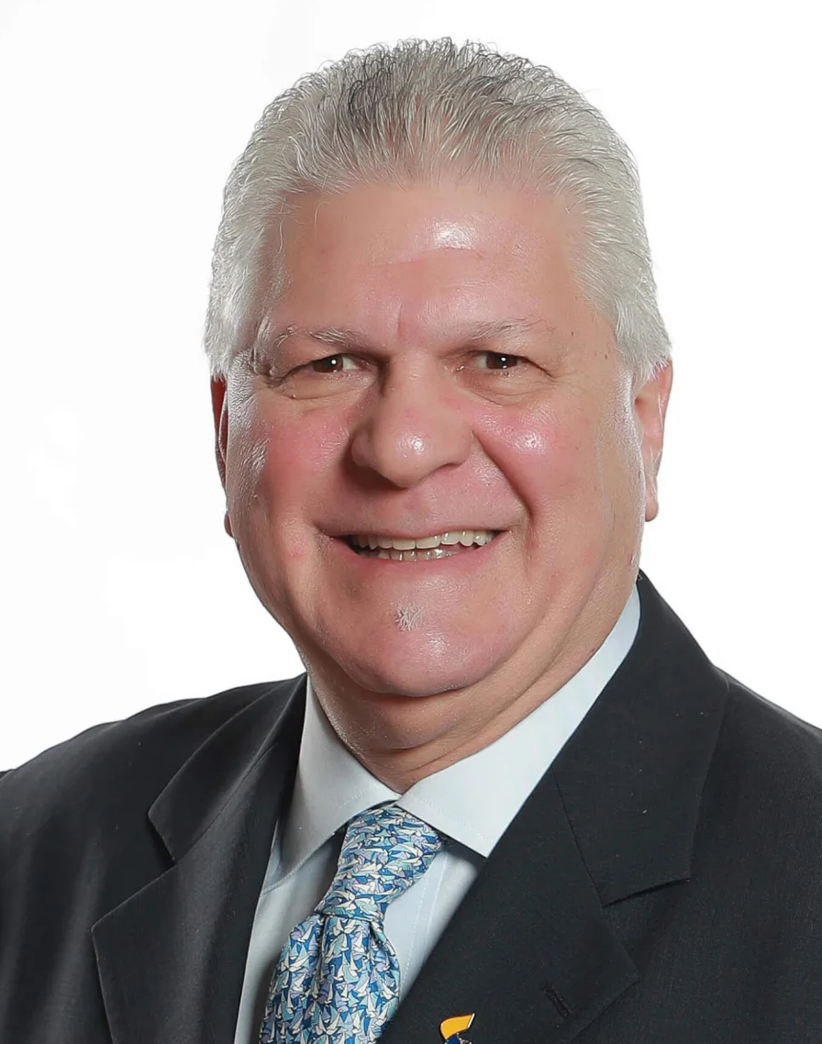
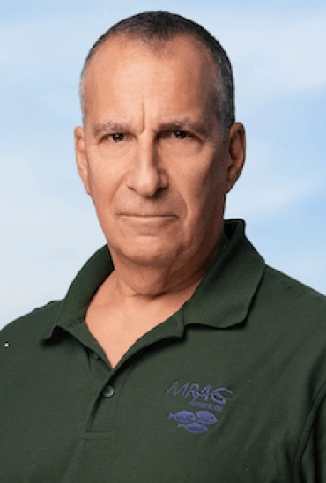
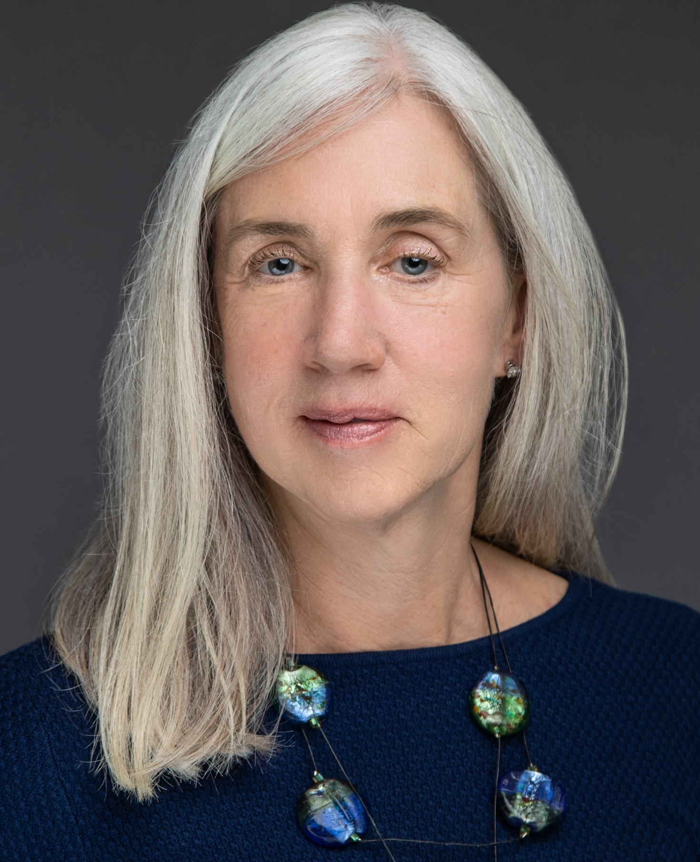
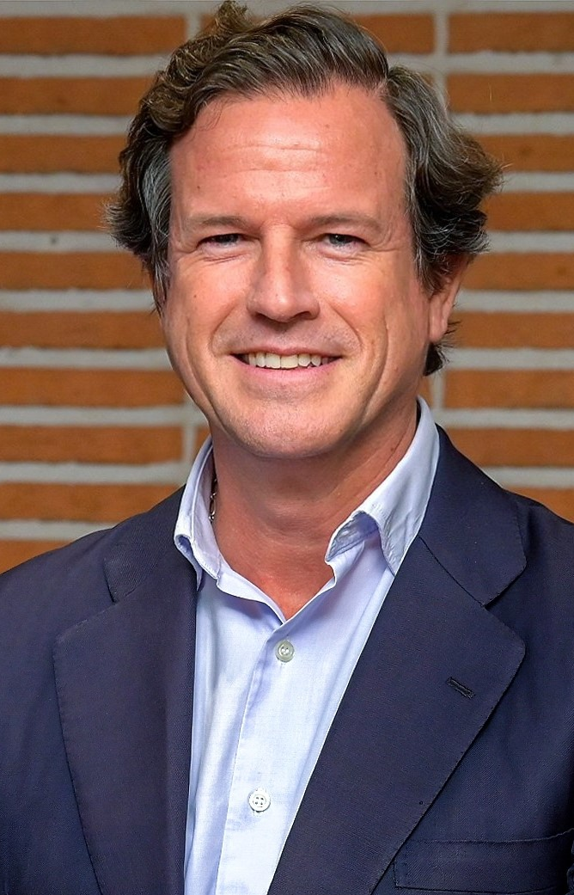
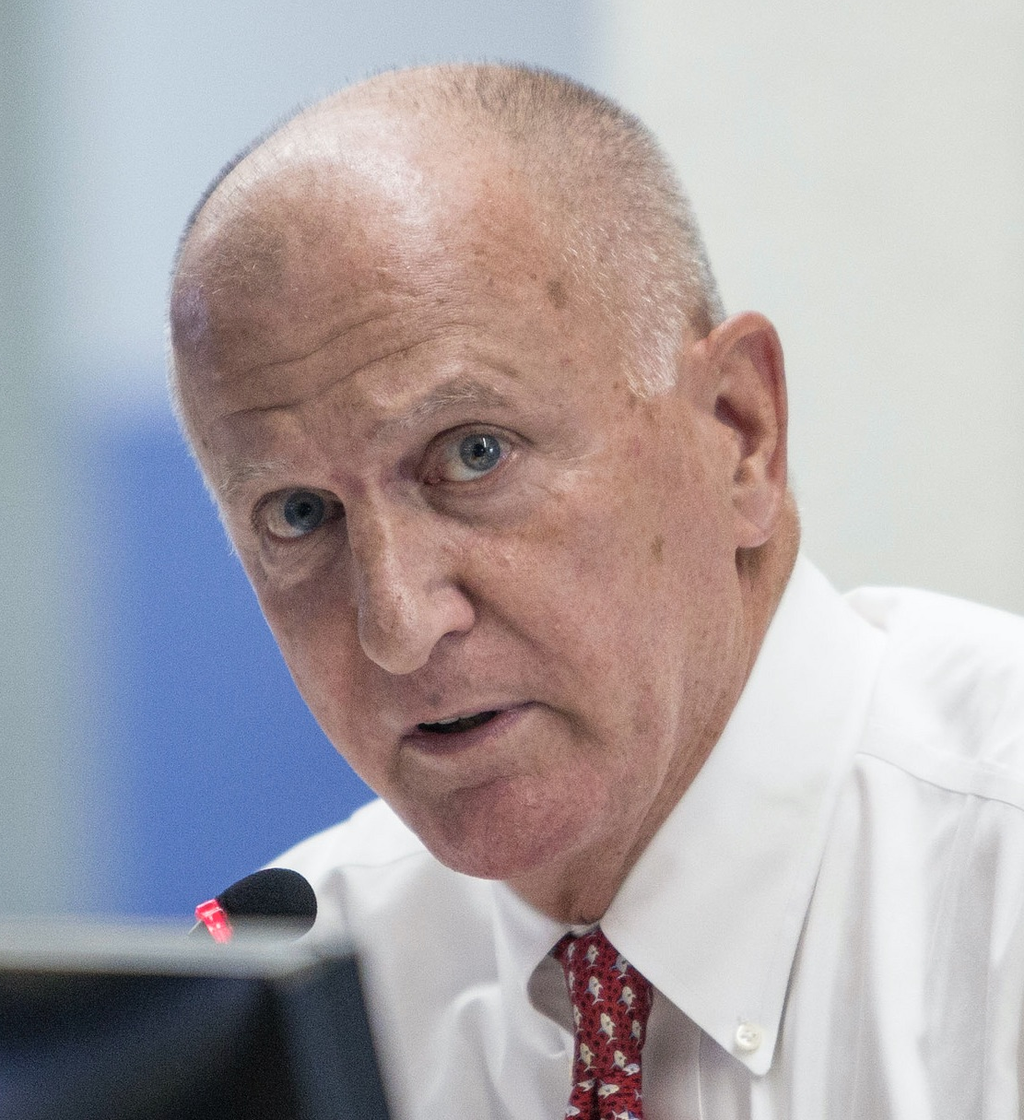
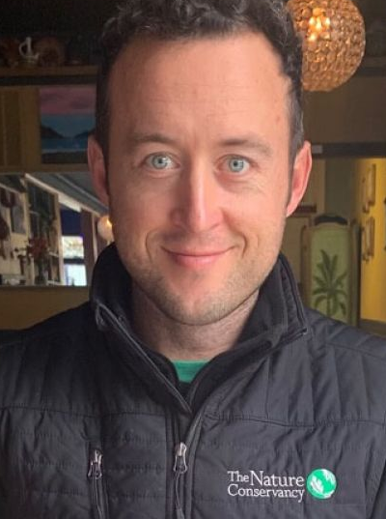
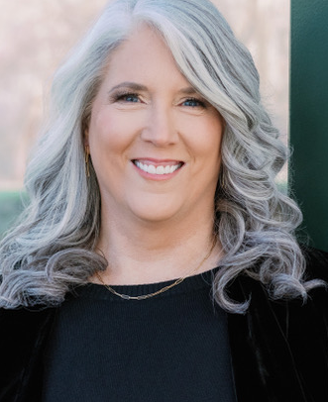
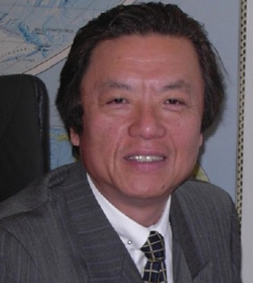
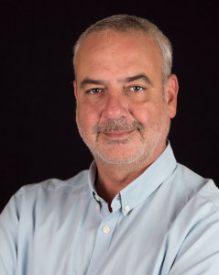
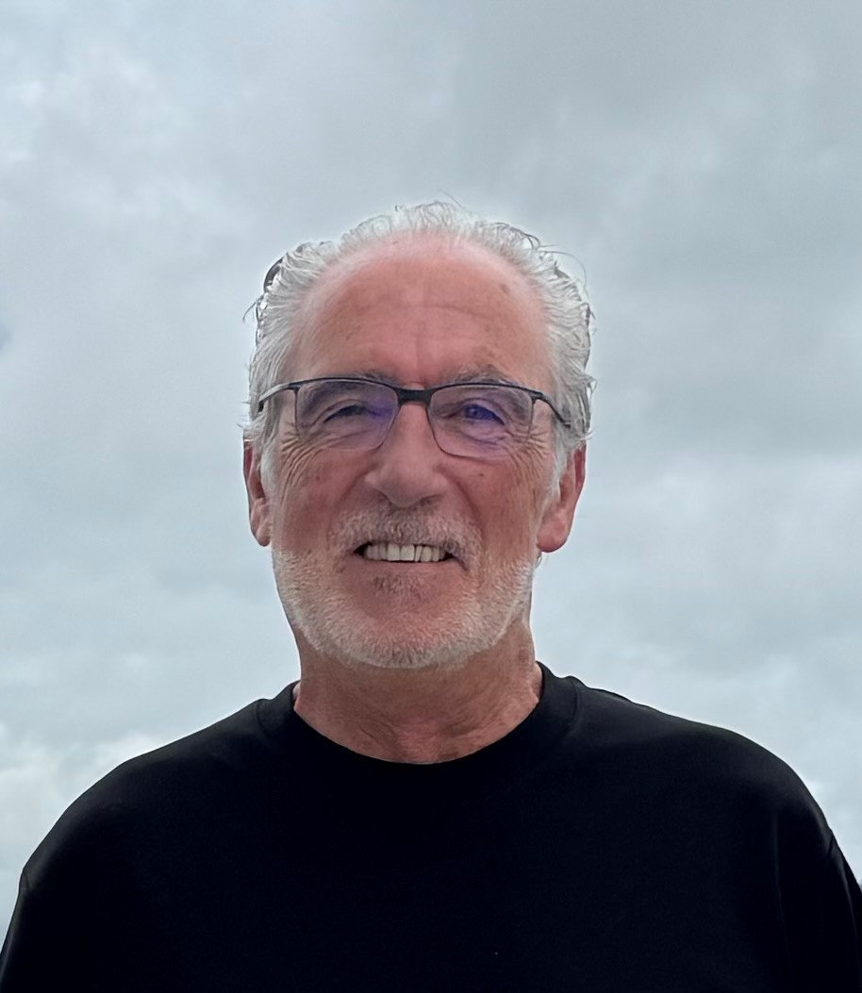
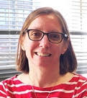
ISSF Theory of Change
ISSF BOARD OF DIRECTORS
ISSF BOARD OF DIRECTORS
Click here for full bios
Tony Lazazzara
ISSF Board Chair
--------------------------------------
Group Director of Global Fish Procurement, Thai Union Group
Dr. Andrew Rosenberg
ISSF Board Vice Chair
--------------------------------------
Marine Scientist & Environmental and Science Policy Expert
Susan Jackson
President, ISSF
Javier Garat
Secretary General, Spanish Fishing Confederation, Cepesca / President, Association of National Organizations of Fishery Enterprises in the European Union (Europêche)
William
Gibbons-Fly
Executive Director, American Tunaboat Association (ATA)
Ben Gilmer
Chair, ISSF Environmental Stakeholder Committee /
Director, Large-Scale Fisheries, The Nature Conservancy (TNC)
ISSF's governance intentionally brings together leaders from science, the seafood industry, environmental NGOs, and independent experts to help ensure solutions are scientifically credible, practical, and broadly supported.
Melissa Murphy
Distinguished Service Professor of Marketing and Corporate Entrepreneurship, Tepper School of Business, Carnegie Mellon University / President, Melissa Murphy Marketing
Ichiro Nomura
Fisheries Policy Advisor, Ministry of Marine Affairs
and Fisheries,
Republic of Indonesia
Dr. Victor Restrepo
Vice President – Science, ISSF / Chair, Scientific Advisory Committee
Dr. Josu Santiago
Head of the Tuna Research Area, AZTI
Amanda
Stern-Pirlot
Chief Standards Officer, Marine Stewardship Council
16

Slide 17
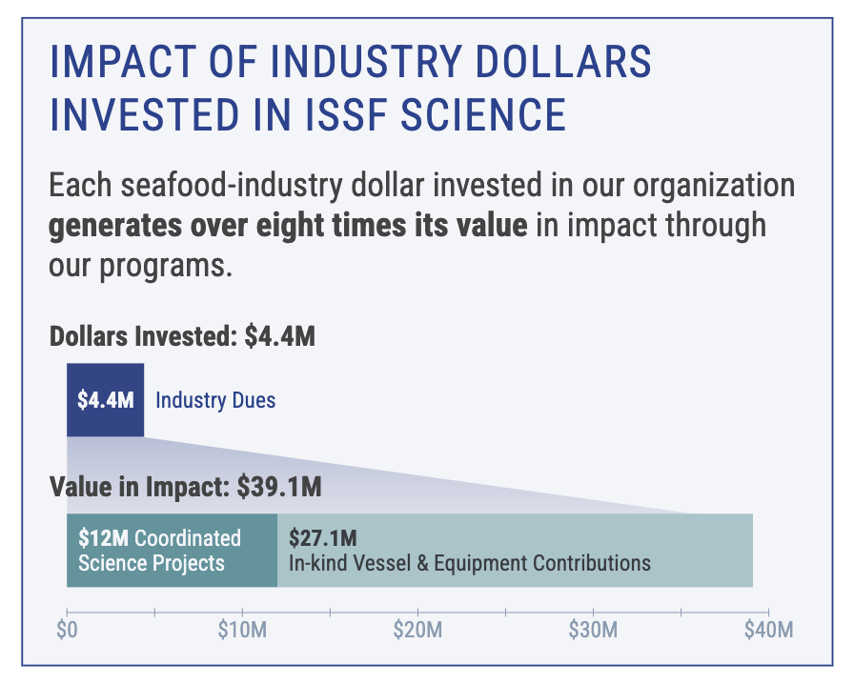
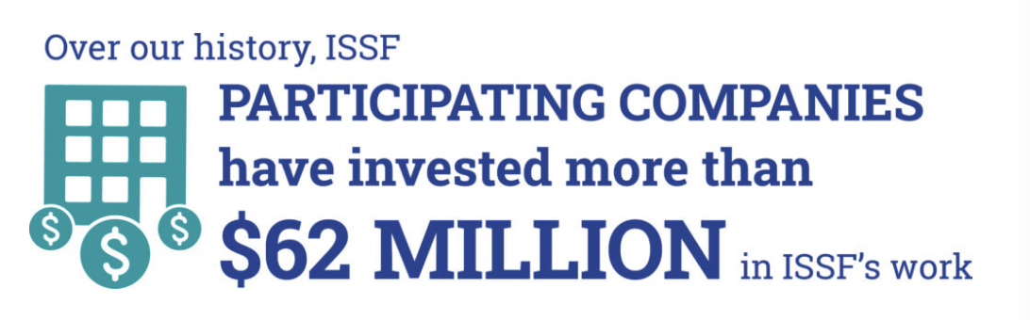
Mobilizing FUNDS Toward Sustainable Fisheries
OUR IMPACT IN NUMBERS
17

Slide 18
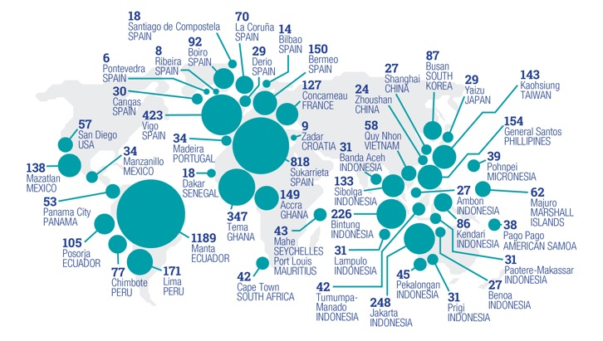
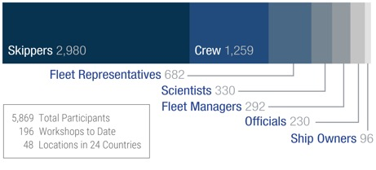
Mobilizing FISHERS Toward Sustainable Fisheries
OUR IMPACT IN NUMBERS
ISSF SKIPPERS WORKSHOP PARTICIPANTS
By Profession (2010–June 2025)
ISSF SKIPPERS WORKSHOP ATTENDANCE
2009–June 2025
18

Slide 19
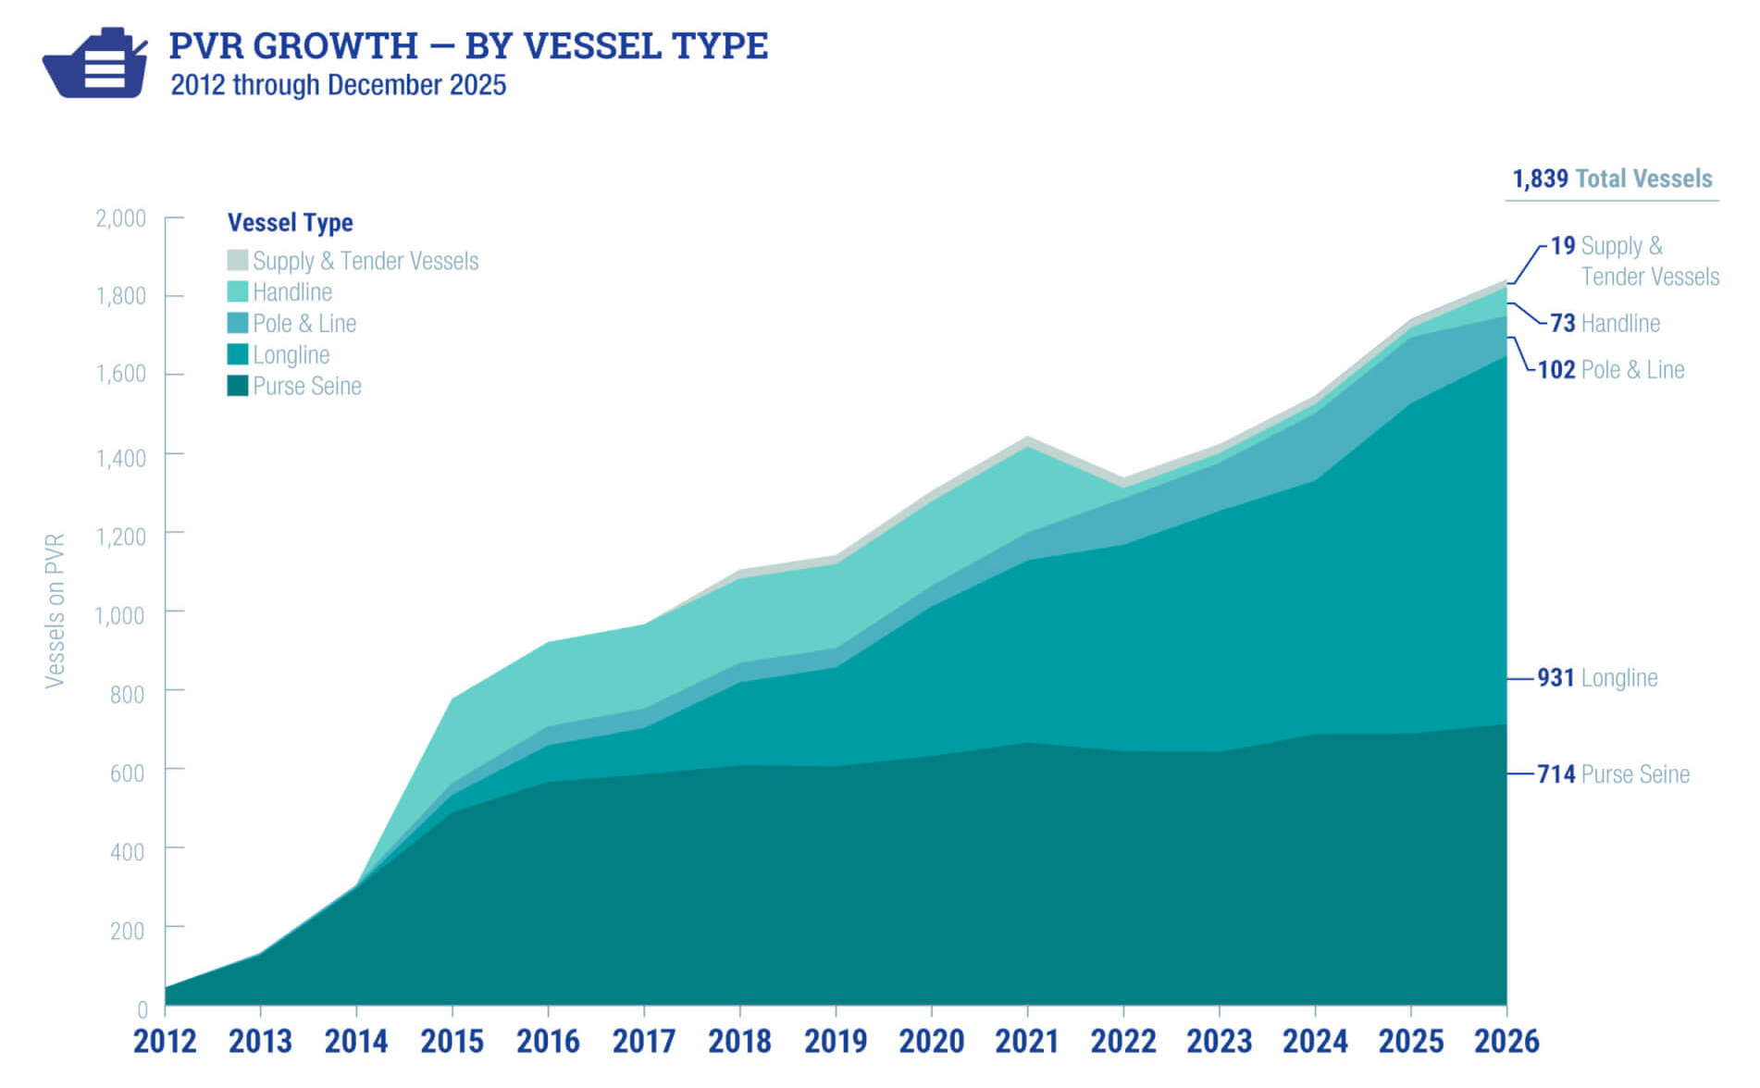
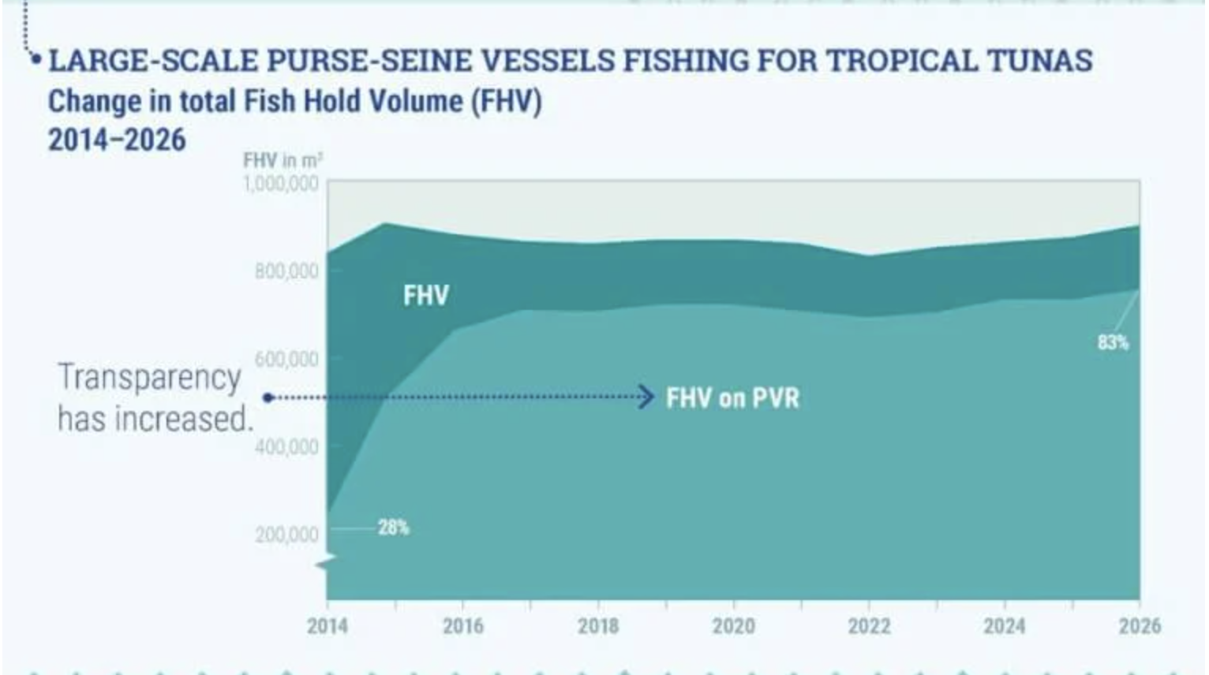
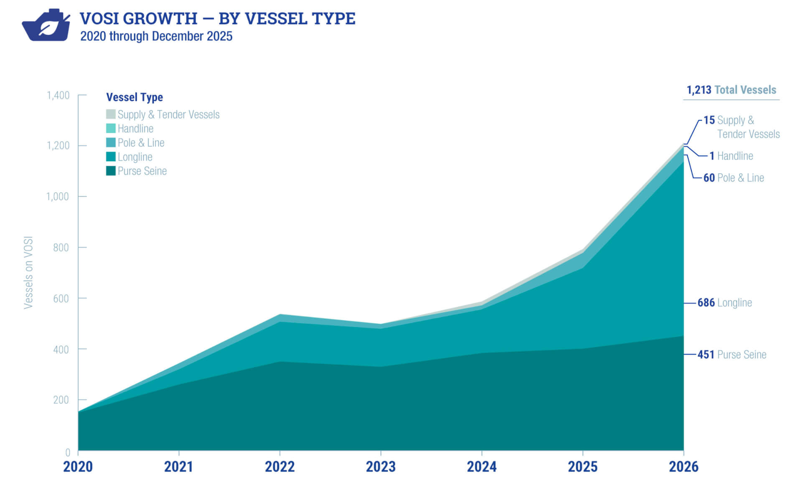
Verified Transparency in Vessel Practices
OUR IMPACT IN NUMBERS
19

Slide 20
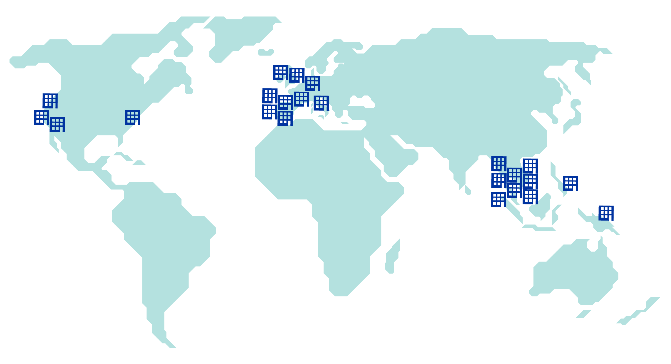

















ISSF Participating Companies
OUR PARTNERS — INDUSTRY
Founding Companies
(Europe)
(COSI)
Full Companies
Global Engagement by
23
Participating Companies
20

Slide 21










Charitable Foundations & Other Partners Supporting ISSF
OUR PARTNERS — FUNDING
Fisheries Improvement Fund
21

Slide 22








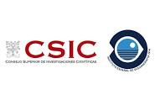


Charitable Foundations & Other Partners Supporting ISSF
OUR PARTNERS — RESEARCH
PLUS Fishing Vessel Owners & Crew
22

Slide 23
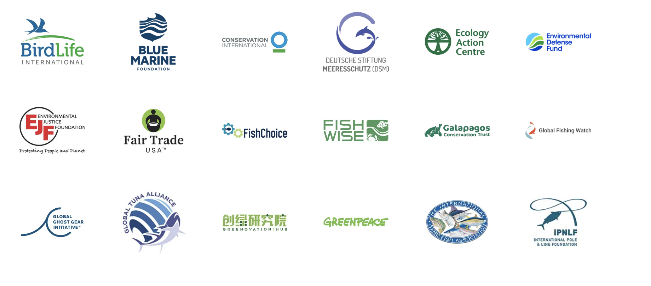
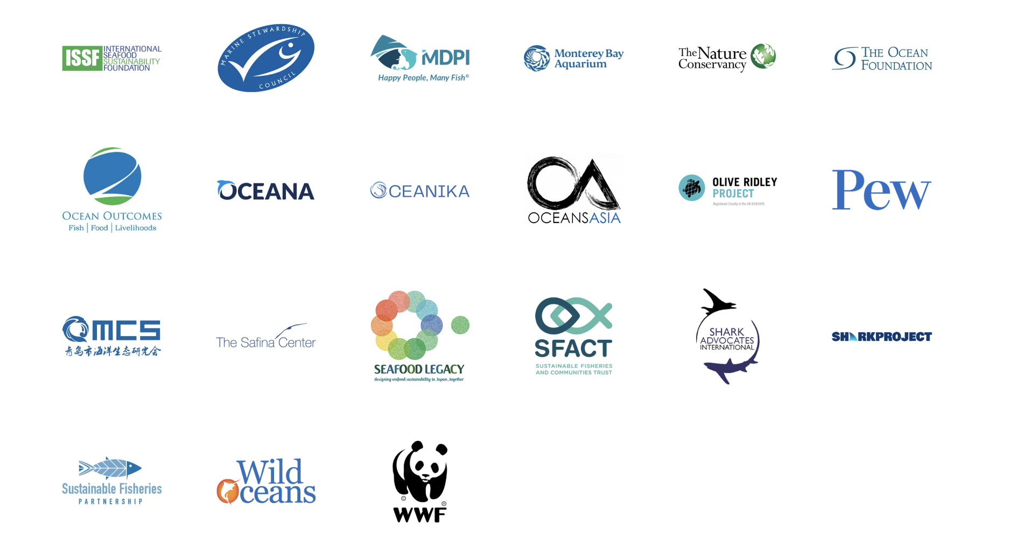
NGO Tuna Forum Participation
23

Slide 24
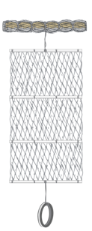


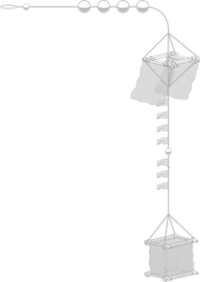
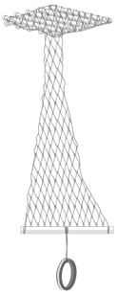
Improved Fishing Gear Design to Minimize Ecosystem Impacts
SCIENCE-LED INNOVATION
Conventional FAD
Jelly-FAD
Bulky and heavy
Hard to build
Results in ghost fishing,
marine pollution, and
damage to habitats
Light and easy
to handle
Materials available worldwide
Easy to build and low cost
24

Slide 25

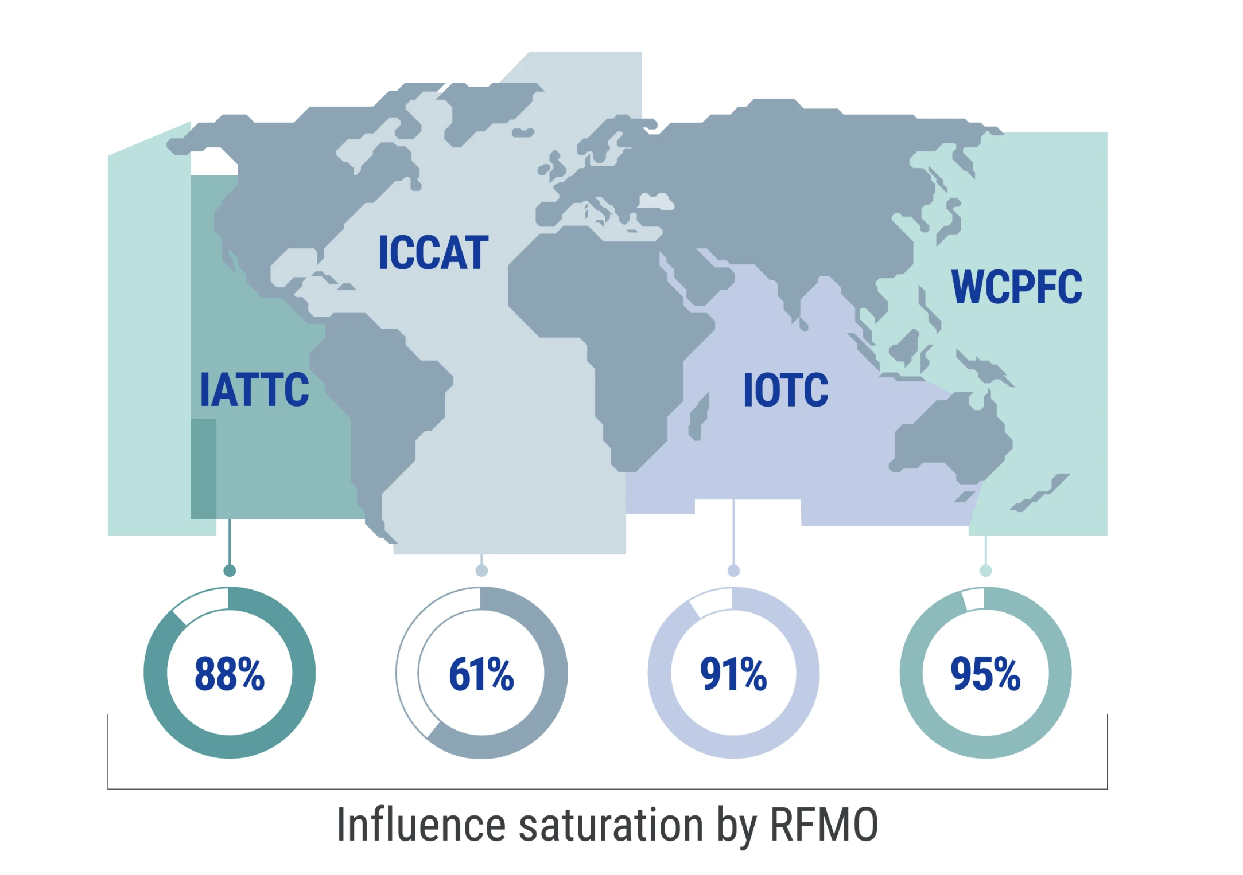
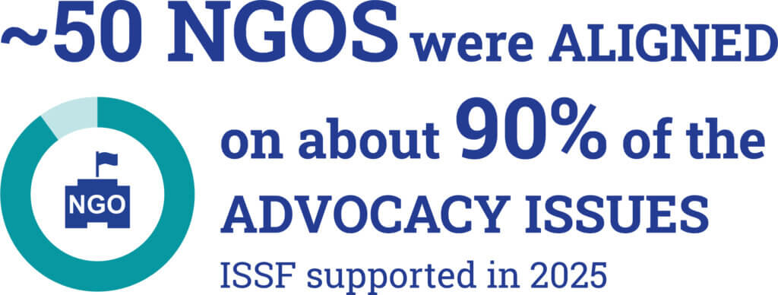
Consistent, Coordinated Advocacy to RFMOs
GLOBAL INFLUENCE
450+
advocacy letters delivered to RFMO delegates across four tuna regions
in 2025
ISSF and its participating companies have driven policy change through sustained advocacy.
Direct meetings
Input via national advisory committees
Engagement with vessels, MSC clients, FIPs
25

Slide 26


Independent Audits • Transparent Reporting • Verified Action
IMPLEMENTATION INTEGRITY
Our approach for tuna fisheries & stakeholders promotes the verifiable implementation of best practices in tuna supply chains
Independent auditing of tuna company compliance with ISSF conservation measures
Independent auditing of vessel compliance with best practices
ISSF works with tuna vessels & processors globally
26

Slide 27
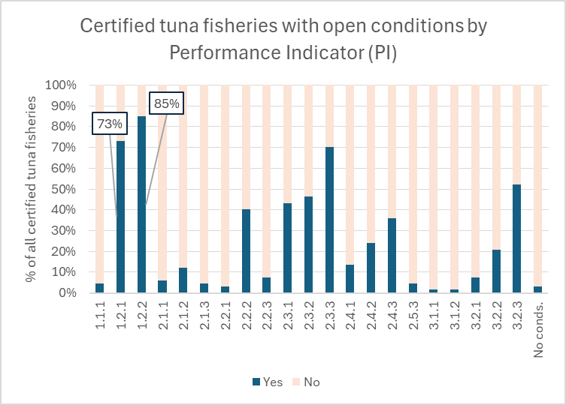
The Path Ahead
CLOSING OPEN CONDITIONS FOR MSC-CERTIFIED TUNA FISHERIES
Of all open conditions for tuna fisheries certified against the MSC Fisheries Standard, the two PIs with the highest number of conditions are 1.2.1 and 1.2.2.
Over half of these conditions correspond to harmonized conditions opened during application of Section SE to Western Pacific stocks
The rest correspond to other stocks in the Pacific, Atlantic and Indian oceans
PI 1.2.1 – Harvest Strategy
PI 1.2.2 – Harvest Control Rules & Tools
27

Slide 28
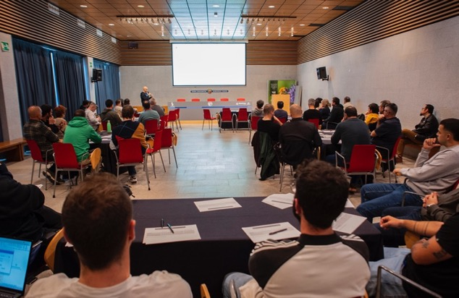
The Path Ahead
ISSF is the only NGO exclusively dedicated to achieving sustainable tuna fisheries
Stands apart for its expertise across tuna science, fishery management, and industry operations
Diverse governance structure includes scientists, environmental NGOs, and seafood companies — bringing all stakeholders to the table in an aligned, science-forward approach
Leads collaborative efforts to improve tuna fishery sustainability through innovation, implementation integrity — a powerful force for change
28

Slide 29
Q&A

Slide 30
Turning Science into Action: Global Tuna Progress Through ISSF Collaboration
7 October 2026
Dr. Victor Restrepo
Chair, ISSF Scientific Advisory Committee

Slide 31

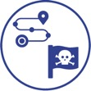

Turning Science into Action:
Global Tuna Progress Through ISSF Collaboration
TODAY’S TOPICS
Traceability &
Mitigating IUU
Tuna Stock Health
Harvest Strategies
Observer Coverage & Electronic Monitoring
Bycatch Mitigation & FAD Management
31

Slide 32
Tuna Stock Health

Slide 33
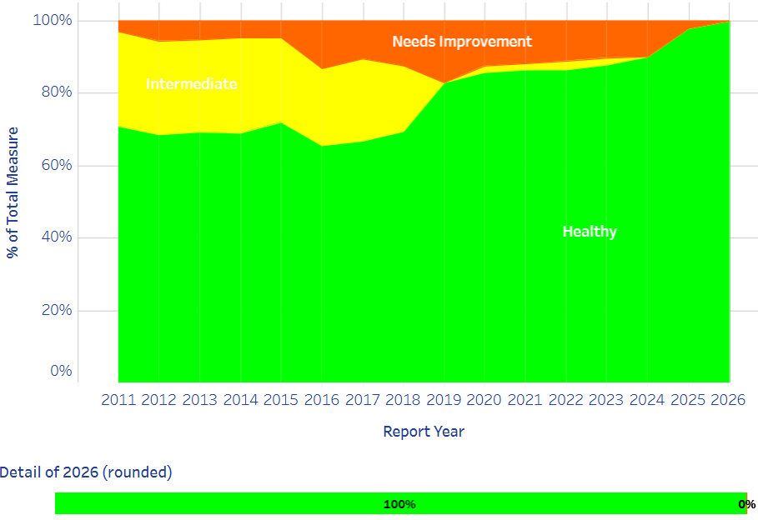

Status of the 23 Major Tuna Stocks
AS OF JANUARY 2026
A growing share of the global tuna catch comes from stocks that are not subject to overfishing, thanks largely to improved management by RFMOs.
33

Slide 34
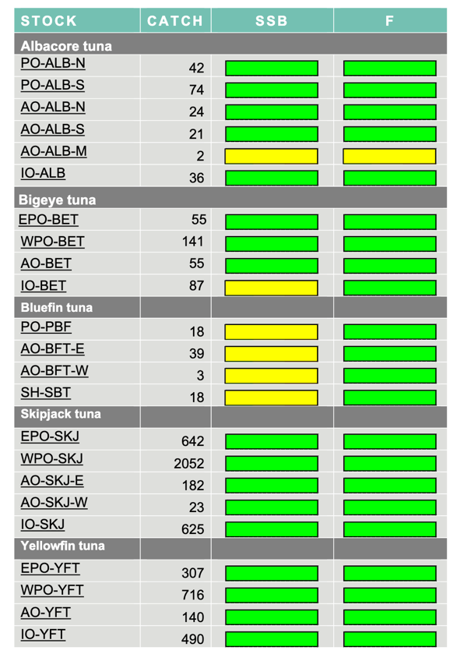
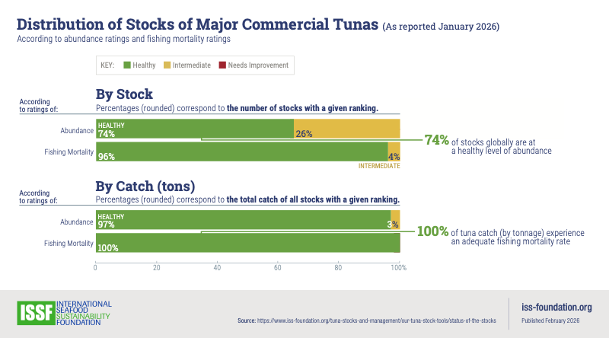


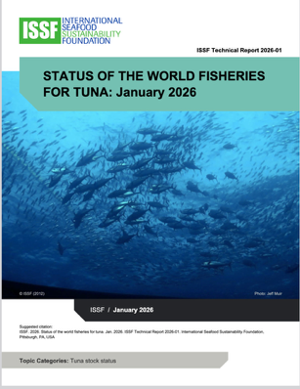



Status of the Major Commercial Tuna Stocks
AS OF JANUARY 2026
Next: 2026
7 Species,
23 stocks
In 2024, global catch was
5.8 million tonnes
Compiled from RFMO reports.
34

Slide 35

IO Yellowfin
The ISSF SAC acted conservatively and waited a year for the assessment inputs to be reviewed.
IO YFT accounts for more than 8% of the global tuna catch, so this change is influential in the statistics cited earlier

Slide 36
Harvest Strategies

Slide 37

Why Harvest Strategies Matter
Harvest strategies (aka management procedures or MPs) are essential tools for sustainable, science-driven fisheries management
Include monitoring programs, stock assessments, harvest control rules (HCRs), & reference points to guide management
Define management responses in advance to help reduce political pressure and promote transparency, consistency, and long-term stock health
15 Years Ago
RFMOs just beginning to consider the adoption of harvest strategies
37

Slide 38

HS/MP progress in tuna RFMOS
52% of global tuna catch has MPs
All RFMOs are in the process of developing and adopting HS/MP for their tuna stocks
0.7% * NP ALB
1.6%
(18%)
36.7% *
(71%)
0%*
12.3%
(51%)
Bold % = Share of global tuna catch
(%) = Share within RFMO
0.3%
(100%)
Notes:
NOTAS:
Año 2024 (último del SoS)
El valor de cada RFMO es la captura con MP de esa RFMO relativa a la captura total. La suma de esos valores da el 52% del total de capturas con MP (51.6%)
El valor entre paréntesis es la captura total de cada RFMO con MPs relativa a la captura de esa RFMO.
EL north Pacific ALB lo he metido en la WCPO (como en el SoS) para ver la captura total de la RFMO con MPs (el valor del paréntesis)
Pero el valor del NP ALB respecto a la captura total lo he separado y mostrado aparte. Si prefieres meterlo en la WCPFC sería 37.4 % (71 %) y deberías quitar el 0.7 del NP ALB

Slide 39
Bycatch Mitigation & FAD Management

Slide 40

All Fisheries Have Impacts
v
40

Slide 41
Purse Seine Bycatch
BY SPECIES GROUP
ALL OCEANS — Current % Bycatch by Species Group & Set Type
Rays
Rays are more common in free school sets.
Sharks
In some regions, shark bycatch
% is higher in free school sets.
Billfish
Bony fish
Minor tuna
Source: Observer data provided from SPC (WCPO), IATTC (EPO) and by the research institutes in charge of EU-PS observer programs in the Atlantic and Indian oceans. Data is 2013-2017 for all oceans, except Atlantic Ocean, which is 2012-2016. Note:"FAD" to include all associated sets, e.g. sets on natural logs would be included there too.

Slide 42

Our Approach to (Bycatch) SCIENCE
OUR RESEARCH PARTNERS
42
Notes:
SCIENCE drives the ISSF. And what is our approach to science?
At ISSF, we place great importance on incorporating fishers’ perspectives and actively involving them in research from the very beginning.
To achieve this, we:
Listen and learn from fishers to find best bycatch practices with their help
Design appropriate bycatch reducing measures that suit best each fleet and ocean
Scientist pass information to fishers on the latests research in bycatch mitigation
In short, We meet/collaborate with scientist to get “possible” ideas and meet with skippers to see if those ideas make sense in the water, then we trial them and if they have potential, we develop best practices and advocate for the adoption of those best practices in RFMOs. For example, we have been advocating for the use of only non-entangling FADs without nets.

Slide 43




Our Approach to (Bycatch) SCIENCE
OUR RESEARCH PARTNERS
ISSF SKIPPERS WORKSHOP ATTENDANCE | 2009–June 2025
ISSF has conducted 135 Workshops, in 44 Locations / 23 Countries, with 4,900 Skippers and Crew
43
Notes:
We have conducted numerous workshops with key fleets across the three oceans. These workshops are designed to facilitate two-way knowledge exchange between scientists and fishers, as well as to develop best practices. Since this is a global effort, it enables us to share successful ideas and practices from one region or fleet with others, amplifying their impact on a global scale
In the last 11 years we have organized around 135 Skipper Workshops around the world (in the main PS fishing ports) with more than 4900 skippers and crews participating in those skipper workshops.

Slide 44




At-Sea Research & Experiments
2011–2024
Excludes biodegradable FAD tests
44
Notes:
The research to test new ideas has been carried out in the three tropical oceans through various approaches: dedicated research cruises on specialized vessels, opportunistic studies conducted during fishing trips aboard purse seiners, and controlled experiments, such as those focusing on acoustics or biodegradability
In the last 15 years around 23 research activities on research cruises from acoustic mitigation, to development and deployment of biodeagradable FADs, etc… have been conducted.

Slide 45
Chronological Hierarchy of Bycatch Mitigation
Passive Mitigation
Avoid Before Setting
Release from the Net
Release from the Deck
Offsets
45
Notes:
Hierarchical steps in the bycatch mitigation.
From measures that avoid bycatch which are considered before those that minimize catch risk. These are then followed by remediation interventions that reduce fishing mortality. Finally, direct, compensatory offsets measures to restore those impacts that were not possible to avoid, minimize and remediate can be implemented as a last resort.
There are several actions designed by the time at which the measure takes place within the fishing operation:
From avoidance to Passive mitigation – before the vessels are at the FAD
e.g., non-entangling FADs; acoustic species discrimination
Avoid catching bycatch – before setting when the vessel is at the FAD, e.g., attraction of sharks away from FADs before setting, acoustic discrimination of species before setting
Release bycatch from the net
e.g., release sharks and small bigeye and/or yellowfin tuna out of the net
Release bycatch from the deck
e.g., release animals alive from the deck
Offsets
e.g., turtle projects

Slide 46


Understanding Entanglement at FADs
Scientists, Managers, Fishers:
Problem of entanglement of sharks in nets of FADs was considered negligible compared to fishery mortality.
Filmalter, J.D., Capello, M., Deneubourg, J., Cowley, P.D. and Dagorn, L. (2013), Looking behind the curtain: quantifying massive shark mortality in fish aggregating devices. Frontiers in Ecology and the Environment, 11: 291-296. https://doi.org/10.1890/130045
46

Slide 47


Entanglements at FADs in the Eastern Pacific
OBSERVER DATA REVIEW
Sea Turtle
in Tuna Fisheries
47

Slide 48
Fully NEFADs Without Netting
OBSERVER DATA REVIEW
Non-Entangling Timeline
2020
Indian Ocean
2021
2022
2023
2024
Western Pacific Ocean
Atlantic Ocean
2025
Eastern Pacific Ocean
48

Slide 49





Non-Entangling AND Biodegradable: Jelly-FAD Design
Conventional FAD
Jelly-FAD
WINNER
Responsible Seafood Innovation Award
49
Notes:
One of our recent contributions is the innovative concept of the JellyFAD. The JellyFAD, which mimics the natural drifting behavior of jellyfish with near-neutral buoyancy, extends its lifespan to match that of conventional FADs.

Slide 50

Conclusion from bioFAD Trials
NEW ISSF TRIALS & LARGE-SCALE DEPLOYMENT
2018–PRESENT
Achieve similar catches and performance as conventional FADs
Lifespan: sets were made after 11 months at sea, meeting fishers’ needs for lifespan
Success relies on number of Jelly-FADs deployed
Ongoing tests w/ fleets from Korea, Taiwan, China, Spain, FSM, USA and Ecuador
Next Steps: Test a new generation of Jelly-FADs in controlled conditions
50
Notes:
Test a new generation of Jelly-FADs in controlled conditions
Lighter structure
Biodegradable flotation
Move from Category II (plastic flotation) to Category I (no plastic)

Slide 51



Management Measures on Biodegradable FADs
RFMO | Management Measures
IATTC 2023 | Stepwise implementation from 2026 to 2029 (Except plastic flotation). In 2030, decide about plastic flotation.
WCPFC | Not required but encouraged
IOTC | Stepwise implementation from 2026 to 2030. Including flotation.
ICCAT | Stepwise implementation from 2025 to 2028. Including flotation.
51

Slide 52
Chronological Hierarchy of Bycatch Mitigation
Passive Mitigation
Avoid Before Setting
Release from the Net
Release from the Deck
Offsets
52

Slide 53







Acoustic Discrimination
ROUGH BIOMASS ESTIMATES
BIOLOGICALLY RELEVANT MEASURES
53
Notes:
• The goal is to provide fishers with more accurate and reliable information on species composition around FADs, transitioning from the current limited understanding (shown on the left) to a clearer and more detailed insight into tuna species composition around FADs.
• This will enable fishers to make more sustainable decisions, such as avoiding areas with a high presence of tuna that needs to be protected or under a quota.

Slide 54









Acoustic Discrimination
Three tropical tunas Target Strength (TS) published:
YFT TS obtained in Panama has an intermediate value between BET and SKJ and a fairly flat frequency response.
Yellowfin
Thunnus albacares
NEW
2024
SKJ TS grows with frequency, as expected, due to its lack of swimmbladder.
Skipjack
Katsuwonus pelamis
BET TS is much higher, staying at 38 and 120, dropping drastically at 200 kHz.
Bigeye
Thunnus obesus
54
Notes:
We began by studying the acoustic signals of tropical tunas, which were previously unknown but are essential for species discrimination, such as frequency response of the different species.
• Our findings revealed that different species respond differently to different acoustic frequencies due to their unique characteristics, such as swimbladder volumen.
• By utilizing multiple acoustic frequencies, it becomes possible to distinguish between species more effectively.
• However, to implement this, the new data and methods must be integrated into the current buoy used to track FADs.
• To address this, we are collaborating with buoy manufacturers to develop and incorporate advanced algorithms that enhance species discrimination.
• Additionally, we are creating a training curriculum for fishers, to provide practical knowledge and skills.

Slide 55


Acoustic Discrimination
Support buoy manufacturers in enhancing their hardware to differentiate tuna species.
Provide support to refine algorithms for tuna species discrimination.
Develop a training curriculum.
55

Slide 56
Chronological Hierarchy of Bycatch Mitigation
Passive Mitigation
Avoid Before Setting
Release from the Net
Release from the Deck
Offsets
56
Notes:
Hierarchical steps in the bycatch mitigation.
From measures that avoid bycatch which are considered before those that minimize catch risk. These are then followed by remediation interventions that reduce fishing mortality. Finally, direct, compensatory offsets measures to restore those impacts that were not possible to avoid, minimize and remediate can be implemented as a last resort.
There are several actions designed by the time at which the measure takes place within the fishing operation:
From avoidance to Passive mitigation – before the vessels are at the FAD
e.g., non-entangling FADs; acoustic species discrimination
Avoid catching bycatch – before setting when the vessel is at the FAD, e.g., attraction of sharks away from FADs before setting, acoustic discrimination of species before setting
Release bycatch from the net
e.g., release sharks and small bigeye and/or yellowfin tuna out of the net
Release bycatch from the deck
e.g., release animals alive from the deck
Offsets
e.g., turtle projects

Slide 57




Shark Releases from the Net
TESTING VARIOUS METHODS
Sharks aggregate in a particular area of the net → Create a window in the net to let the sharks swim out.
Fish and Release → Fishing for shark in the net
Attracting shark on the net → Can we attract sharks away from FADs (e.g. using bait), then set on tunas?
50% success
57

Slide 58
Chronological Hierarchy of Bycatch Mitigation
Passive Mitigation
Avoid Before Setting
Release from the Net
Release from the Deck
Offsets
58
Notes:
Hierarchical steps in the bycatch mitigation.
From measures that avoid bycatch which are considered before those that minimize catch risk. These are then followed by remediation interventions that reduce fishing mortality. Finally, direct, compensatory offsets measures to restore those impacts that were not possible to avoid, minimize and remediate can be implemented as a last resort.
There are several actions designed by the time at which the measure takes place within the fishing operation:
From avoidance to Passive mitigation – before the vessels are at the FAD
e.g., non-entangling FADs; acoustic species discrimination
Avoid catching bycatch – before setting when the vessel is at the FAD, e.g., attraction of sharks away from FADs before setting, acoustic discrimination of species before setting
Release bycatch from the net
e.g., release sharks and small bigeye and/or yellowfin tuna out of the net
Release bycatch from the deck
e.g., release animals alive from the deck
Offsets
e.g., turtle projects

Slide 59



Design & Testing of Sorting Grids
Sorting grids constructed for each of the 12 U.S. tropical tuna purse seine vessels
Design varied based on vessel specifications.
59
Notes:
For this activity, scientists from UCSC and AZTI monitored sorting grid use on board purse seine vessels, during three trips. During those trips, scientists (i) evaluated the efficacy and time of release of mobulids using sorting grids or another release method (i.e., stretchers, manual, etc.) and (ii) evaluated post-release mortality using survivorship tags (sPAT tags). Fishers also evaluated the efficacy of the sorting grid during the fishing operation by filling out a form specifically designed for the project.

Slide 60

Design & Testing of Sorting Grids
60

Slide 61
Chronological Hierarchy of Bycatch Mitigation
Passive Mitigation
Avoid Before Setting
Release from the Net
Release from the Deck
Offsets
61
Notes:
Hierarchical steps in the bycatch mitigation.
From measures that avoid bycatch which are considered before those that minimize catch risk. These are then followed by remediation interventions that reduce fishing mortality. Finally, direct, compensatory offsets measures to restore those impacts that were not possible to avoid, minimize and remediate can be implemented as a last resort.
There are several actions designed by the time at which the measure takes place within the fishing operation:
From avoidance to Passive mitigation – before the vessels are at the FAD
e.g., non-entangling FADs; acoustic species discrimination
Avoid catching bycatch – before setting when the vessel is at the FAD, e.g., attraction of sharks away from FADs before setting, acoustic discrimination of species before setting
Release bycatch from the net
e.g., release sharks and small bigeye and/or yellowfin tuna out of the net
Release bycatch from the deck
e.g., release animals alive from the deck
Offsets
e.g., turtle projects

Slide 62





ISSF Sea Turtle Conservation
PROJECTS TO DATE
ISSF supports sea turtle research, conservation, and educational projects worldwide — including in Brazil, Tanzania, Peru, and Oman — through a more than $100,000 annual fund created by several ISSF Participating Companies.
iss-foundation.org/fishery-goals-and-resources/our-priorities/bycatch-reduction/sea-turtles
Source: © ISSF website
62

Slide 63
Conclusions
PROJECTS TO DATE
HOW?
To improve fundamental knowledge of tunas, sharks and other vulnerable species (sensory cues, habitat and distribution)
To develop new techniques, devices and fishing strategy/methods (innovative technology, improved deck configuration to handle bycatch)
To assist fleets in transitioning to fully NEFAD and biodegradable FADs (evaluate whether current bioFAD designs are sufficient)
To develop potential management measures
to further mitigate bycatch impacts
To promote fewer FADs, but “better” FADs (continue trials of innovative FADs)
Interdisciplinary approach involving oceanographers, shipyard engineers, NGOs, RFMOs
Collaborate closely with fishers selecting proactive and influential participants
Value and Respect fishers’ input: engage knowledgeable scientists with fishers
Incentives: Support Implementation of voluntary measures
Monitor and Verify the best practices and measures implemented.
63

Slide 64

Traceability & Mitigating IUU

Slide 65


Monitoring Transshipment — At Sea vs. In Port
AT SEA
Primarily large-scale longline
IN PORT
Standard practice for purse seine
Catch is transferred to carrier vessels at sea, including on the high seas or within EEZs
Remote locations create greater monitoring and oversight challenges
Catch transfer occurs in port, where monitoring and verification are more readily available
Port-based controls provide greater opportunities for direct oversight and catch verification
MORE CHALLENGING TO MONITOR
GREATER OPPORTUNITY FOR DIRECT OVERSIGHT

Slide 66

Strengthening Transshipment Regulations
TRANSSHIPMENT AT SEA (mostly longline, mostly high-seas)
  ISSF’s at-sea transshipment requirements primarily address large-scale longline vessels
  ISSF advocates for RFMOs to align their transshipment regulations with FAO’s 2023 Voluntary Guidelines Transshipment. Not all RFMOs have the same requirements, so our asks differ, depending on the RFMO.

Slide 67




Tackling IUU From Multiple Angles
Tuna processors globally commit to ISSF Conservation Measures: traceability, data collection and transshipment, among many others that deter IUU activities
67

Slide 68

Tackling IUU From Multiple Angles
Tuna fishing vessels worldwide signaling their commitment to fishing best practices that combat IUU:
ISSF scientific research and advocacy guides outreach to RFMOs and governments:
ProActive Vessel Register (PVR): 3rd-party auditing validates vessels following science-based, sustainable tuna fishing practices
Vessels in Other Sustainability Initiatives (VOSI): Verified resource shows which vessels have made public sustainability commitments beyond PVR
UVI and IMO Databases: Track permanent, unique vessel identifiers
Technical advice
Recommendations on effective RFMO governance
Scientific research reports
UVI
Not IUU Listed
Observer Coverage
Use of EM
& MORE
Today
All 4 tropical tuna RFMOs have adopted EM minimum standards
68

Slide 69

Observer Coverage & Electronic Monitoring

Slide 70

A Collaborative Push to Embrace and Standardize EM
ISSF and other partner NGOs have created EMS resources for fishers, policymakers and authorities
Best-practices reports
Minimum standards recommendations
Data submission guides
Snapshot assessments of RFMO performance toward EM requirements
EMS continuously watch, record, transmit data about activities to governments, RFMOs, other oversight organizations
Substitute for or supplement onboard human observer coverage, for example, documenting catch, bycatch, transshipment and landing activities
Detects overfishing, safety violations and other forms of noncompliance, including IUU fishing
70

Slide 71



Vessels in Other Sustainability Initiatives (VOSI)
A RECENTLY UPDATED & EXPANDED TOOL
A transparency tool for the public that want to understand which tuna vessels have made public commitments to more sustainable fishing beyond the commitments reflected on the PVR
VOSI tracks:
EM field in the VOSI tool is mechanism for verifying vessel participation in
The Nature Conservancy’s Tuna Transparency Pledge
Independent verification
by MRAG Americas
~110
Vessels with EM on VOSI
71

Slide 72
Dramatic Strides toward Worldwide EMS Use in Recent Years
IATTC - LL and PS Interim EM Minimum Standards ADOPTED September 2024
ICCAT - LL and PS EM Minimum Standards ADOPTED November 2023
IOTC - ADOPTED LL, PS, P&L EM definitions, EM program and data minimum standards May 2023 (1st RFMO to do so)
WCPFC - LL and PS Interim EM Minimum Standards ADOPTED September 2024
Today
All RFMOS poised to remedy longstanding problem of subpar observer coverage on longline vessels
72

Slide 73
Q&A

Slide 74
IL RUOLO DI MSC NEL PROGRESSO DELLA SOSTENIBILITÀ DEL TONNO
7 ottobre 2025

Slide 75
MSC- MARINE STEWARDSHIP COUNCIL

Slide 76
MSC: ORGANIZZAZIONE NON PROFIT INDIPENDENTE
VISION
Oceani pieni di vita e risorse ittiche preservate per le future generazioni
MISSION
utilizzare il marchio MSC e il programma di certificazione della pesca per contribuire alla salute degli oceani, influenzando le scelte delle persone durante l’acquisto di prodotti ittici e lavorando con i nostri partner per trasformare il mercato su base sostenibile.

Slide 77
I NOSTRI RISULTATI A OGGI
19,5%
DEL PESCATO GLOBALE PROVIENE DA ATTIVITA’ DI PESCA COINVOLTE NEL NOSTRO PROGRAMMA
789
ATTIVITÀ DI PESCA
63
PAESI IN TUTTO IL MONDO
22K
PRODOTTI CON IL MARCHIO BLU MSC NEL MONDO
Fonte: MSC Annual Report 2026

Slide 78

IL MARCHIO MSC IN ITALIA
AWARENESS
53%
UNDERSTANDING
IMPATTO DEL MARCHIO MSC SULLA PROPENSIONE ALL’ACQUISTO
62%
47%
TRUST
86%
Fonte: MSC - Globescan survey 2026

Slide 79
VERSO UNA PESCA DEL TONNO PIÙ SOSTENIBILE
Matilde Vallerani - Responsabile delle relazioni con le attività di pesca MSC Italia

Slide 80

ATTIVITÀ DI PESCA DEL TONNO COINVOLTE NEL PROGRAMMA MSC
Fonte: MSC Tuna NL June 2026

Slide 81


IL TONNO CERTIFICATO IN FORTE CRESCITA
Fonte: MSC Sustainable Tuna Yearbook 2026

Slide 82



CHE COSA SIGNIFICA SOSTENIBILE?
Principio 1 :
POPOLAZIONI ITTICHE IN SALUTE
Principio 2 :
IMPATTI MINIMIZZATI
Principio 3 :
GESTIONE EFFICACE

Slide 83
LO STANDARD MSC E LA PESCA DEL TONNO
Shark finning – politica Fins Naturally Attached per tutte le fisheries certificate
FADs (Dispositivi di aggregazione di pesci) - requisiti per la gestione della prevenzione e della riduzione dell'impatto
Protezione di specie ETP
Aumento dei livelli di monitoraggio e sorveglianza
Requisiti per le attività di pesca gestite dalle RFMOs (organizzazioni regionali di gestione della pesca) per incentivare l’adozione di strategie cattura

Slide 84
SOSTENIBILITÀ COME PROCESSO CONTINUO
La certificazione MSC premia la sostenibilità dinamica, e richiede progressi continui.
Risultato
Informazioni
Gestione
Notes:
La sostenibilità non è uno stato fisso, ma un processo continuo di adattamento basato su tre elementi interconnessi:
La sostenibilità MSC dipende dalla capacità del sistema di apprendere e correggersi nel tempo, non solo dal livello attuale dello stock.
Status → Informazione → Gestione → nuovo Status
Le decisioni di gestione modificano lo stato dello stock
Il nuovo stato viene nuovamente monitorato e valutato
Il sistema si adatta continuamente

Slide 85

LA CERTIFICAZIONE NON È UN TRAGUARDO STATICO
COSA SONO LE CONDIZIONI?
Requisiti di miglioramento fissati dal CAB quando un indicatore ottiene un punteggio 60–79.
La fishery resta certificata, ma deve attuare un piano d’azione per raggiungere almeno 80.
Il CAB verifica ogni anno i progressi e il rispetto delle scadenze.
Se la condizione non viene chiusa entro i tempi previsti, il certificato viene sospeso.
Notes:
premia la sostenibilità e richiede progressi continui.

Slide 86




MIGLIORAMENTI CONCRETI
229
248
miglioramenti negli ultimi 3 anni
attività di pesca coinvolte
nel programma MSC
39
93
habitat ed ecosistemi
specie ETP e bycatch
72
44
stato dello stock e
strategie di cattura
gestione della pesca,
governance e politiche

Slide 87
MIGLIORAMENTI CONCRETI
FAD biodegradabili che non causano impigliamenti
Riduzione delle catture accessorie
Miglioramento della raccolta dei dati
Sviluppo di meccanismi per la gestione e il rilascio delle catture accessorie
Studi sulla sopravvivenza tramite marcatura satellitare
Migliore gestione, compresi progressi verso strategie di pesca all’avanguardia
Notes:
It would be helpful to recognize the importance of vessel level transparency to mitigate risk, support sustainability improvement and track progress/compliance with sourcing requirements/policy commitments, validate vessel participation in MSC certified fisheries. We’d certainly appreciate the recognition of the work ISSF is doing through our science research, RFMO advocacy initiatives and tools like the ISSF PVR and VOSI to help tuna fisheries be capable of meeting and maintaining the MSC certification standard.

Slide 88
DA CONDIZIONE MSC A STRATEGIA IOTC
Il caso dell’attività di pesca AGAC Four Oceans
2022
PI 1.2.1 Strategia di cattura robusta e precauzionale
Punteggio 75
Condizione entro Y4
2024
Nuova procedura di gestione per il tonno striato nell'area di competenza dell'IOTC.
2025
Stabiliti i limiti di cattura annuali per flotta sulla base del TAC complessivo determinato dalla nuova procedura di gestione.
2022-2024
Promozione di misure efficaci per garantire che non vengano superati i limiti di cattura per il tonno striato presso l’IOTC

Slide 89

LE FISHERIES MSC MIGLIORANO CONTINUAMENTE
Fonte: MSC Sustainable Tuna Yearbook 2026
 | Initial Assessment | 1st Re-Assessment | % Change
Principle 1 | 82.63 | 84.17 | +1.9%
Principle 2 | 88.38 | 90.63 | +2.5%
Principle 3 | 86.71 | 88.54 | +2.1%
Media ponderata volume catture:
 | Initial Assessment | 1st Re-Assessment | % Change
Principle 1 | 83.73 | 86.01 | +2.7%
Principle 2 | 86.04 | 91.82 | +6.7%
Principle 3 | 84.78 | 87.21 | +2.9%

Slide 90
FISHERIES PROGRAM REVISIONS
Evidence Requirements Framework e requisiti di monitoraggio
Processo di certificazione
Requisiti relativi alle specie ETP e out-of-scope
Risk-Based Framework
Utilizzo della Sezione SE
Consultazione pubblica sulle revisioni proposte dall’8 ottobre all’8 dicembre 2026
Webinar dedicati tra il 2 e il 6 novembre 2026
www.msc.org/fisheries-program-revisions

Slide 91
I PROGRESSI NEL MERCATO ITALIANO PER IL TONNO MSC
Paola Guglielmo - Responsabile relazioni con le aziende MSC Italia
Notes:
Abbiamo visto quali sono stati i progressi della sostenibilità del tonno in acqua e quelli che sono i volumi di materia prima certificata che son a disposizione, questo ovviamente si riflette sul mercato italiano. Un mercato in cui il tonno in conserva ha una penetrazione del 96% nelle famiglie italiani e un consumo settimanale per il 60% delle persone, questo ha portato sempre più aziende a scegliere di utilizzare il marchio blu msc sui propri prodotti tanto che l’Italia è il 4 paese per volumi di tonno certificato per msc

Slide 92

I PRINCIPALI MERCATI PER IL TONNO MSC
Fonte: MSC Tuna NL June 2026
Notes:
E siamo appena sotto al podio dopo germania usa e uk e irlanda, quindi mercati che per ampiezza e per attenzione verso la sostenibilità non sono paragonabili all’italia

Slide 93

TONNO MSC IN ITALIA: VOLUMI, SPECIE E CATEGORIE
Fonte: Il mercato del tonno sostenibile in Italia 2026 (MSC)
Notes:
Quello che è sicuramente però importante sottolineare nel guardare nel dettaglio la crescita del tonno certificato MSC negli ultimi 5 anni è che non solo la disponibilità di materia prima certificata ha portato a una crescita dei volumi ma è l’importanza della sostenibilità che è diventata una leva strategica delle aziende e, nonostante il rallentamento del 2023/2024 dovuto alle sfide legate all’inflazione e all’aumento dei costi produttivi che hanno interessato tutta la categoria, il tonno certificato MSC torna a crescere: nell’anno fiscale 2025/2026 ne sono state vendute in Italia oltre 21.000 tonnellate (+50% vs l’anno fiscale 2024/2025), questo ci dice di quanto ormai la sostenibilità sia entrata nei piani strategici delle aziende e non venga quindi abbandonata neanche nei periodi di crisi.
Ovviamente in italia se parliamo di tonno è in conserva per il 94% dei volumi e andiamo a riflettere tutte le tendenza del mercato dove nell’ultimo periodo sempre più centrale sono state le ref olio in lattina e grande dinamismo hanno mostrato invece i prodotti premium, vetro e filetti. Infatti abbiamo visto crescere il volume di tonno a pinne gialle utilizzato proprio per referenze premium.
Parallelamente, si amplia l’offerta: oltre 270 prodotti con il marchio MSC sono oggi presenti nella GDO, coprendo un’ampia gamma che spazia dalle conserve tradizionali alle insalate e ai tramezzini..

Slide 94
IL TONNO IN CONSERVA IN ITALIA
17%
5%
Fonte: Dati interni MSC e dati Circana
Notes:
Se parliamo di tonno certificato parliamo quindi di conserve, e vediamo quindi la crescita che ha avuto il tonno msc nella penetrazione del mercato italiano, crescita che è trainata dai brand leader di mercato ma che vede una crescita importante delle pl.
+ 6 PUNTI PERCENTUALI SULL’ANNO PRECEDENTE di penetrazione e +55% crescita tonno msc rispetto all’anno prima in conserva

Slide 95
TONNO IN CONSERVA CON IL MARCHIO BLU
75%
83%
87%
91%
90%
25%
13%
17%
Fonte: Dati interni MSC
Notes:
Se lo spaccato di mercato pl /brand è del 36% /64%, abbastanza costante negli ultimi anni. Nei volumi MSC vediamo quanto stia crescendo il peso delle PL che da un 10%/90% è arrivato a essere 25/75% segno che quindi anche i retailer stanno adottando sempre di più strategie di sostenibilità seguendo i leader di mercato.
Tra 24 e 25 le pl sono cresciute del 119% mentre i brand del 33%

Slide 96















PRODOTTI DI TONNO MSC IN ITALIA
Notes:
Cercando di non parlare solo di conserve e per dimostrare quanto i prodotti di tonno MSC spazino tra le categorie qui trovate alcuni esempi di prodotti certificati. Sottovuoto, prodotti da frigo, pet food, etcnico e linea ad alto contenuto proteico.
Parliamo sempre più di un mercato dinamico e che sta crescendo anche in altre categorie.

Slide 97


FOCUS EmpCo
Il Programma MSC soddisfa i requisiti della direttiva « Empowering Consumers »:
È aperto a tutti
È sviluppato attraverso un processo multistakeholder, in consultazione con gli esperti del settore
Ha procedure stabilite per affrontare o casi di non conformità
È indipendente e di terza parte.
Notes:
La Direttiva EMPCO non cambia la direzione del mercato: la accelera.
Per organizzazioni come la nostra, che da sempre lavorano su criteri rigorosi, verificabili e indipendenti di sostenibilità ambientale, l'entrata in vigore della Direttiva Empowering Consumers for the Green Transition rappresenta un'ulteriore opportunità. Se negli ultimi anni abbiamo visto una crescita costante dell'interesse verso certificazioni credibili e trasparenti, il nuovo quadro normativo rafforza ulteriormente questa tendenza, valorizzando gli strumenti che aiutano aziende e consumatori a fare scelte informate e basate su evidenze concrete.
I claims MSC sono stati aggiornati
Un team di esperti MSC con sede a Bruxelles continua a monitorare attentamente gli sviluppi politici e normative
Strumenti e risorse disponibili sul nostro sito.

Slide 98



Risorse a disposizione: LINEE GUIDA COMUNICAZIONE

Slide 99

Risorse a disposizione: ATTIVITÀ DI PESCA

Slide 100

Risorse a disposizione: FORNITORI

Slide 101







Risorse a disposizione: SUSTAINABLE TUNA UPDATES
https://www.msc.org/species/tuna

Slide 102
GRAZIE
matilde.vallerani@msc.org
paola.guglielmo@msc.org

Slide 103



Leveraging vessel-level data to advance sustainability: The value of ISSF tools.
Cody Pajunen
Fisheries Policy and Information Analyst
Protecting Ocean Wildlife
cody.pajunen@sustainablefish.org
David Parreño
Partnerships & Markets Engagement
(Europe, Middle East & Latin America)
David.Parreño@sustainablefish.org

Slide 104





Who Are SFP?
NGO, Founded in 2006, exclusively remote organization with more than 60 expert and specialist staff based all around the world.
Scientists, marine biologists, policy and markets experts, analysts and data specialists, and professionals in communications, fundraising, systems, and operations

Slide 105

Our strategy for change
Instead of abandoning problem fisheries, we should support them to improve their practices.
We engage stakeholders throughout the supply chain, from artisanal fishers to large-scale retailers, to foster the sustainability and resilience of the entire global seafood system,
through continuous, dynamic change.

Slide 106

SFP Advisory Services
SFP tools are available to EVERYONE as a trusted source for companies looking to support sustainable fisheries.
We can help you:
Understand the sustainability of your sources
Identify needed improvements
Monitor and report progress
Engage stakeholders
Showcase impact

Slide 107


































SFP Partners
30+ corporate partners in 15+ countries.

Slide 108




Tools & Services (available to everyone)

Slide 109




A data-driven tool that helps you fully understand the level of sustainability risk
in your source fisheries.

Slide 110

Want to show your commitment to sustainable seafood?
Public - The ODP allows your business to disclose key information about your seafood sourcing practices.
https://oceandisclosureproject.org/

Slide 111

Utilizing ISSF Data
No need to recreate the wheel!
SFP is incorporating ISSF data into our platforms:
ISSF already provides valuable transparency & accountability tools at the supplier and vessel-level through the ISSF VOSI, a public, audited platform.
Advances SFP’s focus on:
  Increasing transparency
    ***Down to the vessel level***
  Reducing bycatch
Aligns perfectly with market needs for
  Setting strategic tuna sourcing objectives
  Credibly verifying implementation at the vessel-level
  Pursuing and measuring continuous improvement within fisheries and fleets
  Support fisheries to meet and maintain MSC certification criteria

Slide 112

SFP Tuna Dashboard:
The Value of Vessel-Level Insights
•Centralized insights for simplified monitoring
•Increased risk management across regions, fisheries, and individual vessels
•Enhanced due diligence capacity
•Commitment monitoring + progress
•Concrete improvement opportunities to help drive unique business objectives

Slide 113

ISSF PVR & VOSI Data in Action:
SFP Tuna Dashboard

Slide 114

Example 1: Monitoring Commitments
TNC’s Tuna Transparency Pledge
ISSF VOSI + PVR
Major retailers + suppliers
Phase 1: vessel transparency
  1500+ vessels submitted
Phase 2: verifying observer coverage
**All data shown is from an SFP Seafood Metrics demo account, no proprietary data is reflected**

Slide 115

Example 2: Pursuing Continuous Improvement
Bycatch mitigation within source fleets
ISSF data helps visualize transparency and bycatch reduction by vessel
Linked to concrete improvement opportunities in SFP’s Bycatch Solutions Hub
**All data shown is from an SFP Seafood Metrics demo account, no proprietary data is reflected**

Slide 116



Launched in 2023, the Hub is curated for the seafood industry, and meant to bridge the gap between the industry and efforts to reduce bycatch by gear manufacturers, NGOs, etc., while also providing a tangible means to support for projects working to implement bycatch solutions.
28
projects
27
partners
1.2+ million USD
in funding generated
BioFAD model under construction at a workshop in Spain to improve FADs to reduce bycatch, hosted by ISSF and partially funded through the Hub.

Slide 117

Questions or want to request a demo?
Cody Pajunen
Fisheries Policy and Information Analyst
Protecting Ocean Wildlife
cody.pajunen@sustainablefish.org
David Parreño
Partnerships & Markets Engagement
(Europe, Middle East & Latin America)
David.Parreño@sustainablefish.org

Slide 118
Activating Market Influence & Creating Strategic Value:
ISSF Initiatives & Tools
7 October 2026
Michael Cohen
ISSF Market Outreach Associate

Slide 119

ISSF Portfolio of Initiatives & Tools
AN OVERVIEW
Status of the Stocks
ISSF RFMO Advocacy Program
ISSF Transparency & Accountability Tools
    ISSF Conservation Measures
    ISSF PVR (ProActive Vessel Register)
    ISSF VOSI (Vessels in Other Sustainability Initiatives)
ISSF MSC & FIP Advisory Engagement
119

Slide 120
ISSF Portfolio of Initiatives & Tools
DRIVING TUNA SUSTAINABILITY PROGRESS & CREATING STRATEGIC VALUE
DRIVE SUSTAINABILITY PROGRESS
Strengthen science-based tuna fisheries management
Advance solutions for stock health, bycatch, FADs, IUU fishing and monitoring through innovation and collaboration
Foster supply-chain transparency and accountability
Support tuna fisheries pursuing and maintaining MSC certification
CREATE STRATEGIC VALUE
Foster improved stock health and growing availability of MSC-certified tuna fisheries.
Strengthen supply-chain transparency and accountability, mitigating risk.
Provide harmonized, verified data to monitor progress against policy commitments and supply chain requirements.
Support due diligence reporting objectives. Build trust
Help streamline sustainability programs and operating complexity
120
Notes:
Supports Key Operating Priorities:
A system that enables the Market to activate and amplify its influence … strategically and effectively

Slide 121
ISSF Portfolio of Initiatives & Tools
Highlights

Slide 122

ISSF RFMO Advocacy Program
STRENGTHENING RFMO MANAGEMENT
ISSF RFMO Advocacy Priorities
Robust RFMO member compliance processes
Implementation of rigorous harvest strategies
Science-based FAD management
Adoption of best practice bycatch mitigation for sea turtles, seabirds, sharks and rays
Enhanced Monitoring, Control and Surveillance (MCS) measures
Effective management of fleet capacity
122

Slide 123
ISSF RFMO Advocacy Program
A multi-dimensional approach to strengthening RFMO management
Set priorities & shape positions
Engage decision-makers & partners
Equip market & vessel partners
1
2
3
•
RFMO priorities & position statements
•
Direct strategic outreach to RFMO member nations
•
Support ISSF Participating Companies’ advocacy with model letters and talking points
•
Pre- and post-meeting analysis
•
Participate in annual Commission science and compliance meetings
•
Provide tools for the vessel community, MSC fisheries and FIPs
•
Publish RFMO Best Practices Reports
•
Serve as experts on working groups and panels
•
Conduct RFMO side events
•
Coordinate advocacy efforts with NGOs
Engages RFMO member nations • Coordinates with NGOs, supply chain and fleets

Slide 124
ISSF Transparency & Accountability Tools
Transparency & Accountability is a fundamental element of any credible, transformative sustainability policy and responsible supply chain.
ISSF Transparency & Accountability tools support the Market and its supply chain to advance tuna sustainability and strategic operating priorities.
“The call for transparency and accountability applies to every tuna fishery stakeholder, from vessel owners and fisheries managers to processors and retailers”
- Susan Jackson
President, ISSF
The system features:
Clear, public commitments & measures
Transparent assessment protocols
Independent verification of best practice implementation
Regular public reporting of results
A mechanism to address incomplete conformance
124

Slide 125





ISSF Transparency & Accountability Tools
Processors
Tuna Vessels
Independent auditing of tuna company compliance with ISSF conservation measures
Independent auditing of vessel compliance with best practices on the
ISSF works with tuna vessels & processors globally
1,800+
vessels worldwide
23 participating
companies with operations in ~80 countries
ProActive Vessel Register (PVR)
Vessels in Other Sustainability Initiatives (VOSI)
239
1011
30+ conservation measures across 9 categories
Individual & public company compliance reports
294
327
125

Slide 126

ISSF Conservation Measures
30+ conservation measures across 9 categories
  RFMO Support
  Traceability & Data Collection
  Bycatch Mitigation
  Monitoring, Control & Surveillance
  Fighting IUU
  Capacity Management
  PVR/Vessel Transparency
  Social & Labor Standards
  Misc
ISSF Conservation Measures
iss-foundation.org/vessel-and-company-commitments/conservation-measures-and-auditing/our-conservation-measures/
126

Slide 127

ISSF’s ProActive Vessel Register (PVR)
Vessel-Level Transparency
  Publicly accessible. Free to use.
  Any tuna fishing vessel may register. Free.
  Provides tuna purchasers with transparent, independently-audited information about vessel implementation of science-based best practices.
  Vessels on the PVR commit to:
  Provide detailed vessel information about progress to implement best practices
  Independent audits by MRAG-Americas; transparently report compliance
1800+
vessels
listed
ISSF participating companies have listed all controlled vessels and committed to source 100% of their large-scale purse seine purchases from PVR vessels.
More than 70% of the world’s large tuna purse seine vessels
Longline +100% vs 2020. Now 900+
127

Slide 128

Vessels in Other Sustainability Initiatives (VOSI)
VOSI is a transparency tool for the public that want to understand which tuna vessels have made public commitments to more sustainable fishing beyond the commitments reflected on the PVR.
3,000+ sustainability recognitions in total, covering best practice initiatives
Independent verification
by MRAG Americas
Number of vessels on VOSI by key initiatives, for example:
  Learn more: www.iss-foundation.org/vessel-and-company-commitments/other-vessel-lists/vessels-in-other-sustainability-initiatives-vosi/
MSC-Certified - 889
FIP - 907
EM – 110
Biodegradable FAD Trial - 187
FAD Recovery Initiative - 140
Fins Naturally Attached - 12
Longline Circle Hooks - 8
Longline Shark Lines Not Used - 13
128

Slide 129
Why Your Vessels Should Be on PVR & VOSI
Know your vessels
PVR and VOSI empower vessel-level transparency, partnership and management
Track vessel-level compliance with your policy and supply chain requirements
  PVR and VOSI vessels are audited for commitments re: IUU prevention, Bycatch mitigation, observer coverage, FAD Management, FNA
  Lead Progress
  These tools address growing demand for vessel-level transparency about operating practices.
  VOSI helps fulfill global pledges like 100% on-the-water monitoring and other progressive practices like:
    Biodegradable FADs
    FAD retrieval
    Longline ETP Bycatch Mitigation
Get Started Today:
Apply to the PVR
Apply to the VOSI
129

Slide 130

ISSF Participating Company & PVR Vessel Compliance
AT-A-GLANCE
ISSF annual compliance report documents performance of:
Participating seafood companies, each independently audited by MRAG Americas against 32 ISSF conservation measures
1800+ Vessels listed on PVR against relevant ISSF conservation measures
130

Slide 131


ISSF 2026 Annual Compliance Report
CHANGE OVER TIME — JUNE 2026
All Companies
Ambitious Commitment
+
Implementation Integrity
=
Sustainability Impact
98.83% Compliance
131

Slide 132
ISSF Participating Companies
VALUABLE SUPPLY CHAIN PARTNERS
ISSF Participating Companies make an essential contribution to Progress
Fund solutions-focused science
Supporting research, on-the-water trials and innovations such as electronic monitoring, biodegradable FADs and best-practice training for skippers
Ensure independent verification
Undergo third-party audits with results published transparently to provide stakeholders with credible data on company performance
Advocate for stronger global tuna fisheries management by RFMOs
Implement science-based, best practices
Traceability, Bycatch reduction, Vessel tracking, IUU fishing prevention, Observer coverage and more
Foster vessel-level transparency and continual improvement
Supporting platforms like the ProActive Vessel Register (PVR) and Vessels in Other Sustainability Initiatives (VOSI) which track vessel–level progress to implement best practices.
132

Slide 133
The ISSF Approach
133

Slide 134
Closing Comments
October 2026
Susan Jackson
President

Slide 135
iss-foundation.org
Thank You!
Email: info@iss-foundation.org

