Slide 1
Realizing Value:
Tuna Sustainability Progress
& Market Priorities
ISSF 2026 Tuna Sustainability Market Forum | 9 October 2026

Slide 2
Welcome and Event Overview
9 October 2026
Michael Cohen
ISSF Market Outreach Associate

Slide 3
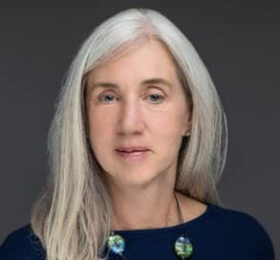
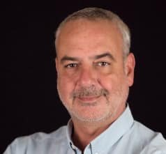
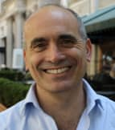
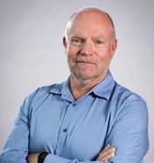
Today’s Presenters
Susan Jackson
ISSF
President, ISSF
Dr. Victor Restrepo
ISSF
Vice President, Science
Michael Cohen
ISSF
Market Outreach Associate
Dr. Laurent Dagorn
Institut de recherche pour le développement (IRD)

Slide 4
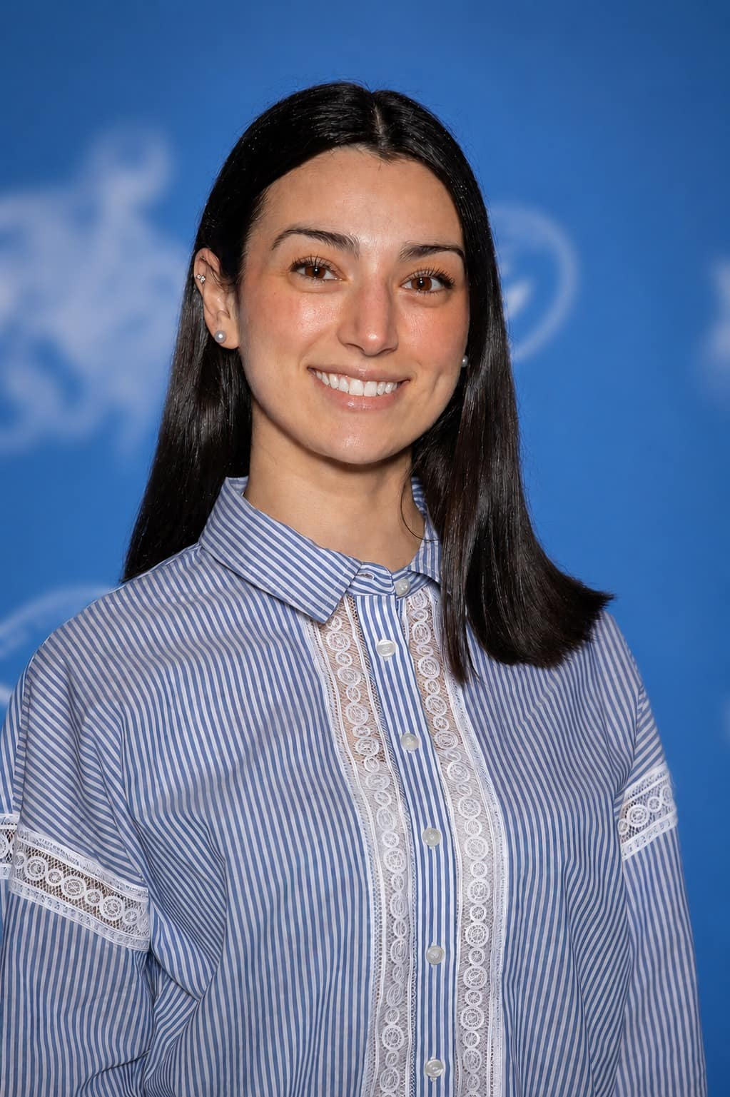
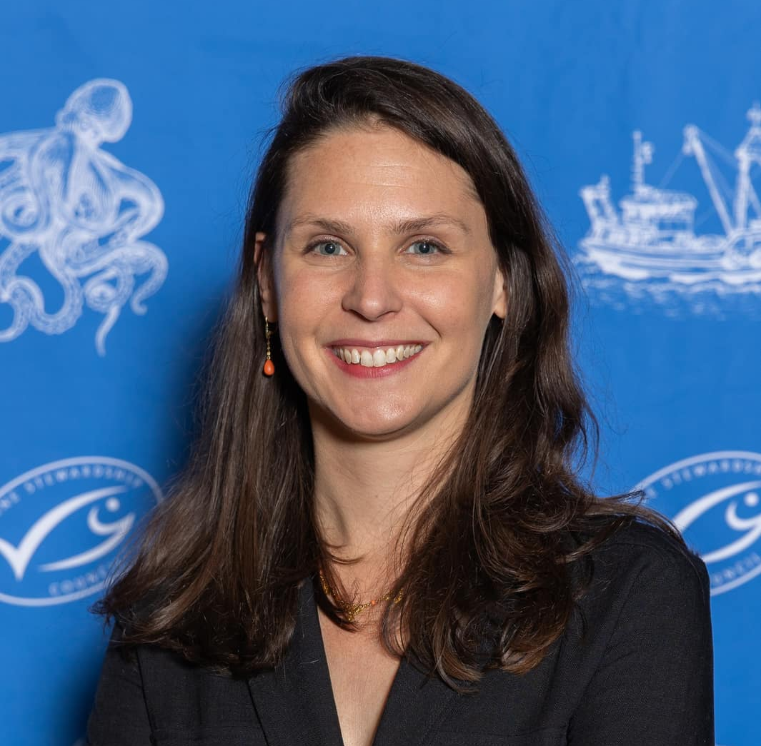
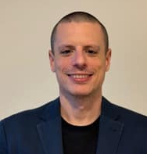
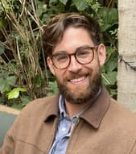
Today’s Presenters
Amélie Martinez
Marine Stewardship
Council France
Senior Manager Corporate Partnerships
Dr. Alexandra Maufroy
Marine Stewardship
Council France
Senior Fisheries Outreach Manager
David Parreño Duque
Sustainable Fisheries Partnership
Partnerships & Markets Engagement Specialist
Cody Pajunen
Sustainable Fisheries Partnership
Fisheries Policy and Information Analyst

Slide 5
Ordre du jour
HORAIRE | INTERVENANT(S) | SUJET
9h30–9h45 | Michael Cohen (ISSF) | Welcome and Event Overview
9h45–11h15 | Session 1 Susan Jackson (ISSF) Dr. Victor Restrepo (ISSF) Dr. Laurent Dagorn (IRD) Discussion/Q&A | Driving Sustainability Progress & Supporting Market Strategic Priorities Turning Science into Action: Global Tuna Progress Through ISSF Collaboration Une approche holistique de la durabilité écologique de la pêche à la senne du thon tropical
11h15-11h45 | Pause café
12h00–13h30 | Session 2 Amélie Martinez & Dr. Alexandra Maufroy (MSC) David Parreño Duque & Cody Pajunen (SFP) Michael Cohen (ISSF) | Filière Thon Durable MSC: Progrès et Engagement Données par navire et outils de l'ISSF au service d’une pêche au thon plus durable Activating Market Influence & Creating Strategic Value
 | Susan Jackson (ISSF) Discussion/Q&A | Closing Comments
13h30–14h30 | Cocktail déjeunatoire

Slide 6
Driving Sustainability Progress
& Supporting Market Strategic Priorities
9 October 2026
Susan Jackson
President

Slide 7

Driving More than a Decade of Measurable Change
For 15+ years, ISSF partners — scientists, seafood companies, environmental NGOs — have worked side-by-side to transform global tuna fisheries
Science-Led Action: Advancing cutting-edge research, practical tools to guide management
Global Collaboration: Uniting industry, governments, & NGOs across every tuna-fishing region
Verified Impact: Independent audits, transparent reporting that prove measurable progress
Sustained commitment has turned early challenges — data gaps, weak management, and limited accountability — into tangible wins:
Healthier tuna stocks
Stronger RFMO policies
Market-recognized best practices
More than half of global tuna catch from MSC-certified fisheries
Our journey shows that long-term collaboration can deliver improved sustainability
7

Slide 8
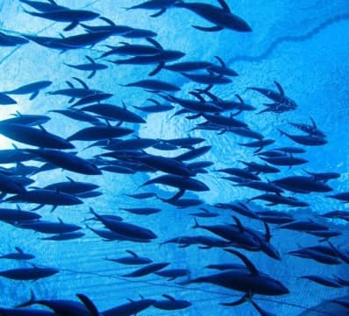
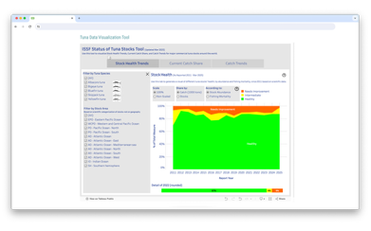

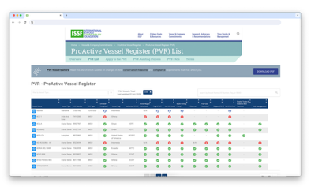
From Challenge to Change
More than a Decade of Sustainable Tuna Progress
DATA & TRANSPARENCY
THEN:
Global tuna stock information fragmented, with no single harmonized source—minimal verifiable vessel reporting
NOW:
Publicly available ISSF Status of the Stocks reports, vessel-level transparency through ProActive Vessel Register (PVR) and Vessels in Other Sustainability Initiatives (VOSI) platform
Our journey shows that long-term collaboration can deliver improved sustainability.
1,800+
vessels
voluntarily
Registered on the PVR
8

Slide 9
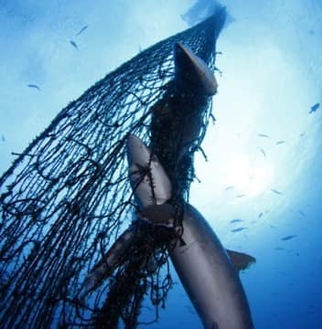
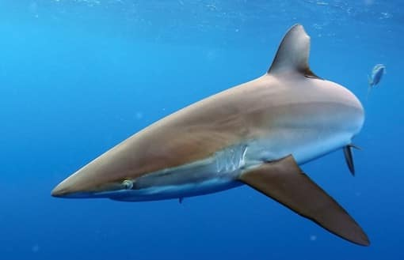
From Challenge to Change
More than a Decade of Sustainable Tuna Progress
BYCATCH & ECOSYSTEM IMPACTS
THEN:
Sparse data on non-target species in tuna fisheries and few safeguards for sharks, sea turtles, and seabirds
NOW:
Widespread adoption of ISSF bycatch mitigation best practices and fishing gear designs that reduce animal entanglement; RFMO-adopted shark-finning bans and seabird mitigation measures
Our journey shows that long-term collaboration can deliver improved sustainability.
9

Slide 10
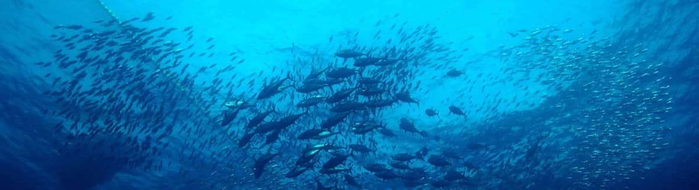
From Challenge to Change
More than a Decade of Sustainable Tuna Progress
HARVEST STRATEGIES
THEN:
Only a handful of tuna stocks had harvest control rules
NOW:
All 4 tropical tuna management organizations have adopted harvest strategies or interim harvest control rules for key species like skipjack and yellowfin, with implementation timelines for others
Our journey shows that long-term collaboration can deliver improved sustainability.
10

Slide 11
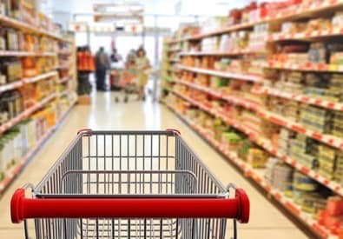
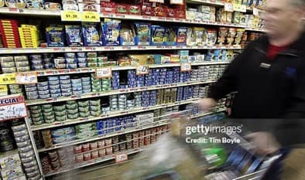
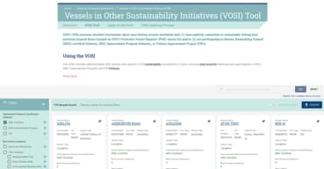
From Challenge to Change
More than a Decade of Sustainable Tuna Progress
INDUSTRY & MARKET ENGAGEMENT
THEN:
Inconsistent industry engagement and transparency
NOW:
ISSF participating companies undergo independent, publicly reported audits and use PVR and VOSI to demonstrate best practice commitments
THEN:
Retail expectations for demonstrable sustainability just beginning to take shape
NOW:
Globally, 73 major retailers reference ISSF participation and PVR/VOSI listings in sourcing policies, helping companies de-risk investments
Our journey shows that long-term collaboration can deliver improved sustainability.
Image to come
11

Slide 12
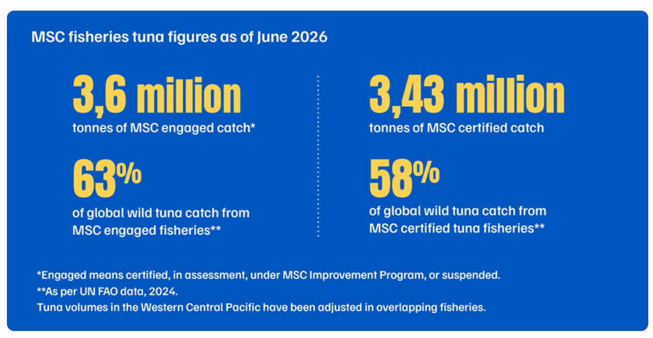
From Challenge to Change
More than a Decade of Sustainable Tuna Progress
MARINE STEWARDSHIP COUNCIL-CERTIFIED TUNA CATCH
THEN:
14% of the world’s annual tuna catch came from Marine Stewardship Council (MSC)-certified catch
NOW:
58% of the world’s annual tuna catch comes from MSC-certified fisheries
Our journey shows that long-term collaboration can deliver improved sustainability.
Source: Marine Stewardship Council, June 2026
12
12

Slide 13
How Did We Get Here?
The ISSF Approach

Slide 14
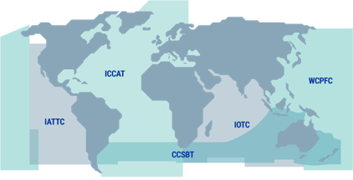
The ISSF Approach
Science-Led Innovation • Global Influence • Implementation Integrity
ABOUT ISSF
ABOUT ISSF
In 2009, acclaimed scientists, leaders in industry, and environmental champions launched the International Seafood Sustainability Foundation (ISSF) based on shared concerns about the future of tuna fisheries and a desire to do something about it — together.
ISSF MISSION
To undertake and facilitate science-based initiatives to continuously improve the sustainability of global tuna fisheries and the health of the ecosystems that support them.
ISSF OBJECTIVE
ISSF OBJECTIVE
To continuously improve the sustainability of global tuna fisheries and the ecosystems that support them to result in those fisheries meeting and maintaining the MSC certification standard.
We achieve this through:
  The development and implementation of verifiable, science-based practices, measurable commitments, and conservation management measures by participating companies
RFMOs: Regional Fisheries Management Organizations
IATTC: Inter-American Tropical Tuna Commission
ICCAT: International Commission for the Conservation of Atlantic Tunas
IOTC: Indian Ocean Tuna Commission
WCPFC: Western and Central Pacific Fisheries Commission
CCSBT: Commission for the Conservation of Southern Bluefin Tuna
  Advocacy to tuna RFMOs
14

Slide 15
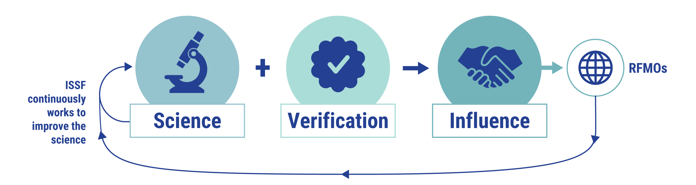
ISSF Theory of Change
Sustainable Management Requires Continuous Improvement
ISSF advocacy to RFMOs is grounded in what the best current science requires.
Simultaneously, ISSF continuously works to improve the science.
The intended result of our efforts is the adoption & implementation of science-based management measures by industry and RFMOs.
We recognize that comprehensive and sustainable management requires continuous improvement.
15

Slide 16
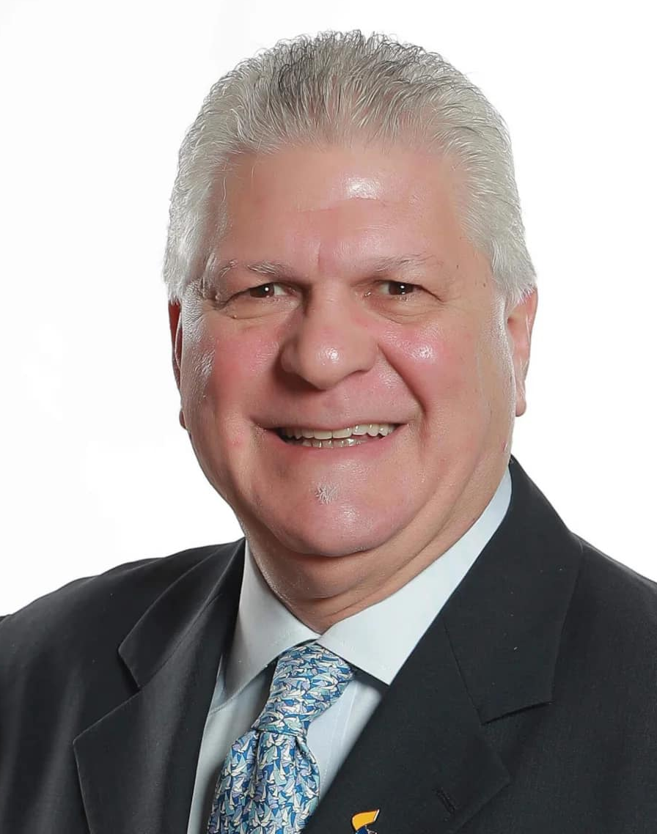
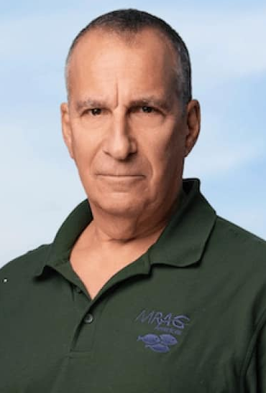
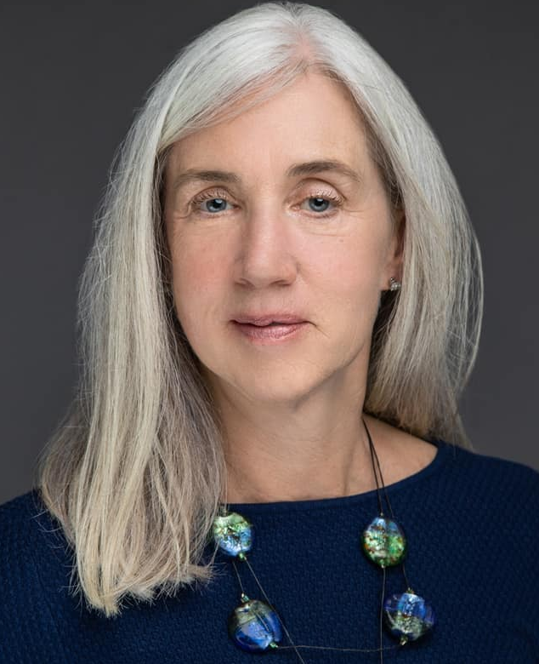
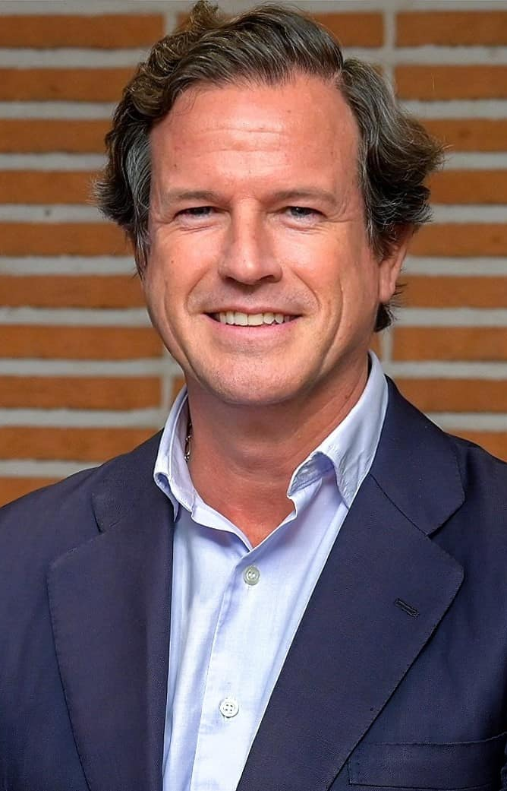
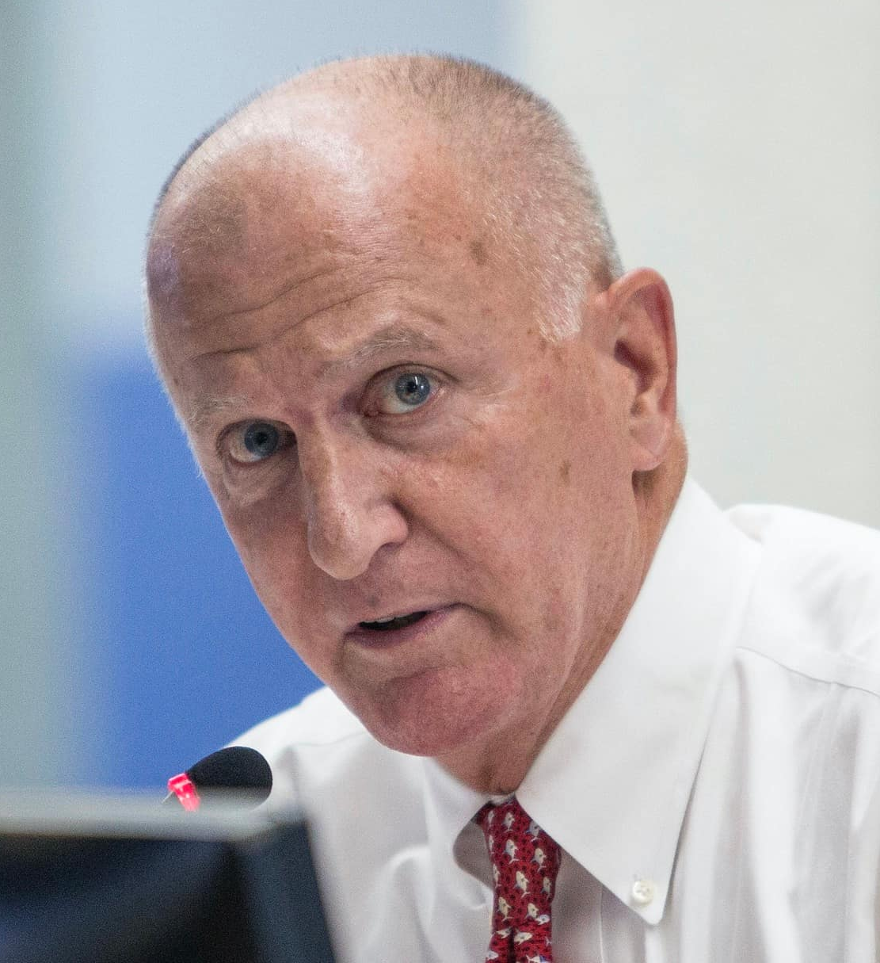
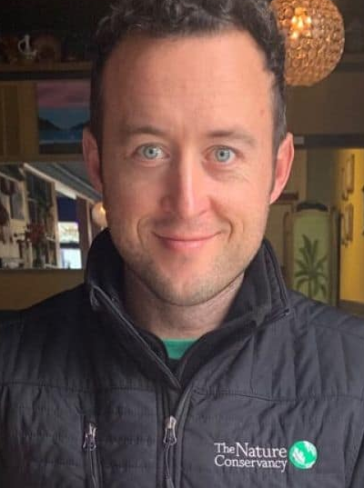
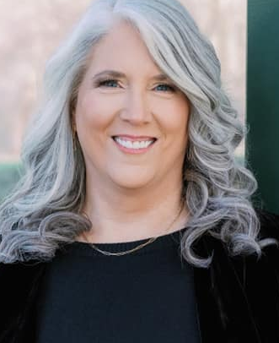
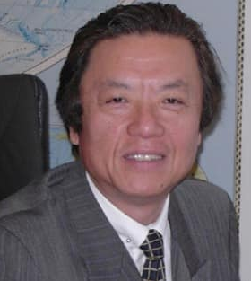
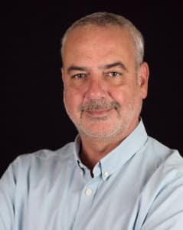
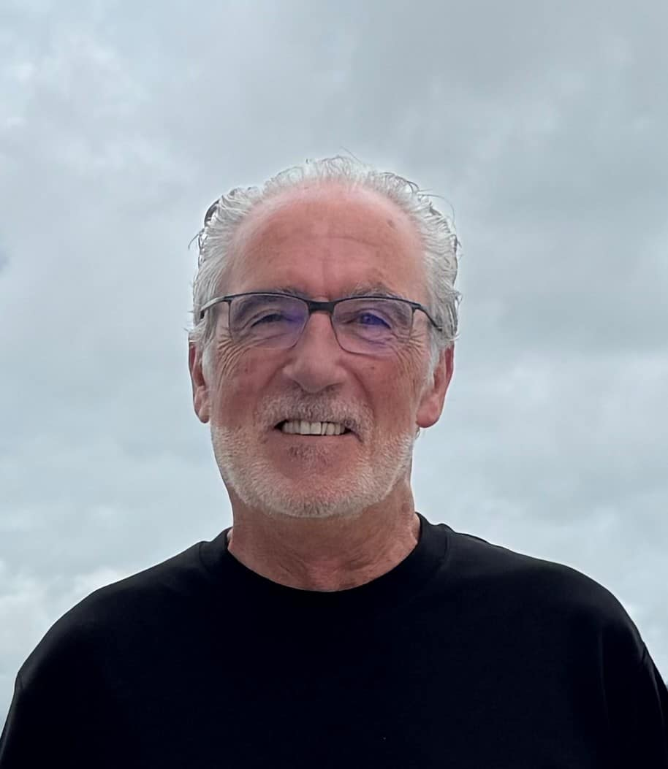
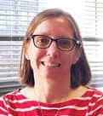
ISSF Theory of Change
ISSF BOARD OF DIRECTORS
ISSF BOARD OF DIRECTORS
Click here for full bios
Tony Lazazzara
ISSF Board Chair
--------------------------------------
Group Director of Global Fish Procurement, Thai Union Group
Dr. Andrew Rosenberg
ISSF Board Vice Chair
--------------------------------------
Marine Scientist & Environmental and Science Policy Expert
Susan Jackson
President, ISSF
Javier Garat
Secretary General, Spanish Fishing Confederation, Cepesca / President, Association of National Organizations of Fishery Enterprises in the European Union (Europêche)
William
Gibbons-Fly
Executive Director, American Tunaboat Association (ATA)
Ben Gilmer
Chair, ISSF Environmental Stakeholder Committee /
Director, Large-Scale Fisheries, The Nature Conservancy (TNC)
ISSF's governance intentionally brings together leaders from science, the seafood industry, environmental NGOs, and independent experts to help ensure solutions are scientifically credible, practical, and broadly supported.
Melissa Murphy
Distinguished Service Professor of Marketing and Corporate Entrepreneurship, Tepper School of Business, Carnegie Mellon University / President, Melissa Murphy Marketing
Ichiro Nomura
Fisheries Policy Advisor, Ministry of Marine Affairs
and Fisheries,
Republic of Indonesia
Dr. Victor Restrepo
Vice President – Science, ISSF / Chair, Scientific Advisory Committee
Dr. Josu Santiago
Head of the Tuna Research Area, AZTI
Amanda
Stern-Pirlot
Chief Standards Officer, Marine Stewardship Council
16

Slide 17
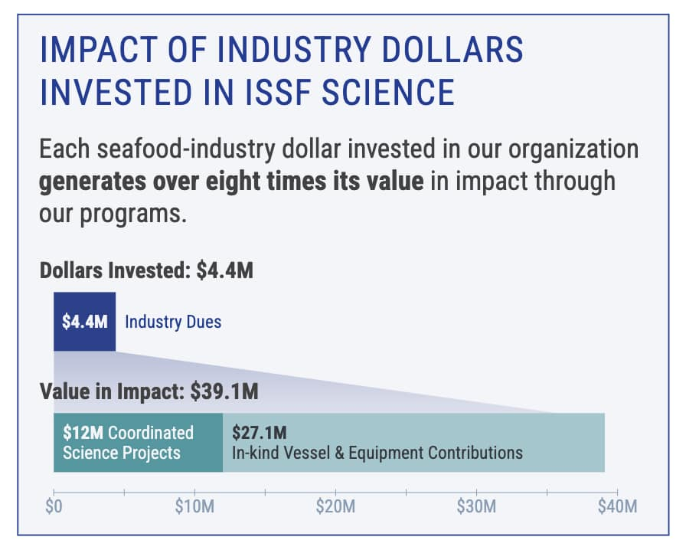
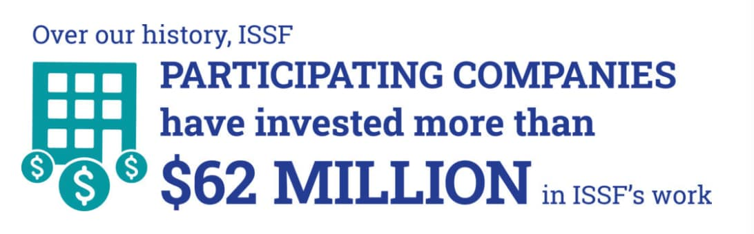
Mobilizing FUNDS Toward Sustainable Fisheries
OUR IMPACT IN NUMBERS
17

Slide 18
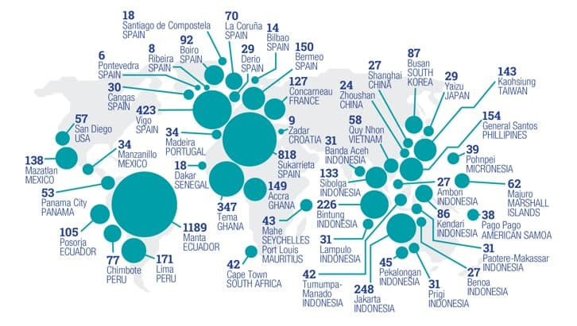
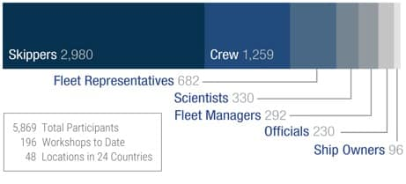
Mobilizing FISHERS Toward Sustainable Fisheries
OUR IMPACT IN NUMBERS
ISSF SKIPPERS WORKSHOP PARTICIPANTS
By Profession (2010–June 2025)
ISSF SKIPPERS WORKSHOP ATTENDANCE
2009–June 2025
18

Slide 19
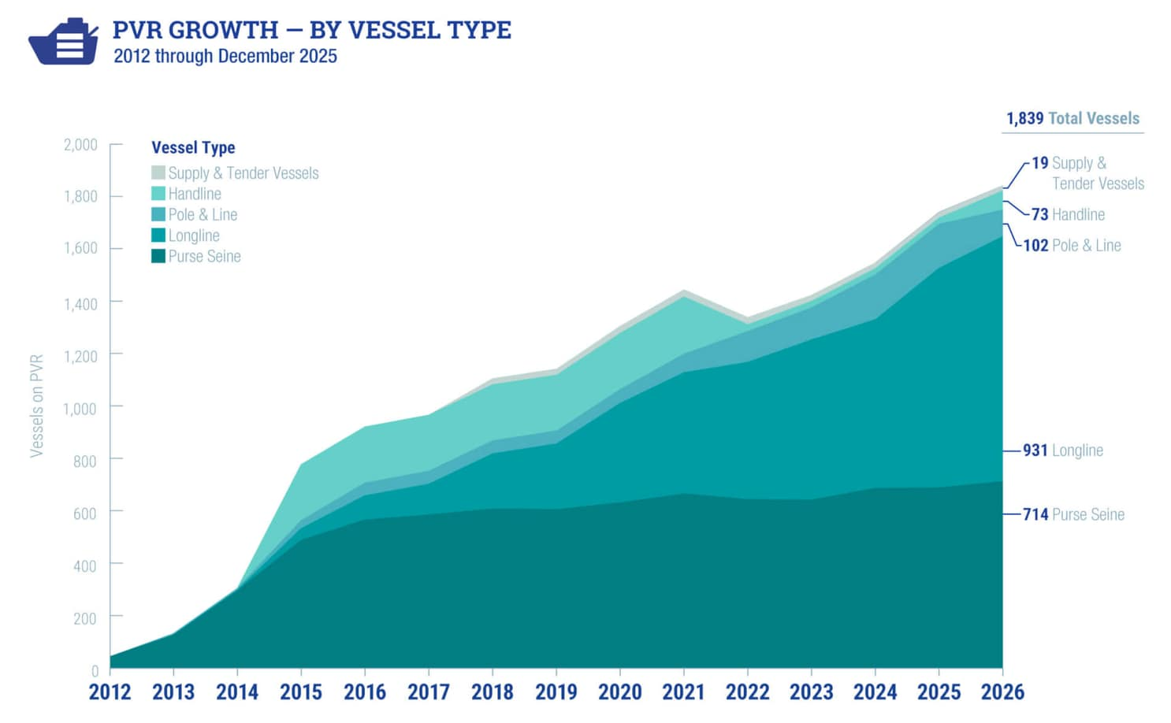
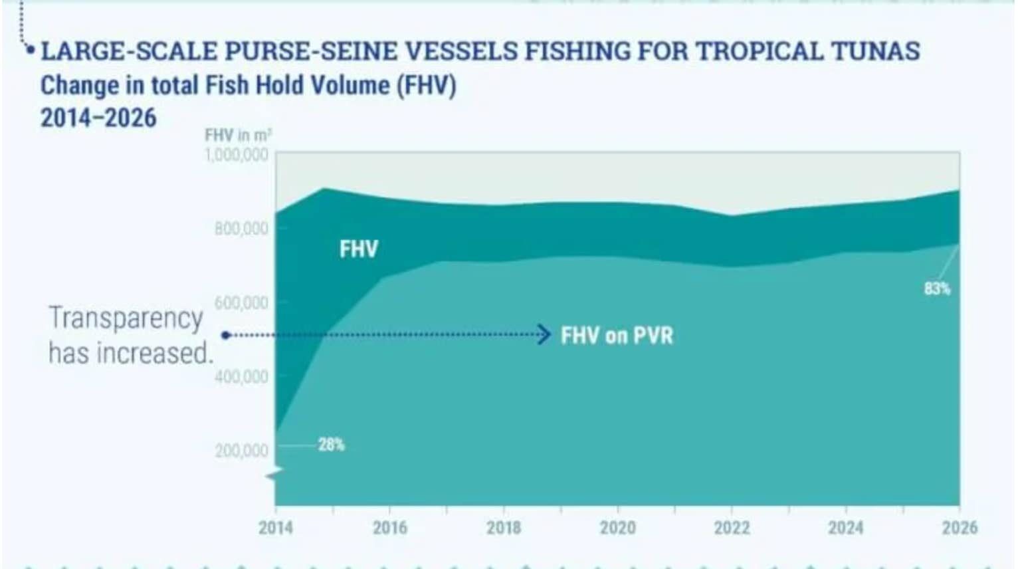
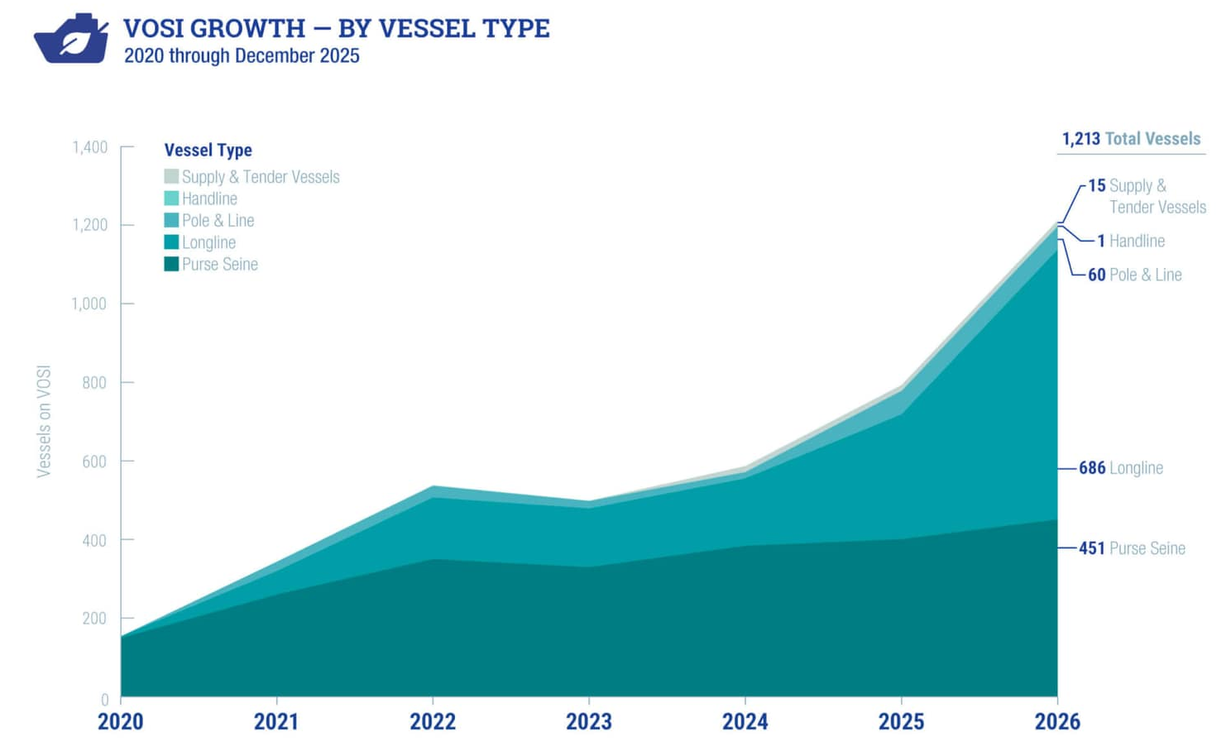
Verified Transparency in Vessel Practices
OUR IMPACT IN NUMBERS
19

Slide 20
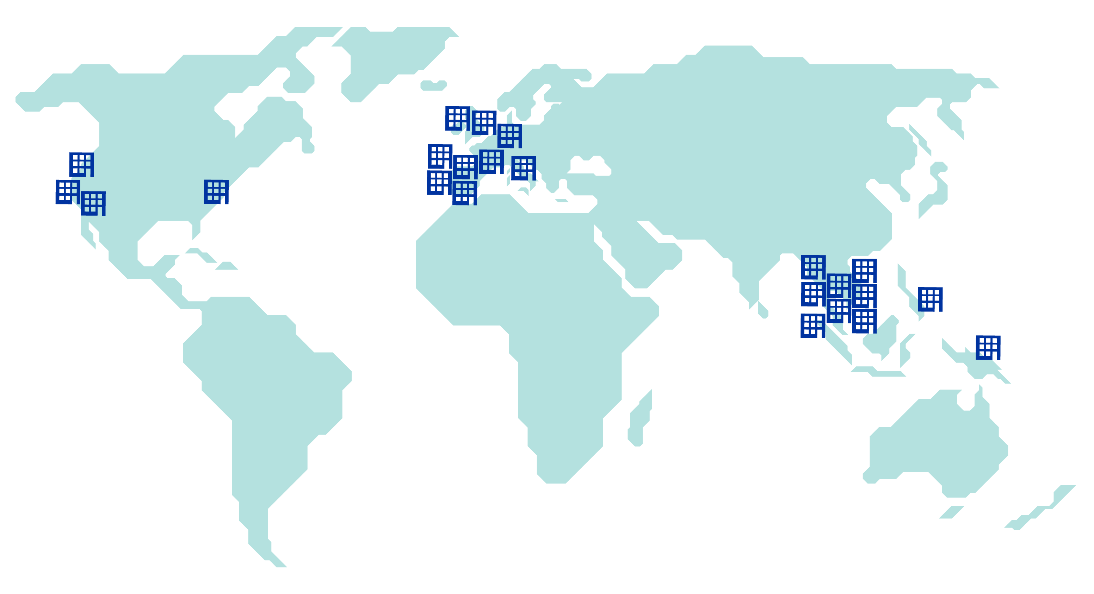

















ISSF Participating Companies
OUR PARTNERS — INDUSTRY
Founding Companies
(Europe)
(COSI)
Full Companies
Global Engagement by
23
Participating Companies
20

Slide 21

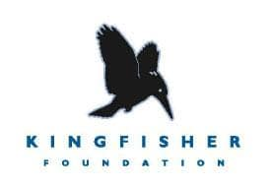








Charitable Foundations & Other Partners Supporting ISSF
OUR PARTNERS — FUNDING
Fisheries Improvement Fund
21

Slide 22












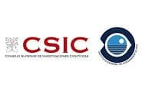





Charitable Foundations & Other Partners Supporting ISSF
OUR PARTNERS — RESEARCH
PLUS Fishing Vessel Owners & Crew
22

Slide 23
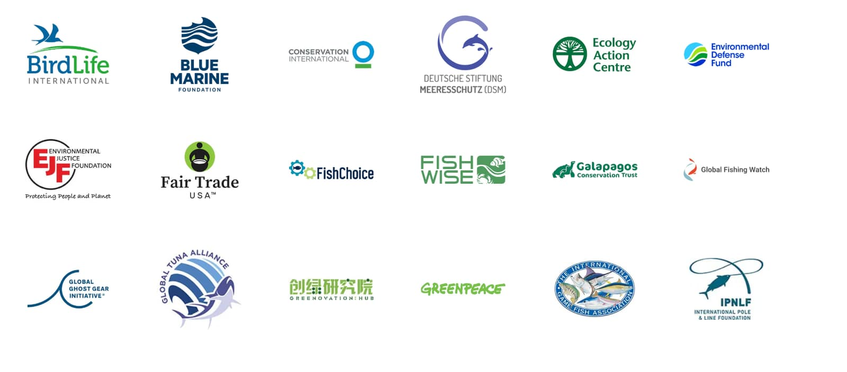
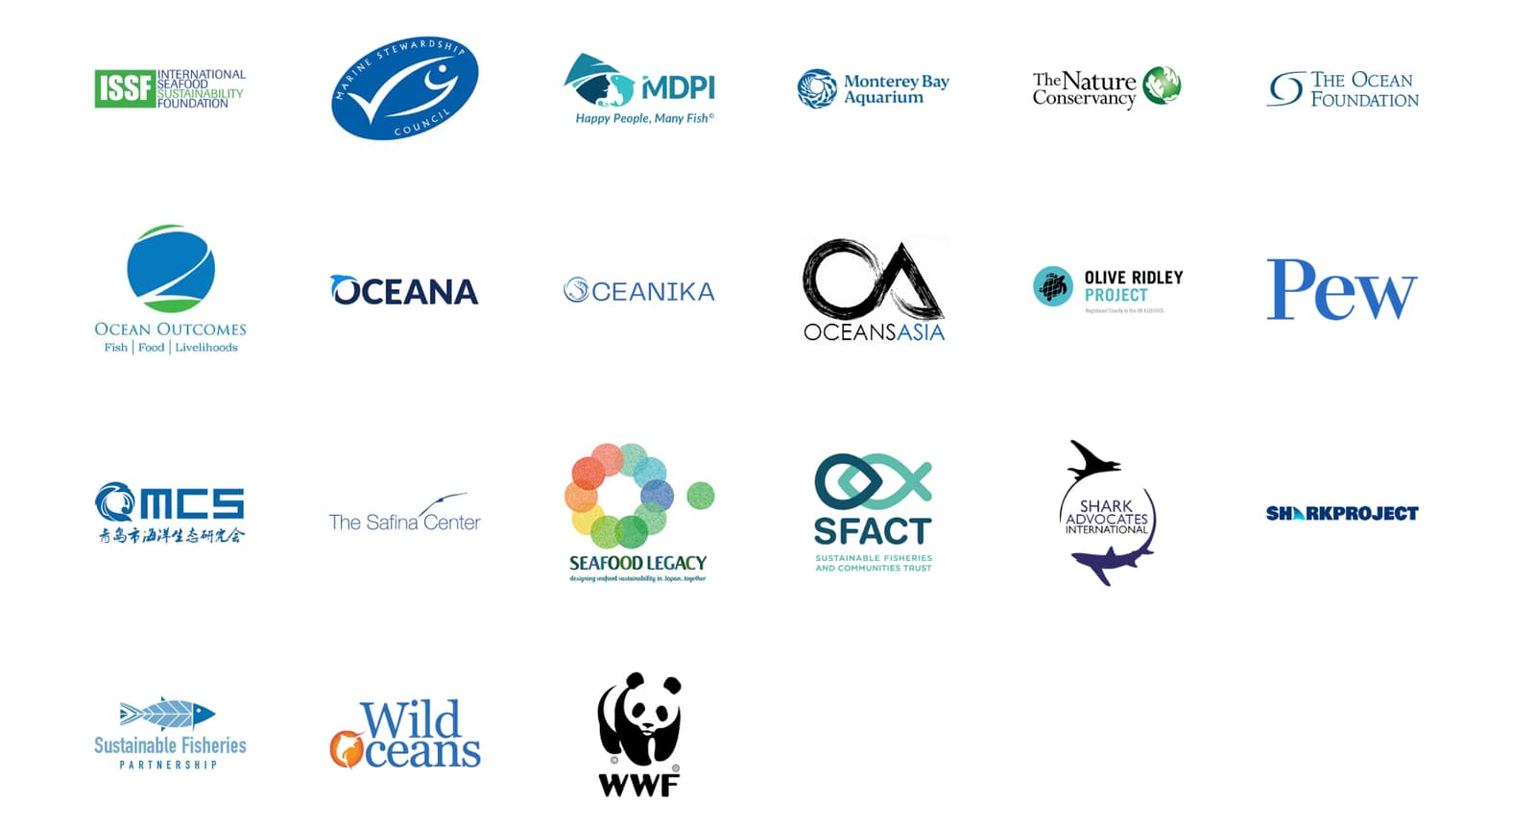
NGO Tuna Forum Participation
23

Slide 24
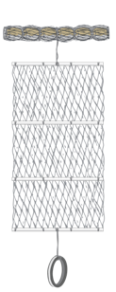


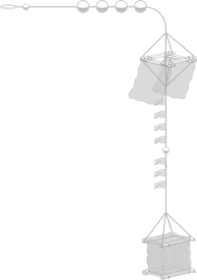
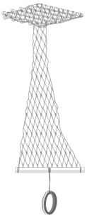
Improved Fishing Gear Design to Minimize Ecosystem Impacts
SCIENCE-LED INNOVATION
Conventional FAD
Jelly-FAD
Bulky and heavy
Hard to build
Results in ghost fishing,
marine pollution, and
damage to habitats
Light and easy
to handle
Materials available worldwide
Easy to build and low cost
24

Slide 25

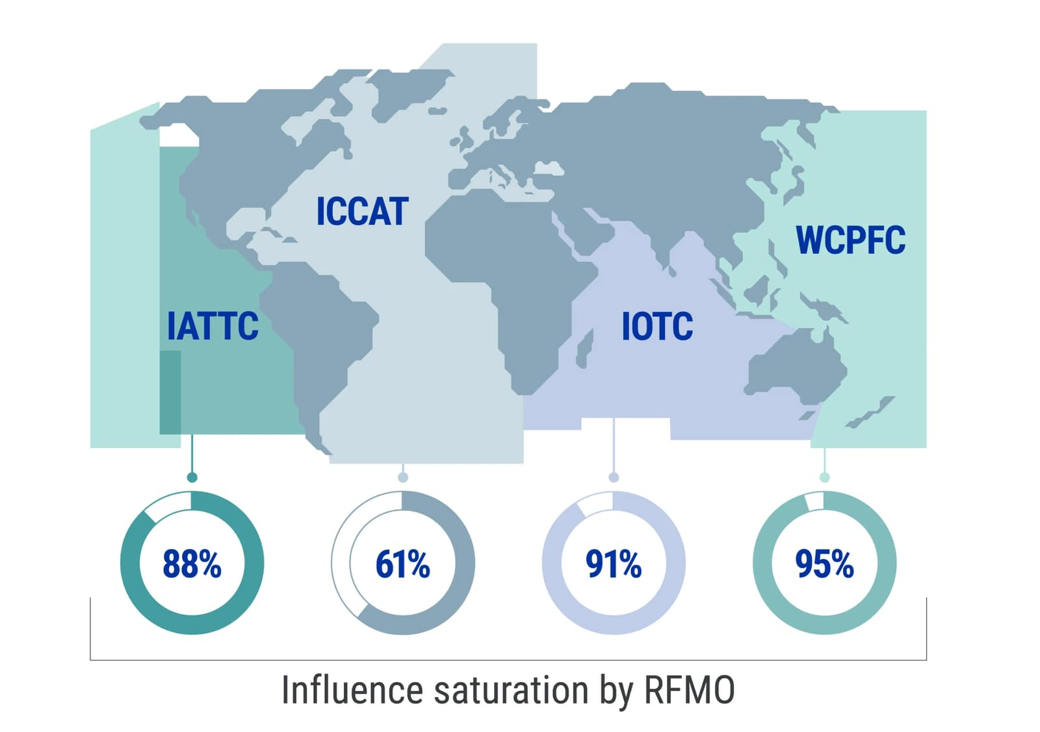
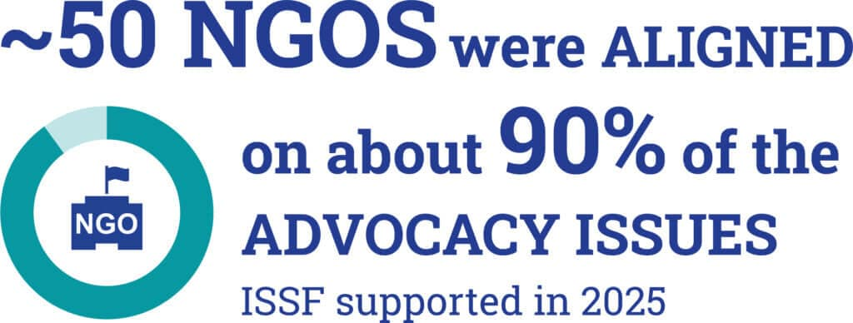
Consistent, Coordinated Advocacy to RFMOs
GLOBAL INFLUENCE
450+
advocacy letters delivered to RFMO delegates across four tuna regions
in 2025
ISSF and its participating companies have driven policy change through sustained advocacy.
Direct meetings
Input via national advisory committees
Engagement with vessels, MSC clients, FIPs
25

Slide 26


Independent Audits • Transparent Reporting • Verified Action
IMPLEMENTATION INTEGRITY
Our approach for tuna fisheries & stakeholders promotes the verifiable implementation of best practices in tuna supply chains
Independent auditing of tuna company compliance with ISSF conservation measures
Independent auditing of vessel compliance with best practices
ISSF works with tuna vessels & processors globally
26

Slide 27
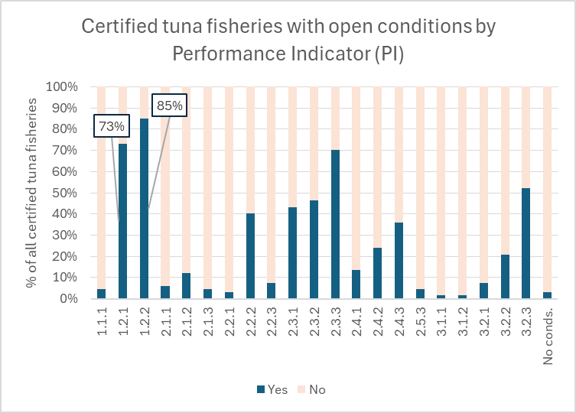
The Path Ahead
CLOSING OPEN CONDITIONS FOR MSC-CERTIFIED TUNA FISHERIES
Of all open conditions for tuna fisheries certified against the MSC Fisheries Standard, the two PIs with the highest number of conditions are 1.2.1 and 1.2.2.
Over half of these conditions correspond to harmonized conditions opened during application of Section SE to Western Pacific stocks
The rest correspond to other stocks in the Pacific, Atlantic and Indian oceans
PI 1.2.1 – Harvest Strategy
PI 1.2.2 – Harvest Control Rules & Tools
27

Slide 28
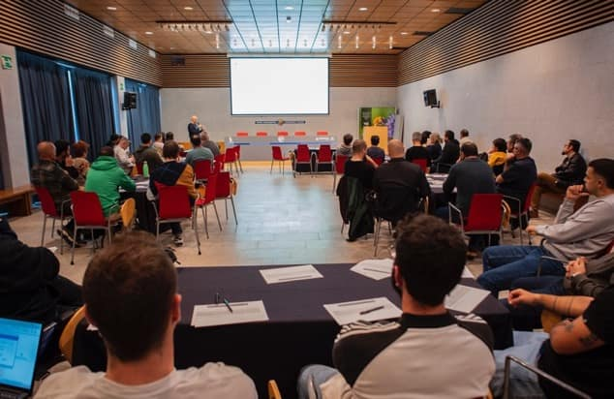
The Path Ahead
ISSF is the only NGO exclusively dedicated to achieving sustainable tuna fisheries
Stands apart for its expertise across tuna science, fishery management, and industry operations
Diverse governance structure includes scientists, environmental NGOs, and seafood companies — bringing all stakeholders to the table in an aligned, science-forward approach
Leads collaborative efforts to improve tuna fishery sustainability through innovation, implementation integrity — a powerful force for change
28

Slide 29
Q&A

Slide 30
Turning Science into Action: Global Tuna Progress Through ISSF Collaboration
9 October 2026
Dr. Victor Restrepo
Chair, ISSF Scientific Advisory Committee

Slide 31





Turning Science into Action:
Global Tuna Progress Through ISSF Collaboration
TODAY’S TOPICS
Traceability &
Mitigating IUU
Tuna Stock Health
Harvest Strategies
Observer Coverage & Electronic Monitoring
Bycatch Mitigation & FAD Management
31

Slide 32
Tuna Stock Health

Slide 33


Status of the 23 Major Tuna Stocks
AS OF JANUARY 2026
A growing share of the global tuna catch comes from stocks that are not subject to overfishing, thanks largely to improved management by RFMOs.
33

Slide 34








Status of the Major Commercial Tuna Stocks
AS OF JANUARY 2026
Next: 2026
7 Species,
23 stocks
In 2024, global catch was
5.8 million tonnes
Compiled from RFMO reports.
34

Slide 35

IO Yellowfin
The ISSF SAC acted conservatively and waited a year for the assessment inputs to be reviewed.
IO YFT accounts for more than 8% of the global tuna catch, so this change is influential in the statistics cited earlier

Slide 36
Carbon Footprint & Climate Change

Slide 37
Building Climate-Ready Fisheries Management at Tuna RFMOs
Climate considerations being integrated into:
  Stock assessments
  Management Strategy Evaluation (MSE)
Development of climate & ecosystem indicators:
  Ocean temperature (SST), ENSO, warm pool size
  Habitat and fish condition trends
New tools emerging:
  Ecosystem “report cards” (EcoCards)
  Climate-resilient management roadmaps
Progress is real, but most work still at scientific level
Full integration into management decisions is still evolving

Slide 38

Projected redistribution of tropical tuna biomass in the P.O.
Projected change from 2009-18 to 2050 under two climate change scenarios
Source: Bell et al., 2021. Nature Sustainability 4: 900–910

Slide 39


Example Candidate Climate Indicators
warmpool Area/volume
2024 TFAR (https://fame.spc.int/resources/documents/tuna-fisheries-assessment-report)
Indo-Pacific Warm Pool has expanded since 1980s, potentially expanding the spawning habitat of tropical tunas like skipjack.
Estimated skipjack recruitment has increased, but a mechanistic relationship is yet to be established.
Notes:
ENSO, SST, western Pacific warm pool area (likely unique to us!), ocean heat content, marine heatwaves + ecosystem indicators like mean fish condition, PS fishery distribution

Slide 40

Baseline: 1991-2020
Source: NOAA

Slide 41
Harvest Strategies

Slide 42

Why Harvest Strategies Matter
Harvest strategies (aka management procedures or MPs) are essential tools for sustainable, science-driven fisheries management
Include monitoring programs, stock assessments, harvest control rules (HCRs), & reference points to guide management
Define management responses in advance to help reduce political pressure and promote transparency, consistency, and long-term stock health
15 Years Ago
RFMOs just beginning to consider the adoption of harvest strategies
42

Slide 43

HS/MP progress in tuna RFMOS
52% of global tuna catch has MPs
All RFMOs are in the process of developing and adopting HS/MP for their tuna stocks
0.7% * NP ALB
1.6%
(18%)
36.7% *
(71%)
0%*
12.3%
(51%)
Bold % = Share of global tuna catch
(%) = Share within RFMO
0.3%
(100%)
Notes:
NOTAS:
Año 2024 (último del SoS)
El valor de cada RFMO es la captura con MP de esa RFMO relativa a la captura total. La suma de esos valores da el 52% del total de capturas con MP (51.6%)
El valor entre paréntesis es la captura total de cada RFMO con MPs relativa a la captura de esa RFMO.
EL north Pacific ALB lo he metido en la WCPO (como en el SoS) para ver la captura total de la RFMO con MPs (el valor del paréntesis)
Pero el valor del NP ALB respecto a la captura total lo he separado y mostrado aparte. Si prefieres meterlo en la WCPFC sería 37.4 % (71 %) y deberías quitar el 0.7 del NP ALB

Slide 44
Bycatch Mitigation & FAD Management

Slide 45

All Fisheries Have Impacts
v
45

Slide 46
Purse Seine Bycatch
BY SPECIES GROUP
ALL OCEANS — Current % Bycatch by Species Group & Set Type
Rays
Rays are more common in free school sets.
Sharks
In some regions, shark bycatch
% is higher in free school sets.
Billfish
Bony fish
Minor tuna
Source: Observer data provided from SPC (WCPO), IATTC (EPO) and by the research institutes in charge of EU-PS observer programs in the Atlantic and Indian oceans. Data is 2013-2017 for all oceans, except Atlantic Ocean, which is 2012-2016. Note:"FAD" to include all associated sets, e.g. sets on natural logs would be included there too.

Slide 47

Our Approach to (Bycatch) SCIENCE
OUR RESEARCH PARTNERS
47
Notes:
SCIENCE drives the ISSF. And what is our approach to science?
At ISSF, we place great importance on incorporating fishers’ perspectives and actively involving them in research from the very beginning.
To achieve this, we:
Listen and learn from fishers to find best bycatch practices with their help
Design appropriate bycatch reducing measures that suit best each fleet and ocean
Scientist pass information to fishers on the latests research in bycatch mitigation
In short, We meet/collaborate with scientist to get “possible” ideas and meet with skippers to see if those ideas make sense in the water, then we trial them and if they have potential, we develop best practices and advocate for the adoption of those best practices in RFMOs. For example, we have been advocating for the use of only non-entangling FADs without nets.

Slide 48




Our Approach to (Bycatch) SCIENCE
OUR RESEARCH PARTNERS
ISSF SKIPPERS WORKSHOP ATTENDANCE | 2009–June 2025
ISSF has conducted 135 Workshops, in 44 Locations / 23 Countries, with 4,900 Skippers and Crew
48
Notes:
We have conducted numerous workshops with key fleets across the three oceans. These workshops are designed to facilitate two-way knowledge exchange between scientists and fishers, as well as to develop best practices. Since this is a global effort, it enables us to share successful ideas and practices from one region or fleet with others, amplifying their impact on a global scale
In the last 11 years we have organized around 135 Skipper Workshops around the world (in the main PS fishing ports) with more than 4900 skippers and crews participating in those skipper workshops.

Slide 49




At-Sea Research & Experiments
2011–2024
Excludes biodegradable FAD tests
49
Notes:
The research to test new ideas has been carried out in the three tropical oceans through various approaches: dedicated research cruises on specialized vessels, opportunistic studies conducted during fishing trips aboard purse seiners, and controlled experiments, such as those focusing on acoustics or biodegradability
In the last 15 years around 23 research activities on research cruises from acoustic mitigation, to development and deployment of biodeagradable FADs, etc… have been conducted.

Slide 50
Chronological Hierarchy of Bycatch Mitigation
Passive Mitigation
Avoid Before Setting
Release from the Net
Release from the Deck
Offsets
50
Notes:
Hierarchical steps in the bycatch mitigation.
From measures that avoid bycatch which are considered before those that minimize catch risk. These are then followed by remediation interventions that reduce fishing mortality. Finally, direct, compensatory offsets measures to restore those impacts that were not possible to avoid, minimize and remediate can be implemented as a last resort.
There are several actions designed by the time at which the measure takes place within the fishing operation:
From avoidance to Passive mitigation – before the vessels are at the FAD
e.g., non-entangling FADs; acoustic species discrimination
Avoid catching bycatch – before setting when the vessel is at the FAD, e.g., attraction of sharks away from FADs before setting, acoustic discrimination of species before setting
Release bycatch from the net
e.g., release sharks and small bigeye and/or yellowfin tuna out of the net
Release bycatch from the deck
e.g., release animals alive from the deck
Offsets
e.g., turtle projects

Slide 51


Understanding Entanglement at FADs
Scientists, Managers, Fishers:
Problem of entanglement of sharks in nets of FADs was considered negligible compared to fishery mortality.
Filmalter, J.D., Capello, M., Deneubourg, J., Cowley, P.D. and Dagorn, L. (2013), Looking behind the curtain: quantifying massive shark mortality in fish aggregating devices. Frontiers in Ecology and the Environment, 11: 291-296. https://doi.org/10.1890/130045
51

Slide 52
Fully NEFADs Without Netting
OBSERVER DATA REVIEW
Non-Entangling Timeline
2020
Indian Ocean
2021
2022
2023
2024
Western Pacific Ocean
Atlantic Ocean
2025
Eastern Pacific Ocean
52

Slide 53


Entanglements at FADs in the Eastern Pacific
OBSERVER DATA REVIEW
Sea Turtle
in Tuna Fisheries
53

Slide 54





Non-Entangling AND Biodegradable: Jelly-FAD Design
Conventional FAD
Jelly-FAD
WINNER
Responsible Seafood Innovation Award
54
Notes:
One of our recent contributions is the innovative concept of the JellyFAD. The JellyFAD, which mimics the natural drifting behavior of jellyfish with near-neutral buoyancy, extends its lifespan to match that of conventional FADs.

Slide 55

Conclusion from bioFAD Trials
NEW ISSF TRIALS & LARGE-SCALE DEPLOYMENT
2018–PRESENT
Achieve similar catches and performance as conventional FADs
Lifespan: sets were made after 11 months at sea, meeting fishers’ needs for lifespan
Success relies on number of Jelly-FADs deployed
Ongoing tests w/ fleets from Korea, Taiwan, China, Spain, FSM, USA and Ecuador
Next Steps: Test a new generation of Jelly-FADs in controlled conditions
55
Notes:
Test a new generation of Jelly-FADs in controlled conditions
Lighter structure
Biodegradable flotation
Move from Category II (plastic flotation) to Category I (no plastic)

Slide 56



Management Measures on Biodegradable FADs
RFMO | Management Measures
IATTC 2023 | Stepwise implementation from 2026 to 2029 (Except plastic flotation). In 2030, decide about plastic flotation.
WCPFC | Not required but encouraged
IOTC | Stepwise implementation from 2026 to 2030. Including flotation.
ICCAT | Stepwise implementation from 2025 to 2028. Including flotation.
56

Slide 57
Chronological Hierarchy of Bycatch Mitigation
Passive Mitigation
Avoid Before Setting
Release from the Net
Release from the Deck
Offsets
57

Slide 58







Acoustic Discrimination
ROUGH BIOMASS ESTIMATES
BIOLOGICALLY RELEVANT MEASURES
58
Notes:
• The goal is to provide fishers with more accurate and reliable information on species composition around FADs, transitioning from the current limited understanding (shown on the left) to a clearer and more detailed insight into tuna species composition around FADs.
• This will enable fishers to make more sustainable decisions, such as avoiding areas with a high presence of tuna that needs to be protected or under a quota.

Slide 59









Acoustic Discrimination
Three tropical tunas Target Strength (TS) published:
YFT TS obtained in Panama has an intermediate value between BET and SKJ and a fairly flat frequency response.
Yellowfin
Thunnus albacares
NEW
2024
SKJ TS grows with frequency, as expected, due to its lack of swimmbladder.
Skipjack
Katsuwonus pelamis
BET TS is much higher, staying at 38 and 120, dropping drastically at 200 kHz.
Bigeye
Thunnus obesus
59
Notes:
We began by studying the acoustic signals of tropical tunas, which were previously unknown but are essential for species discrimination, such as frequency response of the different species.
• Our findings revealed that different species respond differently to different acoustic frequencies due to their unique characteristics, such as swimbladder volumen.
• By utilizing multiple acoustic frequencies, it becomes possible to distinguish between species more effectively.
• However, to implement this, the new data and methods must be integrated into the current buoy used to track FADs.
• To address this, we are collaborating with buoy manufacturers to develop and incorporate advanced algorithms that enhance species discrimination.
• Additionally, we are creating a training curriculum for fishers, to provide practical knowledge and skills.

Slide 60


Acoustic Discrimination
Support buoy manufacturers in enhancing their hardware to differentiate tuna species.
Provide support to refine algorithms for tuna species discrimination.
Develop a training curriculum.
60

Slide 61
Chronological Hierarchy of Bycatch Mitigation
Passive Mitigation
Avoid Before Setting
Release from the Net
Release from the Deck
Offsets
61
Notes:
Hierarchical steps in the bycatch mitigation.
From measures that avoid bycatch which are considered before those that minimize catch risk. These are then followed by remediation interventions that reduce fishing mortality. Finally, direct, compensatory offsets measures to restore those impacts that were not possible to avoid, minimize and remediate can be implemented as a last resort.
There are several actions designed by the time at which the measure takes place within the fishing operation:
From avoidance to Passive mitigation – before the vessels are at the FAD
e.g., non-entangling FADs; acoustic species discrimination
Avoid catching bycatch – before setting when the vessel is at the FAD, e.g., attraction of sharks away from FADs before setting, acoustic discrimination of species before setting
Release bycatch from the net
e.g., release sharks and small bigeye and/or yellowfin tuna out of the net
Release bycatch from the deck
e.g., release animals alive from the deck
Offsets
e.g., turtle projects

Slide 62




Shark Releases from the Net
TESTING VARIOUS METHODS
Sharks aggregate in a particular area of the net → Create a window in the net to let the sharks swim out.
Fish and Release → Fishing for shark in the net
Attracting shark on the net → Can we attract sharks away from FADs (e.g. using bait), then set on tunas?
50% success
62

Slide 63
Chronological Hierarchy of Bycatch Mitigation
Passive Mitigation
Avoid Before Setting
Release from the Net
Release from the Deck
Offsets
63
Notes:
Hierarchical steps in the bycatch mitigation.
From measures that avoid bycatch which are considered before those that minimize catch risk. These are then followed by remediation interventions that reduce fishing mortality. Finally, direct, compensatory offsets measures to restore those impacts that were not possible to avoid, minimize and remediate can be implemented as a last resort.
There are several actions designed by the time at which the measure takes place within the fishing operation:
From avoidance to Passive mitigation – before the vessels are at the FAD
e.g., non-entangling FADs; acoustic species discrimination
Avoid catching bycatch – before setting when the vessel is at the FAD, e.g., attraction of sharks away from FADs before setting, acoustic discrimination of species before setting
Release bycatch from the net
e.g., release sharks and small bigeye and/or yellowfin tuna out of the net
Release bycatch from the deck
e.g., release animals alive from the deck
Offsets
e.g., turtle projects

Slide 64



Design & Testing of Sorting Grids
Sorting grids constructed for each of the 12 U.S. tropical tuna purse seine vessels
Design varied based on vessel specifications.
64
Notes:
For this activity, scientists from UCSC and AZTI monitored sorting grid use on board purse seine vessels, during three trips. During those trips, scientists (i) evaluated the efficacy and time of release of mobulids using sorting grids or another release method (i.e., stretchers, manual, etc.) and (ii) evaluated post-release mortality using survivorship tags (sPAT tags). Fishers also evaluated the efficacy of the sorting grid during the fishing operation by filling out a form specifically designed for the project.

Slide 65

Design & Testing of Sorting Grids
65

Slide 66
Chronological Hierarchy of Bycatch Mitigation
Passive Mitigation
Avoid Before Setting
Release from the Net
Release from the Deck
Offsets
66
Notes:
Hierarchical steps in the bycatch mitigation.
From measures that avoid bycatch which are considered before those that minimize catch risk. These are then followed by remediation interventions that reduce fishing mortality. Finally, direct, compensatory offsets measures to restore those impacts that were not possible to avoid, minimize and remediate can be implemented as a last resort.
There are several actions designed by the time at which the measure takes place within the fishing operation:
From avoidance to Passive mitigation – before the vessels are at the FAD
e.g., non-entangling FADs; acoustic species discrimination
Avoid catching bycatch – before setting when the vessel is at the FAD, e.g., attraction of sharks away from FADs before setting, acoustic discrimination of species before setting
Release bycatch from the net
e.g., release sharks and small bigeye and/or yellowfin tuna out of the net
Release bycatch from the deck
e.g., release animals alive from the deck
Offsets
e.g., turtle projects

Slide 67





ISSF Sea Turtle Conservation
PROJECTS TO DATE
ISSF supports sea turtle research, conservation, and educational projects worldwide — including in Brazil, Tanzania, Peru, and Oman — through a more than $100,000 annual fund created by several ISSF Participating Companies.
iss-foundation.org/fishery-goals-and-resources/our-priorities/bycatch-reduction/sea-turtles
Source: © ISSF website
67

Slide 68
Conclusions
PROJECTS TO DATE
HOW?
To improve fundamental knowledge of tunas, sharks and other vulnerable species (sensory cues, habitat and distribution)
To develop new techniques, devices and fishing strategy/methods (innovative technology, improved deck configuration to handle bycatch)
To assist fleets in transitioning to fully NEFAD and biodegradable FADs (evaluate whether current bioFAD designs are sufficient)
To develop potential management measures
to further mitigate bycatch impacts
To promote fewer FADs, but “better” FADs (continue trials of innovative FADs)
Interdisciplinary approach involving oceanographers, shipyard engineers, NGOs, RFMOs
Collaborate closely with fishers selecting proactive and influential participants
Value and Respect fishers’ input: engage knowledgeable scientists with fishers
Incentives: Support Implementation of voluntary measures
Monitor and Verify the best practices and measures implemented.
68

Slide 69

Traceability & Mitigating IUU

Slide 70


Monitoring Transshipment — At Sea vs. In Port
AT SEA
Primarily large-scale longline
IN PORT
Standard practice for purse seine
Catch is transferred to carrier vessels at sea, including on the high seas or within EEZs
Remote locations create greater monitoring and oversight challenges
Catch transfer occurs in port, where monitoring and verification are more readily available
Port-based controls provide greater opportunities for direct oversight and catch verification
MORE CHALLENGING TO MONITOR
GREATER OPPORTUNITY FOR DIRECT OVERSIGHT

Slide 71

Strengthening Transshipment Regulations
TRANSSHIPMENT AT SEA (mostly longline, mostly high-seas)
  ISSF’s at-sea transshipment requirements primarily address large-scale longline vessels
  ISSF advocates for RFMOs to align their transshipment regulations with FAO’s 2023 Voluntary Guidelines Transshipment. Not all RFMOs have the same requirements, so our asks differ, depending on the RFMO.

Slide 72




Tackling IUU From Multiple Angles
Tuna processors globally commit to ISSF Conservation Measures: traceability, data collection and transshipment, among many others that deter IUU activities
72

Slide 73

Tackling IUU From Multiple Angles
Tuna fishing vessels worldwide signaling their commitment to fishing best practices that combat IUU:
ISSF scientific research and advocacy guides outreach to RFMOs and governments:
ProActive Vessel Register (PVR): 3rd-party auditing validates vessels following science-based, sustainable tuna fishing practices
Vessels in Other Sustainability Initiatives (VOSI): Verified resource shows which vessels have made public sustainability commitments beyond PVR
UVI and IMO Databases: Track permanent, unique vessel identifiers
Technical advice
Recommendations on effective RFMO governance
Scientific research reports
UVI
Not IUU Listed
Observer Coverage
Use of EM
& MORE
Today
All 4 tropical tuna RFMOs have adopted EM minimum standards
73

Slide 74

Observer Coverage & Electronic Monitoring

Slide 75

A Collaborative Push to Embrace and Standardize EM
ISSF and other partner NGOs have created EMS resources for fishers, policymakers and authorities
Best-practices reports
Minimum standards recommendations
Data submission guides
Snapshot assessments of RFMO performance toward EM requirements
EMS continuously watch, record, transmit data about activities to governments, RFMOs, other oversight organizations
Substitute for or supplement onboard human observer coverage, for example, documenting catch, bycatch, transshipment and landing activities
Detects overfishing, safety violations and other forms of noncompliance, including IUU fishing
75

Slide 76



Vessels in Other Sustainability Initiatives (VOSI)
A RECENTLY UPDATED & EXPANDED TOOL
A transparency tool for the public that want to understand which tuna vessels have made public commitments to more sustainable fishing beyond the commitments reflected on the PVR
VOSI tracks:
EM field in the VOSI tool is mechanism for verifying vessel participation in
The Nature Conservancy’s Tuna Transparency Pledge
Independent verification
by MRAG Americas
~110
Vessels with EM on VOSI
76

Slide 77
Dramatic Strides toward Worldwide EMS Use in Recent Years
IATTC - LL and PS Interim EM Minimum Standards ADOPTED September 2024
ICCAT - LL and PS EM Minimum Standards ADOPTED November 2023
IOTC - ADOPTED LL, PS, P&L EM definitions, EM program and data minimum standards May 2023 (1st RFMO to do so)
WCPFC - LL and PS Interim EM Minimum Standards ADOPTED September 2024
Today
All RFMOS poised to remedy longstanding problem of subpar observer coverage on longline vessels
77

Slide 78
Une approche holistique de la
durabilité écologique
de la pêche à la senne du thon tropical
Laurent DAGORN

Slide 79

Durabilité écologique
Pêcher des juvéniles est-il mauvais ?
Peut-on envisager une pêche FAD-free ?

Slide 80

Quelles captures pour une exploitation durable ?
Un stock est surexploité quand on pêche trop
Un stock peut être surexploité quand on pêche :
Trop
d’adultes
Trop
de juvéniles
Trop
d’adultes et de juvéniles

Slide 81

Quelles captures pour une exploitation durable ?
La nature produit plus de petits que de grands
La pêche doit respecter la structure de l’écosystème
(Convention pour la Diversité Biologique CBD)
La pêche doit prélever
plus de petits
que de grands

Slide 82

Quels efforts de pêche, répartis entre pêcheries, faut-il
pour atteindre un bon équilibre de structure de tailles
dans 20 ans ?
Log (Nombre de poissons)
Log (Longueur des poissons)

Slide 83





Quelles captures pour une exploitation durable ?
Un stock (espèce) est pêché par plusieurs engins de pêche
Un engin de pêche exploite plusieurs stocks (espèces)
Senneurs
Palangriers
Canneurs
Toutes les pêcheries qui exploitent un même écosystème (mêmes stocks) doivent être gérées,
en prenant en compte les diagrammes d’exploitation (espèces, tailles) de chaque pêcherie

Slide 84



Pêche à la senne du thon tropical
Deux modes de captures
DCP
Bancs libres

Slide 85




Sélectivité par tailles des engins de pêche (océan Indien)
Canne
Filet maillant
Ligne
Fréquence
Palangre
DCP
Bancs libres
Senne
Autres
Longueur des poissons

Slide 86


Ajuster les efforts de pêche
Quels efforts de pêche faut-il
pour atteindre un équilibre de structure de tailles
dans 20 ans ?
Situation dans 20 ans
Nombre de poissons
Situation actuelle
Modification des efforts de pêche de chaque pêcherie,
pour atteindre
une situation équilibrée
dans 20 ans
Longueur des poissons

Slide 87


Ajuster les efforts de pêche
Senneurs
DCP
Le modèle
ne propose pas de supprimer
la pêche sous DCP (FAD-free), ou toute autre pêcherie, mais propose une autre proportion des captures entre pêcheries
Le modèle propose de réduire l’effort de pêche de Tous les engins de pêche
Bancs libres
Senne : il faut optimiser la proportion des captures entre
Bancs Libres et DCP

Slide 88
FAD-free ?
100% FAD-free provoquerait rapidement
un effondrement du stock d’albacore (Yellowfin)
Quels objectifs rechercherait-on avec le FAD-free ?
Objectifs | Solutions | Disponibilité de la solution
Juvéniles | Equilibrer effort de pêche entre DCP et bancs libres | ✓
Prises accessoires (requins, raies) | Mise en place de bonnes pratiques, sur DCP et bancs libres | ✓
Pollution des DCP | DCP Biodégradables Réduire le nombre de DCP | ✓ ?

Slide 89

Peut-on réduire le nombre de DCP en augmentant le partage d’informations ?
Chaque bateau a ses propres DCP
Certains bateaux partagent leurs DCP
Mais pas de partage complet
Situation actuelle
Partage des informations des DCP
Idée inspirée des pêcheries sur DCP ancrés
(gestions privées ou centralisées)

Slide 90

Résultats du modèle
Respect des quotas
Diminution de la pollution des DCP
Réduction de la consommation de fuel
Gestion centrale des DCP
Nombre de DCP divisé par 4
Meilleure profitabilité des navires
Mais problème d’acceptabilité

Slide 91

Conclusions
Avoir une approche écosystémique et holistique :
  Bon état des stocks de thons (quotas, limites d’efforts de pêche)
  Bon état des populations d’espèces accessoires, vulnérables (bonnes pratiques)
  Respect de la structure des écosystèmes (gestion multi-spécifique)
  Bon état des habitats (réduction des modifications anthropiques)

Slide 92
Q&A

Slide 93
FILIÈRE THON
DURABLE MSC :
PROGRÈS ET ENGAGEMENT
Paris, 9 octobre 2026

Slide 94
LA MISSION DU MSC
Depuis plus de 25 ans, le MSC lutte contre la surpêche et œuvre pour la préservation des ressources marines au niveau mondial en s’appuyant sur une approche scientifique.

Slide 95




COMMENT ACCOMPLIR CETTE MISSION
Référentiels et label bleu
MSC Pêche Durable et Chaine de Garantie d’Origine
Amélioration continue
MSC Improvement Program et Ocean Stewardship Fund
Sensibilisation
et valorisation

Slide 96




LE PROGRAMME DU MSC
Programme volontaire et non discriminatoire
Evaluations scientifiques, tierce-parties et indépendantes
RIGOUREUX
CRÉDIBLE
SC
TIERCE PARTIE
RECONNAISSANCE
SC
Conférence des Nations Unies sur la biodiversité (COP-15) : Reconnaissance du MSC comme un indicateur global pour lutter contre la perte de biodiversité
EXIGENCE DE RÉSULTATS
TRANSPARENCE
PROTECTION DES TORTUES À LA RÉUNION
IMPARTIALITÉ
PROTECTION DES TORTUES À LA RÉUNION
2023 - 2025
2023 - 2025
Démonstration des performances du programme et amélioration continue
Consultations et rapports d’évaluation publics
Absence de conflits d’intérêts
et évaluation externe
ARIPA, Kelonia, CITEB
ARIPA, Kelonia, CITEB

Slide 97

LES PÊCHERIES DE THONS
ENGAGÉES AVEC LE MSC
Alexandra Maufroy, Responsable du Pôle Pêcheries MSC France

Slide 98


LES PÊCHERIES DE THONS
ENGAGÉES AVEC LE MSC
3,6
MILLIONS DE TONNES ENGAGÉES
dont 3,43 millions de tonnes proviennent de pêcheries de thonidés certifiées.
63%
DES CAPTURES MONDIALES
soit 58% provenant de pêcheries de
thonidés certifiées.
* certifiées, en évaluation, MSC Improvement Program ou suspendues.
** données MSC 2026 et FAO 2024

Slide 99



LES PÊCHERIES DE THONS
UNE FORTE CROISSANCE DANS LE PROGRAMME MSC
Source : guide MSC du thon durable 2026
Notes:
TBC Alexandra

Slide 100






LES PÊCHERIES ENGAGÉES EN FRANCE
Espadon, albacore, germon
ARIPA
Espadon et thons des palangriers de la Réunion
<<<
Espadon, germon, albacore
Ocean Products Tahiti
Listao et albacore
ORTHONGEL et adhérents
Thons et espadon de Polynésie
Thon tropical de l'Atlantique à la senne
Thon tropical de l'océan Indien à la senne
Germon
Pêcheurs d’Aquitaine
@Marc Dando
Thon rouge
SATHOAN
Pêcherie artisanale de germon de l'Atlantique
Thon rouge des petits métiers de Méditerranée
Certifiée (5)
Pêcherie suspendue (1)

Slide 101

ÊTRE DURABLE …
PRINCIPE 1 : DES STOCKS DURABLES
PRINCIPE 2 : DES IMPACTS MINIMISÉS
PRINCIPE 3 : UNE GESTION EFFICACE
PRINCIPE 1 : DES STOCKS DURABLES
1.1 ETAT DU STOCK CIBLÉ
1.1.1 Stock en bonne santé
1.1.2 Stock en reconstitution
2.1 ESPÈCES ACCESSOIRES
2.1.1 Stock en bonne santé
2.1.2 Stratégie de gestion
2.1.3 Informations fiables
3.1 GOUVERNANCE & POLITIQUES
3.1.1 Cadre légal et coutumier
3.1.2 Consultation
3.1.2 Objectifs long terme
2.2 ESPÈCES SENSIBLES
2.2.1 Risques
2.2.2 Stratégie de gestion
2.2.3 Informations fiables
1.2 GESTION DU STOCK
1.2.1 Stratégie de gestion
1.2.2 Contrôle des captures
1.2.3 Information et suivi
1.2.4 Evaluation du stock
3.2 GESTION DE LA PÊCHERIE
3.2.1 Objectifs spécifiques
3.2.2 Processus de décision
3.2.3 Conformité et contrôle
3.2.4 Efficacité de la gestion
2.3 HABITATS
2.3.1 Risques
2.3.2 Stratégie de gestion
2.3.3 Informations fiables
2.4 ÉCOSYSTÈMES
2.4.1 Risques
2.4.2 Stratégie de gestion
2.4.3 Informations fiables

Slide 102


ÊTRE DURABLE …
LA NOTATION DES PÊCHERIES
Pour être certifiée, une pêcherie doit :
Avoir un score supérieur à 60 sur chaque indicateur de performance
Atteindre la moyenne de 80 par principe

Slide 103

CONTINUER À PROGRESSER
C’EST QUOI UNE CONDITION ?
Pour un score entre 60 et 80 sur un indicateur de performance
Un score de 80 minimum, à atteindre sous 5 ans maximum, avec des jalons fixés par les évaluateurs indépendants
Un plan d’action, avec des actions précises et un calendrier validé par les évaluateurs et leur organisme d’accréditation (ASI)
Des audits de surveillance annuels, avec un suivi des progrès réalisés. Si la pêcherie est en retard deux années consécutives ou si elle ne ferme pas la condition avant la date limite, elle est suspendue.

Slide 104

LES PÊCHERIES DE THONS
PROGRÈS RÉALISÉS
204
AMÉLIORATIONS
ces trois dernières années
Améliorations pour réduire les impacts sur les espèces accessoires et sensibles
93
Améliorations pour réduire les impacts sur les habitats marins
39
Améliorations concernant l’état des stocks et les stratégies de gestion des espèces cibles
72
Améliorations concernant la gestion des pêches et la gouvernance des pêcheries
44

Slide 105
LES PÊCHERIES DE THONS
LES PROGRÈS EN COURS
Gestion des captures
Suivi des impacts
Réduction des impacts
Système de gestion
SUIVRE LA SCIENCE
TOUT ÉVALUER
GÉRER DE A À Z
ÊTRE PRÊTS À S’ADAPTER
Avis scientifique
= décisions de gestion
Collecter des données
suffisantes et de qualité
Fin de vie des engins et dispositifs de pêche
Objectifs à long terme fondés sur l’avis scientifique

Slide 106
CONTINUER DE PROGRESSER
AVEC UN PROGRAMME QUI ACCOMPAGNE LE CHANGEMENT
PROJET RAYVIVAL
PROJET SAVE TURTLE RUN
PROJET SID2O
OCEAN STEWARDSHIP FUND
CRÉÉ EN 2019
7,7 millions d’euros
34 pays
144 projets financés
MARQUAGES DE RAIES
EN MÉDITERRANÉE
PROTECTION DES TORTUES À LA RÉUNION
DONNÉES FIABLES SUR LES INTERACTIONS
2021 - 2023
2023 - 2025
2025 - 2026
En 2025, 1,89 millions d’euros pour soutenir 85 projets dans le monde
SATHOAN et Ifremer
ARIPA, Kelonia, CITEB
ORTHONGEL et adherents BV Living Resources

Slide 107


4. Condition 7 – Réponse de la pêcherie
Minimiser la mortalité des espèces ETP (tortues marines en priorité)
Mesures opérationnelles
Formation des pêcheurs
Collaboration scientifique
• Pose de nuit
• Dispositifs d'effarouchement
• Bonnes pratiques de manipulation
• Remise à l'eau rapide
• Identification des espèces
• Manipulation sécurisée
• Kits de manipulation à bord
• Protocoles de remise à l'eau
• Centre Kelonia
• Collecte de données terrain
• Analyse saisonnalité & zones
• Suivi de survie post-capture

Slide 108



5. Projet phare :Save Turtle RUN
Projet financé par le MSC Ocean Stewardship Fund / Science & Research Fund (2023)
Montant : ~57 800 € | Porteur : ARIPA | Objectif : former les pêcheurs et améliorer les données pour clôturer les conditions liées aux captures accidentelles
Résultats & impacts concrets
>400
80%
Caouanne
tortues sauvées
(collaboration historique)
taux de survie estimé
au centre Kelonia
espèce principale
concernée (VU – UICN)

Slide 109

PROPOSER DES OUTILS D’AMÉLIORATION
POUR LES PÊCHERIES EN ROUTE VERS LA DURABILITÉ
Le MSC Improvement Program | Marine Stewardship Council
Des critères d’entrée
Une base de travail
Un engagement concret
Un engagement clair
ÊTRE ÉLIGIBLE
PRÉ-ÉVALUATION
PLAN D’ACTION
5 ANS MAXIMUM
Être dans le champ du
programme de certification MSC
Être dans le champ du
programme de certification MSC
Avoir un plan
d’amélioration crédible
Engagement pour une évaluation MSC complète sous 5 ans

Slide 110
PROPOSER DES OUTILS D’AMÉLIORATION
ET CRÉER DE NOUVELLES OPPORTUNITÉS AVEC LA FILIÈRE
Pêcheries du MSC Improvement Program soumises à une évaluation optionnelle indépendante une fois un niveau minimum de performance écologique atteint
Obligation de séparer les prises associées au MSC Improvement Program du reste des prises dans la chaîne d’approvisionnement
Accès aux chaînes d’approvisionnement certifiées MSC
Déclaration d’appartenance au MSC Improvement Programme au dos de l’emballage
Source: Fishery certification guide | Marine Stewardship Council (msc.org)

Slide 111


UN PROGRAMME
EXIGEANT ET QUI LE RESTE
AMÉLIORATION CONTINUE
du programme MSC en conformité avec l’ISEAL
EXIGENCES EN MATIÈRE DE PREUVES
pour des données et des informations de qualité
CLASSIFICATION DES ESPÈCES
pour une protection renforcée
SECTION SE
pour des stratégies de gestion qui voient loin

Slide 112
Le marché du thon MSC en France
Amélie Martinez –
Responsable du Pôle Partenariats Entreprises
MSC France
Notes:
ORAL
Remercier Alexandra pour la passation
Se présenter rapidement
Introduire les prochains diapos, état des lieux du marché du thon avec une ouverture la directive EmpCo et les outils à votre disposition.
EN
Thank Alexandra for the handover
Briefly introduce yourself
Introduce the next slides and objectives

Slide 113

Données marché toute espèce MSC - Top 5
Source : données partenaires 2025/2026 - extraction octobre 2026
Notes:
ORAL
On débute cette session marché avec une vue d'ensemble du top 5 toute espèce MSC confondue, la France étant en 3ème position pour un peu plus de 143 000 tonnes de produits labellisés MSC sur le marché.
EN
We’ll begin this session with an overview of the top 5 countries across all species, with France ranking 3rd with just over 143,000 metric tons of MSC-certified products on the market.

Slide 114

Données marché thon MSC - monde
Source : Newsletter thon MSC "Sustainable Tuna Updates" - juin 2026
Notes:
ORAL
Toujours à l'échelle macro, voici cette fois-ci les principaux marchés de produits de thon labellisés MSC en tonnes ainsi que leur rythme de croissance annuelle.
L’Allemagne constitue le plus grand marché en 2025/26, suivie des États-Unis (avec +76K tonnes) et du Royaume-Uni/Irlande (avec +68K tonnes).
Les Pays-Bas et l’Italie représentent également des volumes de marché importants, tandis que la Suisse affiche un volume plus faible.
En matière de croissance annuelle, le Royaume-Uni/Irlande enregistrent la plus forte progression (+50 %), suivi des Pays-Bas (+48 %) et de l’Italie (+40 %).
On observe une croissance assez nette sur ces pays tandis que la France affiche une croissance plus timide parmi les marchés présentés, avec +5 %.
Vous pouvez retrouver ces données via notre newsletter dédiée au thon MSC.

Slide 115





Données marché thon MSC - monde
Source : guide du thon durable MSC édition 2026
Notes:
ORAL
2 graphiques, 3 grands chiffres qui racontent assez clairement la même histoire : la progression rapide des volumes de thon labellisé MSC dans le monde avec un focus en Europe du Sud comprenant la France.
Une progression portée par le thon listao - principal moteur - et un élargissement de l'offre labellisée sur le marché.
En chiffres, comment cela se traduit ?
Le volume mondial de thon vendu avec le label a dépassé les 400 000 tonnes, principalement porté par 3 espèces : le listao, l'albacore et le germon.
C'est la preuve que l’aval impulse et soutient la filière et particulièrement les pêcheries certifiées qui font le choix de s'engager, d'améliorer leurs pratiques et de s'appuyer sur les derniers avis scientifiques.
Si le développement est soutenu par davantage de tonnes, il s'appuie également sur la multiplication des marques qui s'engagent et commercialisent ce produit.

Slide 116



Consommation du thon MSC en France
Source : guide du thon durable MSC édition 2026
Notes:
ORAL
Qu'en est-il de la France : même corrélation entre développement de la certification MSC des pêcheries et développement des produits de thon MSC, surtout le thon listao que l'on retrouve majoritairement en conserves.
Les thons MSC représentent 10% des produits labellisés contre 90% pour les autres espèces.
On distingue ici 2 niveaux de lecture
Le premier : à date les produits à base de thon ont un fort potentiel de développement avec des volumes disponibles (on l’a vu avec Alexandra). On sait que par rapport au volume qui existe sur le marché français, il y a de quoi faire progresser la filière pour que le consommateur ait un produit issu de pêcheries de thons certifiées.
Le second : la conserve est un excellent levier pour soutenir cette progression car si les autres formes de commercialisation sont plus dispersées, la conserve représente à elle seule 72% des produits de thon labellisés MSC à date.

Slide 117






























Partenaires engagés en France - thon MSC
Notes:
ORAL
Si la grande distribution et les marques nationales restent un vecteur capable de sensibiliser le consommateur final, il y a avant tout une chaîne d'approvisionnement certifiée et solide. Vous avez ici une photo de la filière engagée en France avec une grande diversité de partenaires qui propose du thon MSC en B2B, en B2C, dont c’est le cœur de métier ou qui ont d’autres cœurs de métier mais qui sont tous engagés et cherchent à avoir un approvisionnement durable.
C'est l'occasion pour toute l'équipe du MSC et moi-même de remercier nos partenaires engagés à nos côtés.

Slide 118











Produits de thon MSC en grande distribution
Notes:
ORAL
On vient de le voir, la grande distribution demeure une excellente caisse de résonance et un levier essentiel pour soutenir la filière thon.
Merci à Aldi, Auchan, Carrefour, Intermarché, E.Leclerc, le Groupe Casino dont Monoprix, Grand Frais, Système U mais aussi Lidl d'appuyer les pêcheries de thon certifiées MSC qui s'engagent dans notre programme.

Slide 119










Innovation : les derniers produits de thon MSC en France
Notes:
ORAL
Si la conserve reste un moteur de croissance pour soutenir le développement du thon (on le voit notamment ici avec les marques Rio Mare, Petit Navire et Calvo), les innovations prennent également leur part de marché.
Dans le secteur de la restauration, le MSC a accueilli 2 nouveaux partenaires : la chaîne de poke bowls "Pokawa" et la chaîne de restaurants de sushi "Côté Sushi". Ces deux nouveaux partenaires proposent du thon albacore (Yellowfin) issu de pêcheries certifiées MSC dans leurs menus.
Le secteur du petfood soutient cette croissance avec notamment Nestlé Purina qui a lancé plus de 100 produits labellisés MSC en Europe. Vous le savez, l'utilisation de chutes et de parures réduit le gaspillage mais apporte aussi une valeur ajoutée non négligeable aux pêcheries certifiées.

Slide 120



Label MSC et directive EmpCo
Notes:
ORAL
On se rapproche de la fin de cette présentation marché autour du thon.
Je saisis donc l'opportunité de cette conférence pour faire un rapide point sur la directive européenne EmpCo qui concerne notamment les produits de thon labellisés MSC.
La directive Empowering Consumers de l'UE a été adoptée en 2024 et les Etats membres étaient tenus de la transposer d'ici 2026.
Concrètement, cette directive cherche à renforcer la confiance des consommateurs envers les labels environnementaux, elle vise à garantir des conditions de concurrence équitables pour les entreprises mais aussi à soutenir la transition vers un marché européen pérenne.
Elle met en lumière plusieurs éléments clés :
L'interdiction des allégations environnementales vagues
Des règles plus strictes sur l'utilisation des labels de durabilité et les systèmes de certification
Une obligation de fonder les allégations sur des preuves claires, vérifiables et scientifiquement fondées
Une transparence accrue envers les consommateurs sur le lieu de vente des produits
Nous sommes aujourd'hui le 9 octobre, les entreprises B2B et B2C sont tenues d'être conformes face à cette directive depuis le 27 septembre dernier.
EN
We’re nearing the end of this presentation on the tuna market.
I’d therefore like to take this opportunity to provide a brief update on the EU’s EmpCo Directive, which specifically concerns MSC-certified tuna products.
The EU’s Empowering Consumers Directive was adopted in 2024, and member states were required to implement it by 2026.
In practical terms, this directive seeks to strengthen consumer confidence in environmental labels; it aims to ensure a level playing field for businesses while also supporting the transition toward a sustainable European market.
It highlights several key elements:
A ban on vague environmental claims
Stricter rules on the use of sustainability labels and certification systems
A requirement to base claims on clear, verifiable, and scientifically sound evidence
Increased transparency for consumers at the point of sale
Today is October 9; B2B and B2C companies have been required to comply with this directive since September 27.

Slide 121





Label MSC et directive EmpCo
msc.org/fr
Notes:
ORAL
Et le label MSC dans tout ça ?
Le MSC a effectué un travail de fond en rencontrant la Commission Européenne aux côtés d'autres programmes de certification et de l'ISEAL.
Je rappelle que l'ISEAL définit et promeut des bonnes pratiques pour les systèmes de certification, de labellisation et les standards volontaires.
Notre label est conforme et répond aux critères imposés par cette directive, à sa définition de la durabilité et il s'appuie sur un système de vérification indépendant.
Nous avons donc saisi l'opportunité de clarifier et de mettre à jour notre site internet avec une section explicative sur ce que couvre le label MSC.
Si le label reste inchangé, nous avons mis à jour les phrases d'accompagnement MSC présentes sur vos packagings afin qu'elles restent alignées à cette directive, précisant que le MSC est un référentiel environnemental basé sur la science.
Un guide autour de cette directive a également été préparé pour nos partenaires avec une version FR en cours que je partagerai avec nos partenaires prochainement.
EN
And what about the MSC label in all of this?
The MSC has done extensive groundwork by meeting with the European Commission alongside other certification programs and ISEAL.
As a reminder, ISEAL defines and promotes best practices for certification and labeling systems, as well as voluntary standards.
Our label complies with and meets the criteria set forth in this directive, including its definition of sustainability, and is backed by an independent verification system.
We have therefore taken this opportunity to clarify and update our website with an explanatory section on what the MSC label covers.
While the label itself remains unchanged, we have updated the accompanying MSC statements on your packaging to ensure they remain aligned with this directive, specifying that the MSC is a science-based environmental standard.
A guide on this directive has also been prepared for our partners, with a French version currently in progress.

Slide 122


Label MSC et directive EmpCo – en résumé
Programme de certification indépendant et tierce partie
Répond aux exigences spécifiques de la directive « Empowering Consumers »
Les phrases d'accompagnement (MSC claims) ont été actualisées.
Une équipe d’experts MSC basée à Bruxelles reste à l'affût des évolutions politiques.
Nos outils et ressources sont disponibles.
amelie.martinez@msc.org
Notes:
ORAL
Ce qu'il faut retenir (passer rapidement les mots en gras à l'oral)
EN
Key Takeaways (Skip over the words in bold when speaking)
https://www.msc.org/about-the-msc/how-we-meet-best-practice

Slide 123








Outils et ressources
Notes:
ORAL
Pour finir (dernier diapo) et revenir spécifiquement sur les outils dédiés au thon MSC, nous mettons à disposition de nos partenaires :
Un guide sur le thon chaque année avec une analyse du marché FR
Une newsletter dédiée au thon
Des rapports Excel sur demande sur l'approvisionnement et les pêcheries disponibles
Une formation en ligne sur le référentiel CGO
Un registre public des fournisseurs certifiés MSC qui proposent du thon MSC
Un grand merci pour votre attention.
EN
To conclude, and specifically regarding the tools for MSC-certified tuna, we provide our partners with:
An annual tuna guide featuring an analysis of the French market
A newsletter dedicated to tuna
Excel reports on demand regarding supply and available fisheries
An online training course on the CGO framework
A public registry of MSC-certified companies that offer certified tuna
Thank you very much for your attention.

Slide 124


Merci à tous de votre attention !
Alexandra Maufroy
Responsable du Pôle Pêcheries
alexandra.maufroy@msc.org
Amélie Martinez
Responsable du Pôle Partenariats
amelie.martinez@msc.org

Slide 125



Leveraging vessel-level data to advance sustainability: The value of ISSF tools.
Cody Pajunen
Fisheries Policy and Information Analyst
Protecting Ocean Wildlife
cody.pajunen@sustainablefish.org
David Parreño
Partnerships & Markets Engagement
(Europe, Middle East & Latin America)
David.Parreño@sustainablefish.org

Slide 126





Who Are SFP?
NGO, Founded in 2006, exclusively remote organization with more than 60 expert and specialist staff based all around the world.
Scientists, marine biologists, policy and markets experts, analysts and data specialists, and professionals in communications, fundraising, systems, and operations

Slide 127

Our strategy for change
Instead of abandoning problem fisheries, we should support them to improve their practices.
We engage stakeholders throughout the supply chain, from artisanal fishers to large-scale retailers, to foster the sustainability and resilience of the entire global seafood system,
through continuous, dynamic change.

Slide 128

SFP Advisory Services
SFP tools are available to EVERYONE as a trusted source for companies looking to support sustainable fisheries.
We can help you:
Understand the sustainability of your sources
Identify needed improvements
Monitor and report progress
Engage stakeholders
Showcase impact

Slide 129


































SFP Partners
30+ corporate partners in 15+ countries.

Slide 130




Tools & Services (available to everyone)

Slide 131




A data-driven tool that helps you fully understand the level of sustainability risk
in your source fisheries.

Slide 132

Want to show your commitment to sustainable seafood?
Public - The ODP allows your business to disclose key information about your seafood sourcing practices.
https://oceandisclosureproject.org/

Slide 133

Utilizing ISSF Data
No need to recreate the wheel!
SFP is incorporating ISSF data into our platforms:
ISSF already provides valuable transparency & accountability tools at the supplier and vessel-level through the ISSF VOSI, a public, audited platform.
Advances SFP’s focus on:
  Increasing transparency
    ***Down to the vessel level***
  Reducing bycatch
Aligns perfectly with market needs for
  Setting strategic tuna sourcing objectives
  Credibly verifying implementation at the vessel-level
  Pursuing and measuring continuous improvement within fisheries and fleets
  Support fisheries to meet and maintain MSC certification criteria

Slide 134

SFP Tuna Dashboard:
The Value of Vessel-Level Insights
•Centralized insights for simplified monitoring
•Increased risk management across regions, fisheries, and individual vessels
•Enhanced due diligence capacity
•Commitment monitoring + progress
•Concrete improvement opportunities to help drive unique business objectives

Slide 135

ISSF PVR & VOSI Data in Action:
SFP Tuna Dashboard

Slide 136

Example 1: Monitoring Commitments
TNC’s Tuna Transparency Pledge
ISSF VOSI + PVR
Major retailers + suppliers
Phase 1: vessel transparency
  1500+ vessels submitted
Phase 2: verifying observer coverage
**All data shown is from an SFP Seafood Metrics demo account, no proprietary data is reflected**

Slide 137

Example 2: Pursuing Continuous Improvement
Bycatch mitigation within source fleets
ISSF data helps visualize transparency and bycatch reduction by vessel
Linked to concrete improvement opportunities in SFP’s Bycatch Solutions Hub
**All data shown is from an SFP Seafood Metrics demo account, no proprietary data is reflected**

Slide 138



Launched in 2023, the Hub is curated for the seafood industry, and meant to bridge the gap between the industry and efforts to reduce bycatch by gear manufacturers, NGOs, etc., while also providing a tangible means to support for projects working to implement bycatch solutions.
28
projects
27
partners
1.2+ million USD
in funding generated
BioFAD model under construction at a workshop in Spain to improve FADs to reduce bycatch, hosted by ISSF and partially funded through the Hub.

Slide 139

Questions or want to request a demo?
Cody Pajunen
Fisheries Policy and Information Analyst
Protecting Ocean Wildlife
cody.pajunen@sustainablefish.org
David Parreño
Partnerships & Markets Engagement
(Europe, Middle East & Latin America)
David.Parreño@sustainablefish.org

Slide 140
Activating Market Influence & Creating Strategic Value:
ISSF Initiatives & Tools
9 October 2026
Michael Cohen
ISSF Market Outreach Associate

Slide 141

ISSF Portfolio of Initiatives & Tools
AN OVERVIEW
Status of the Stocks
ISSF RFMO Advocacy Program
ISSF Transparency & Accountability Tools
    ISSF Conservation Measures
    ISSF PVR (ProActive Vessel Register)
    ISSF VOSI (Vessels in Other Sustainability Initiatives)
ISSF MSC & FIP Advisory Engagement
141

Slide 142
ISSF Portfolio of Initiatives & Tools
DRIVING TUNA SUSTAINABILITY PROGRESS & CREATING STRATEGIC VALUE
DRIVE SUSTAINABILITY PROGRESS
Strengthen science-based tuna fisheries management
Advance solutions for stock health, bycatch, FADs, IUU fishing and monitoring through innovation and collaboration
Foster supply-chain transparency and accountability
Support tuna fisheries pursuing and maintaining MSC certification
CREATE STRATEGIC VALUE
Foster improved stock health and growing availability of MSC-certified tuna fisheries.
Strengthen supply-chain transparency and accountability, mitigating risk.
Provide harmonized, verified data to monitor progress against policy commitments and supply chain requirements.
Support due diligence reporting objectives. Build trust
Help streamline sustainability programs and operating complexity
142
Notes:
Supports Key Operating Priorities:
A system that enables the Market to activate and amplify its influence … strategically and effectively

Slide 143
ISSF Portfolio of Initiatives & Tools
Highlights

Slide 144

ISSF RFMO Advocacy Program
STRENGTHENING RFMO MANAGEMENT
ISSF RFMO Advocacy Priorities
Robust RFMO member compliance processes
Implementation of rigorous harvest strategies
Science-based FAD management
Adoption of best practice bycatch mitigation for sea turtles, seabirds, sharks and rays
Enhanced Monitoring, Control and Surveillance (MCS) measures
Effective management of fleet capacity
144

Slide 145
ISSF RFMO Advocacy Program
A multi-dimensional approach to strengthening RFMO management
Set priorities & shape positions
Engage decision-makers & partners
Equip market & vessel partners
1
2
3
•
RFMO priorities & position statements
•
Direct strategic outreach to RFMO member nations
•
Support ISSF Participating Companies’ advocacy with model letters and talking points
•
Pre- and post-meeting analysis
•
Participate in annual Commission science and compliance meetings
•
Provide tools for the vessel community, MSC fisheries and FIPs
•
Publish RFMO Best Practices Reports
•
Serve as experts on working groups and panels
•
Conduct RFMO side events
•
Coordinate advocacy efforts with NGOs
Engages RFMO member nations • Coordinates with NGOs, supply chain and fleets

Slide 146
ISSF Transparency & Accountability Tools
Transparency & Accountability is a fundamental element of any credible, transformative sustainability policy and responsible supply chain.
ISSF Transparency & Accountability tools support the Market and its supply chain to advance tuna sustainability and strategic operating priorities.
“The call for transparency and accountability applies to every tuna fishery stakeholder, from vessel owners and fisheries managers to processors and retailers”
- Susan Jackson
President, ISSF
The system features:
Clear, public commitments & measures
Transparent assessment protocols
Independent verification of best practice implementation
Regular public reporting of results
A mechanism to address incomplete conformance
146

Slide 147





ISSF Transparency & Accountability Tools
Processors
Tuna Vessels
Independent auditing of tuna company compliance with ISSF conservation measures
Independent auditing of vessel compliance with best practices on the
ISSF works with tuna vessels & processors globally
1,800+
vessels worldwide
23 participating
companies with operations in ~80 countries
ProActive Vessel Register (PVR)
Vessels in Other Sustainability Initiatives (VOSI)
239
1011
30+ conservation measures across 9 categories
Individual & public company compliance reports
294
327
147

Slide 148

ISSF Conservation Measures
30+ conservation measures across 9 categories
  RFMO Support
  Traceability & Data Collection
  Bycatch Mitigation
  Monitoring, Control & Surveillance
  Fighting IUU
  Capacity Management
  PVR/Vessel Transparency
  Social & Labor Standards
  Misc
ISSF Conservation Measures
iss-foundation.org/vessel-and-company-commitments/conservation-measures-and-auditing/our-conservation-measures/
148

Slide 149

ISSF’s ProActive Vessel Register (PVR)
Vessel-Level Transparency
  Publicly accessible. Free to use.
  Any tuna fishing vessel may register. Free.
  Provides tuna purchasers with transparent, independently-audited information about vessel implementation of science-based best practices.
  Vessels on the PVR commit to:
  Provide detailed vessel information about progress to implement best practices
  Independent audits by MRAG-Americas; transparently report compliance
1800+
vessels
listed
ISSF participating companies have listed all controlled vessels and committed to source 100% of their large-scale purse seine purchases from PVR vessels.
More than 70% of the world’s large tuna purse seine vessels
Longline +100% vs 2020. Now 900+
149

Slide 150

Vessels in Other Sustainability Initiatives (VOSI)
VOSI is a transparency tool for the public that want to understand which tuna vessels have made public commitments to more sustainable fishing beyond the commitments reflected on the PVR.
3,000+ sustainability recognitions in total, covering best practice initiatives
Independent verification
by MRAG Americas
Number of vessels on VOSI by key initiatives, for example:
  Learn more: www.iss-foundation.org/vessel-and-company-commitments/other-vessel-lists/vessels-in-other-sustainability-initiatives-vosi/
MSC-Certified - 889
FIP - 907
EM – 110
Biodegradable FAD Trial - 187
FAD Recovery Initiative - 140
Fins Naturally Attached - 12
Longline Circle Hooks - 8
Longline Shark Lines Not Used - 13
150

Slide 151
Why Your Vessels Should Be on PVR & VOSI
Know your vessels
PVR and VOSI empower vessel-level transparency, partnership and management
Track vessel-level compliance with your policy and supply chain requirements
  PVR and VOSI vessels are audited for commitments re: IUU prevention, Bycatch mitigation, observer coverage, FAD Management, FNA
  Lead Progress
  These tools address growing demand for vessel-level transparency about operating practices.
  VOSI helps fulfill global pledges like 100% on-the-water monitoring and other progressive practices like:
    Biodegradable FADs
    FAD retrieval
    Longline ETP Bycatch Mitigation
Get Started Today:
Apply to the PVR
Apply to the VOSI
151

Slide 152

ISSF Participating Company & PVR Vessel Compliance
AT-A-GLANCE
ISSF annual compliance report documents performance of:
Participating seafood companies, each independently audited by MRAG Americas against 32 ISSF conservation measures
1800+ Vessels listed on PVR against relevant ISSF conservation measures
152

Slide 153


ISSF 2026 Annual Compliance Report
CHANGE OVER TIME — JUNE 2026
All Companies
Ambitious Commitment
+
Implementation Integrity
=
Sustainability Impact
98.83% Compliance
153

Slide 154
ISSF Participating Companies
VALUABLE SUPPLY CHAIN PARTNERS
ISSF Participating Companies make an essential contribution to Progress
Fund solutions-focused science
Supporting research, on-the-water trials and innovations such as electronic monitoring, biodegradable FADs and best-practice training for skippers
Ensure independent verification
Undergo third-party audits with results published transparently to provide stakeholders with credible data on company performance
Advocate for stronger global tuna fisheries management by RFMOs
Implement science-based, best practices
Traceability, Bycatch reduction, Vessel tracking, IUU fishing prevention, Observer coverage and more
Foster vessel-level transparency and continual improvement
Supporting platforms like the ProActive Vessel Register (PVR) and Vessels in Other Sustainability Initiatives (VOSI) which track vessel–level progress to implement best practices.
154

Slide 155
The ISSF Approach
155

Slide 156
Closing Comments
9 October 2026
Susan Jackson
President

Slide 157

iss-foundation.org
Thank You!
Email: info@iss-foundation.org

